Slide 1
Using Smartphones to Support Daily Living After A Brain Injury
Michelle Ranae Wild, M.A.
Brain Education Strategies & Technology (BEST)

Slide 2
Speaker Disclosure
Michelle Ranae Wild is the founder and CEO of Brain Education Strategies & Technology (BEST) a 501(c)(3) nonprofit organization. She does not take a salary from BEST.

Slide 3
Executive Functioning

Slide 4
Executive Function Defined
Executive function skills are the mental processes that enable us to plan, focus attention, remember, and juggle multiple tasks.¹
1.https://developingchild.harvard.edu/science/key-concepts/executive-function/

Slide 5
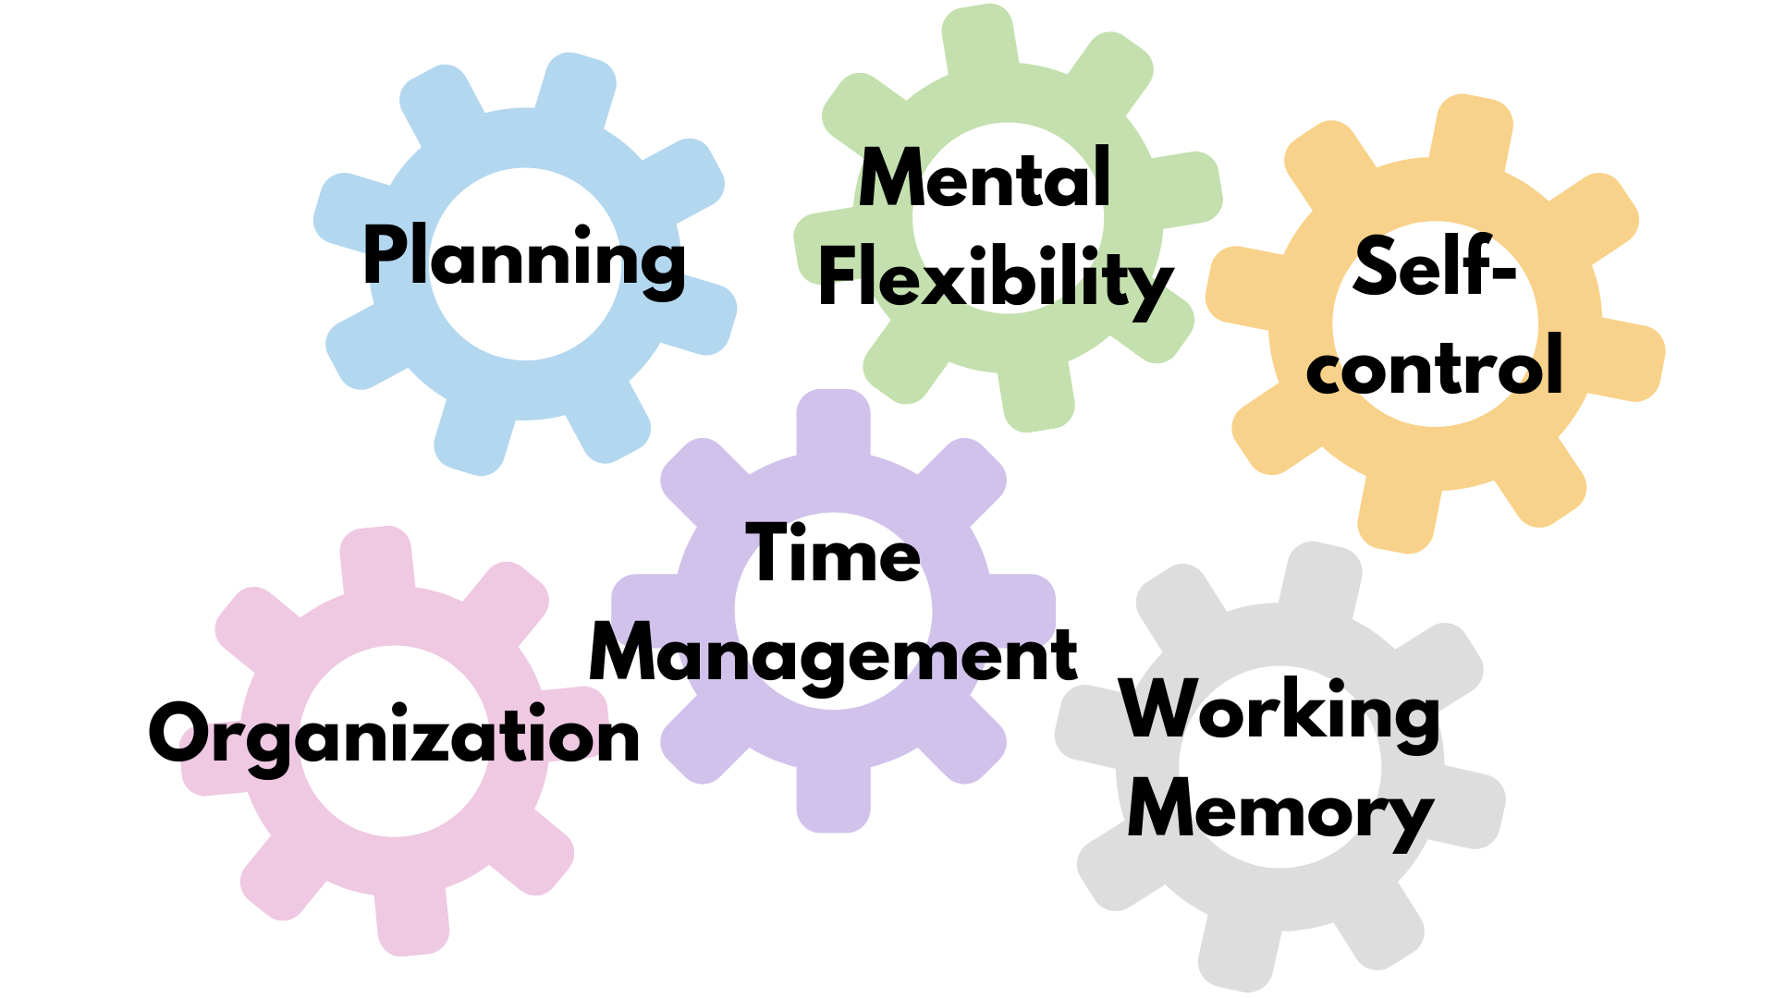
Executive Function Skills

Slide 6
Smartphones

Slide 7
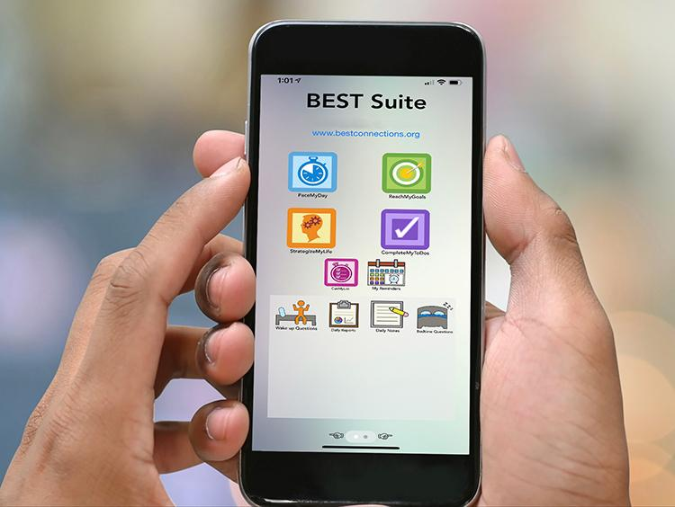
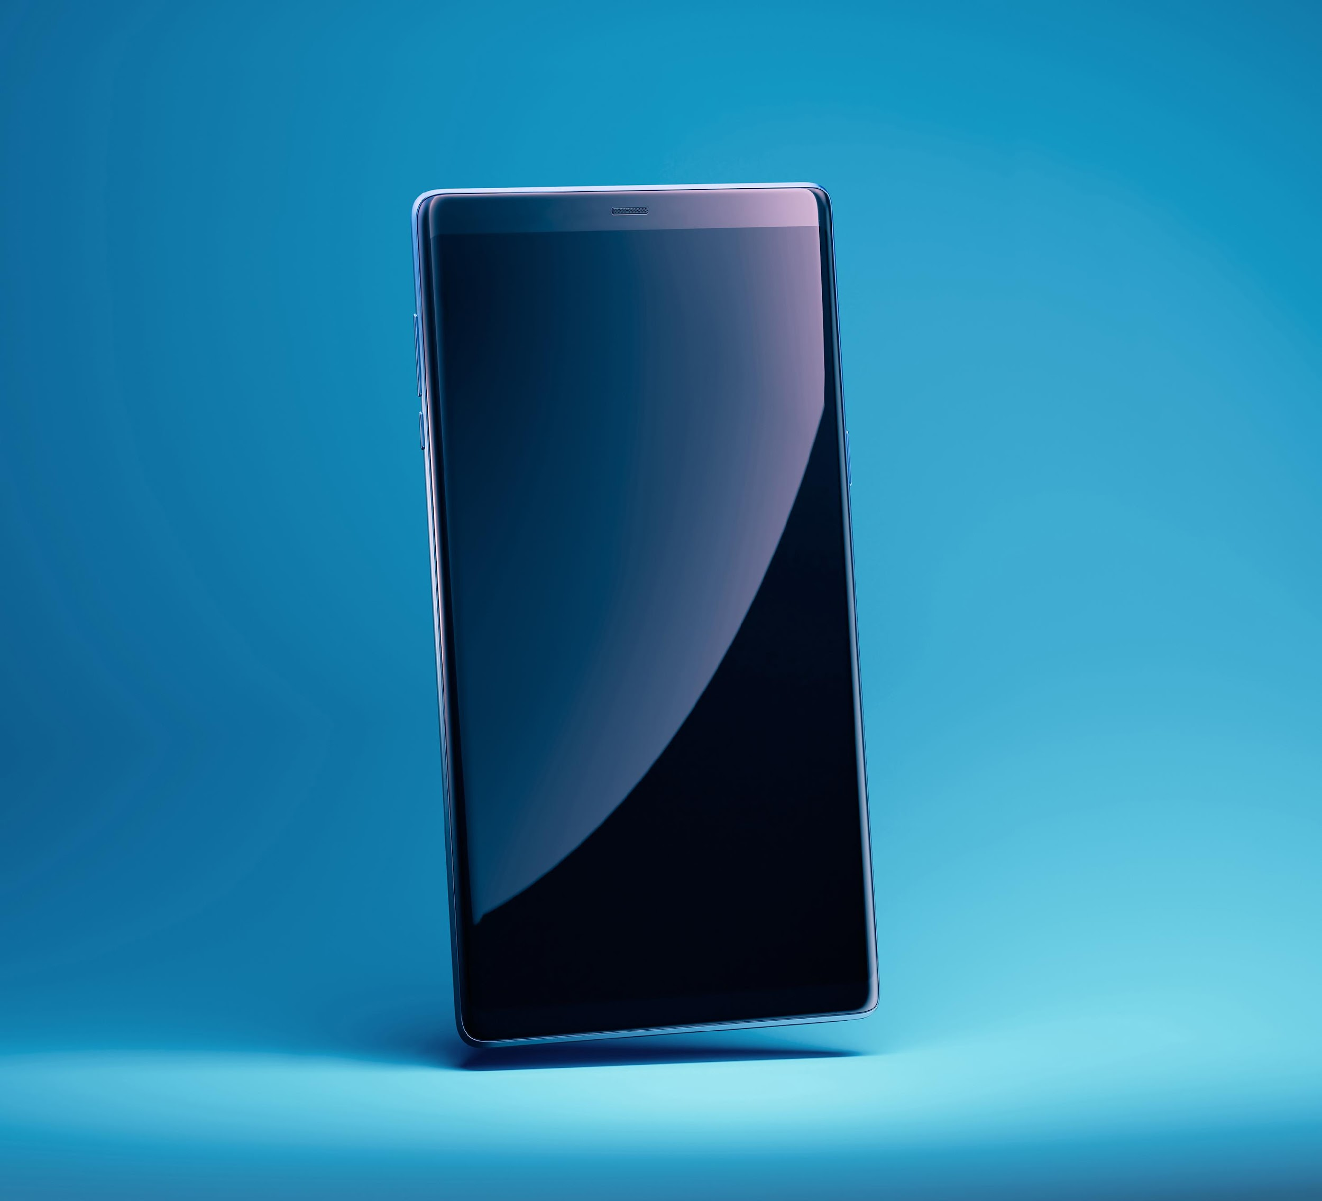
iPhone vs. Android

Slide 8

Chat & Questions (1)

Slide 9

Practical Cognitive Retraining
Notes:
Two concepts of scaffolding: 1) teach concept then step back to allow students to practice independently, 2) establish a framework for learning then build on that framework. Demonstrate, practice together, do alone.

Slide 10
Making Cognitive Connections®
An educational-based approach to help brain injury survivors identify and understand the cognitive skills impacted by brain injury, the relationships among those skills, and how their insights about the relationships can improve their cognitive function and skills development.

Slide 11
Chat & Questions (2)

Slide 12
Smart Device Accessibility

Slide 13
Accessibility Settings (1)
Appearance
Brightness
Night Shift
Auto-Lock
Zoom

Slide 14
Accessibility Settings (2)
Display & Text Size
Contrast
Color Filters
Spoken Content

Slide 15
Chat & Questions (3)

Slide 16
Focus

Slide 17
Focus Feature
Focus eliminates device-related distractions such as notifications and calls
Focus can be set for different activities
Focus can be set to allow certain calls or notifications to get through
To access Focus: Settings > Focus
To start Focus: Open Control Center > Focus > desired focus option

Slide 18
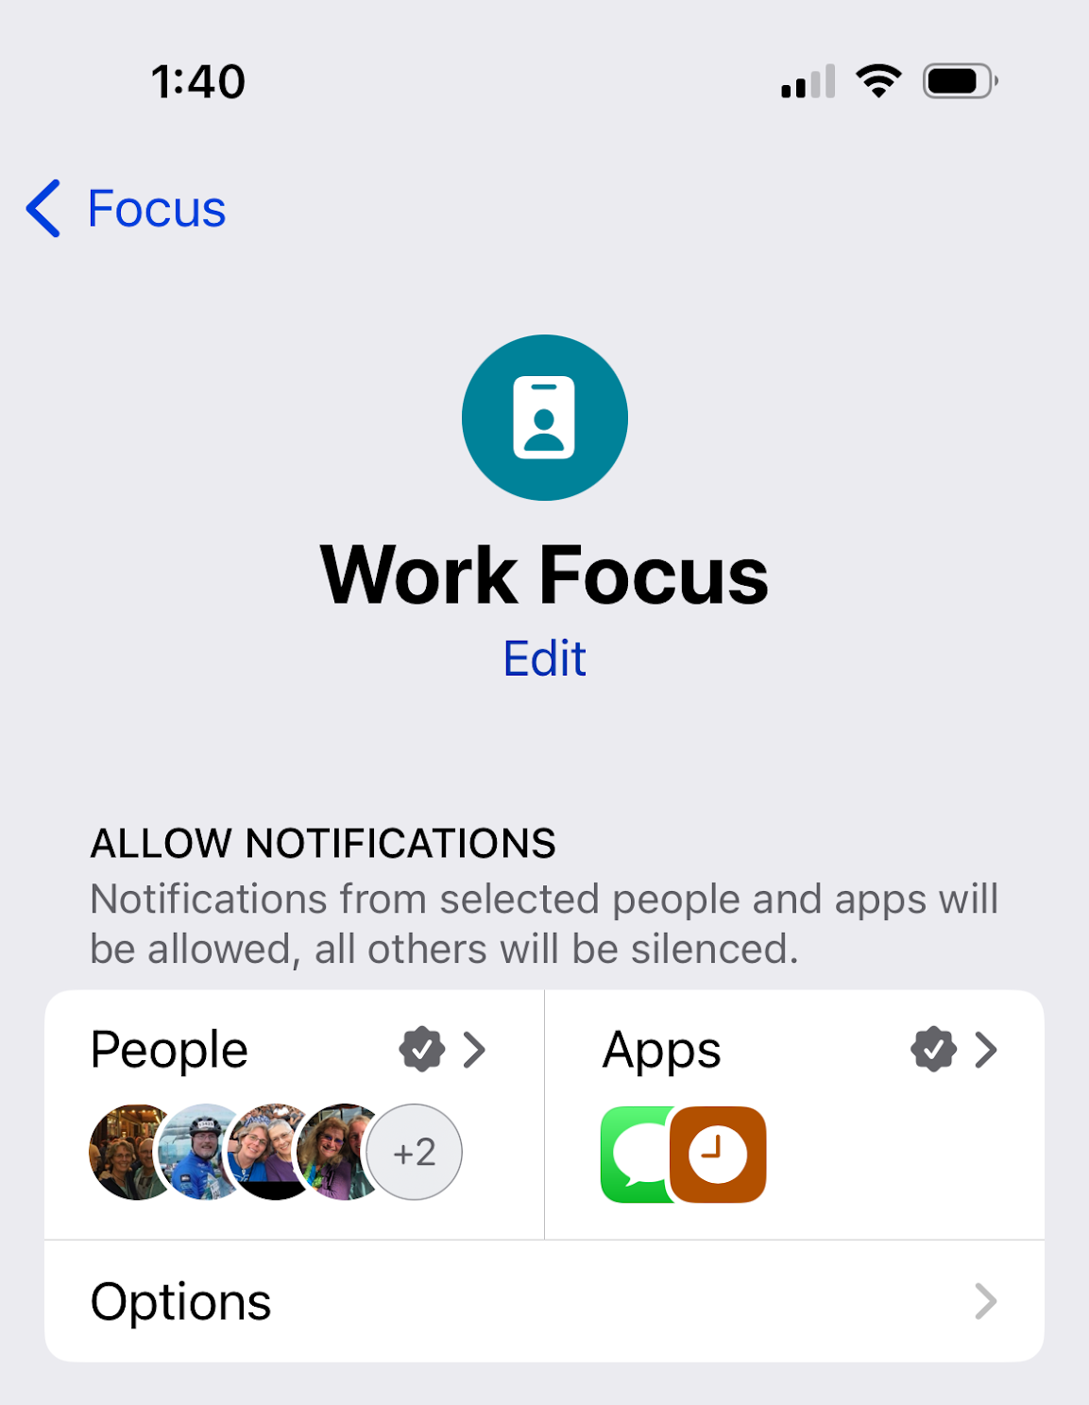
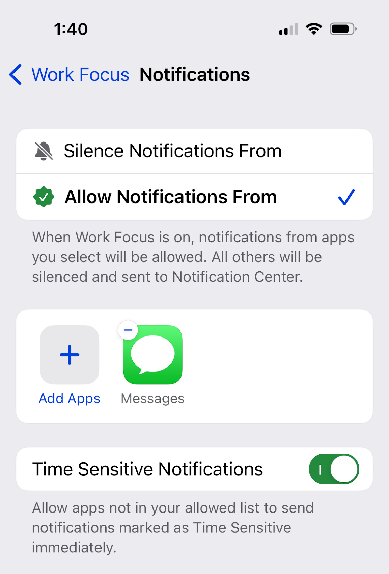
Focus Feature (1 of 2)

Slide 19
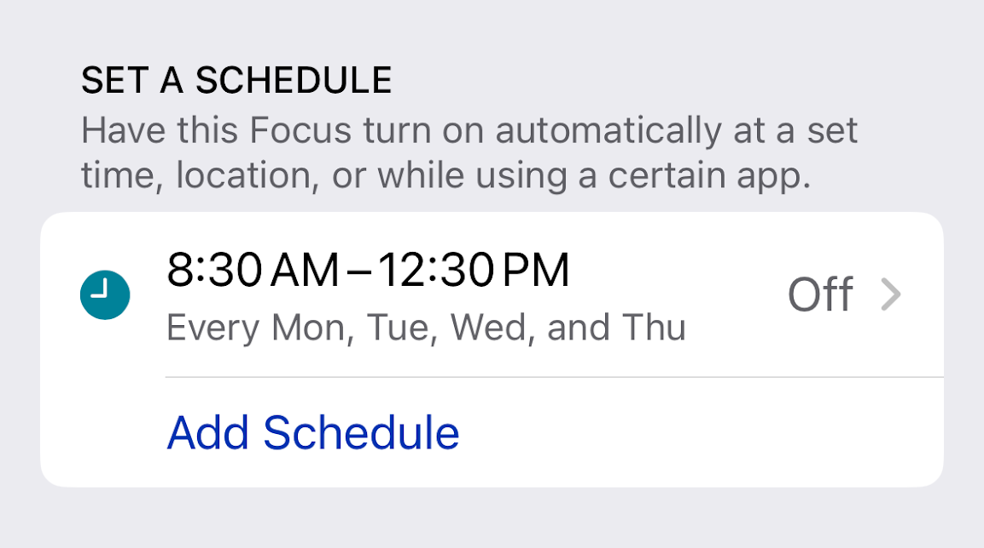
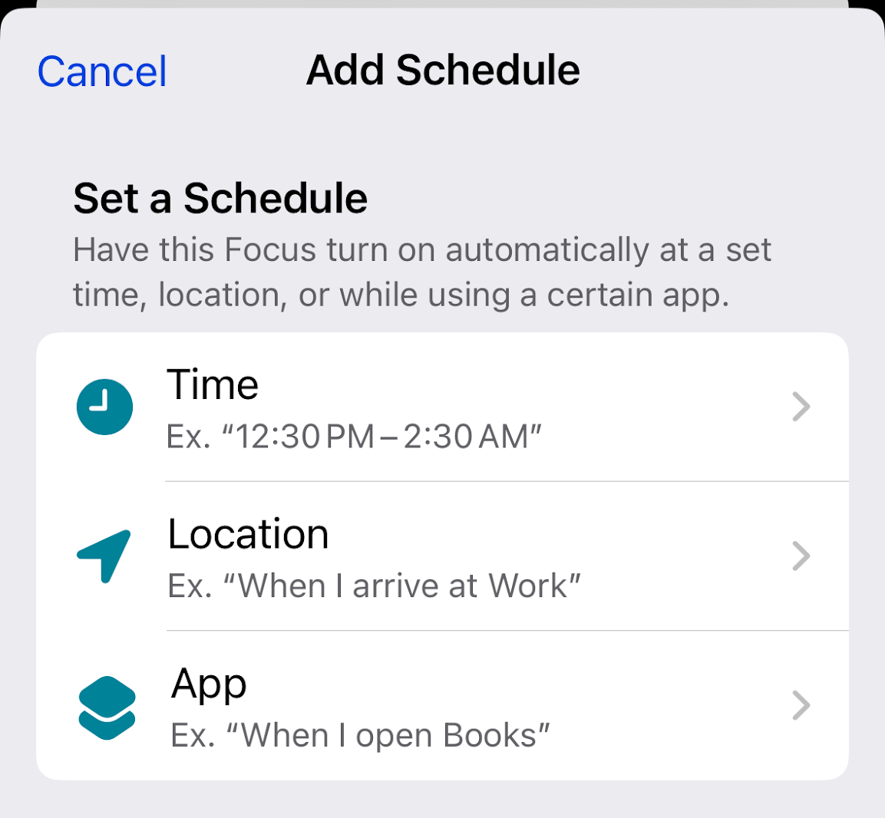
Focus Feature (2 of 2)

Slide 20
Do Not Disturb

Slide 21
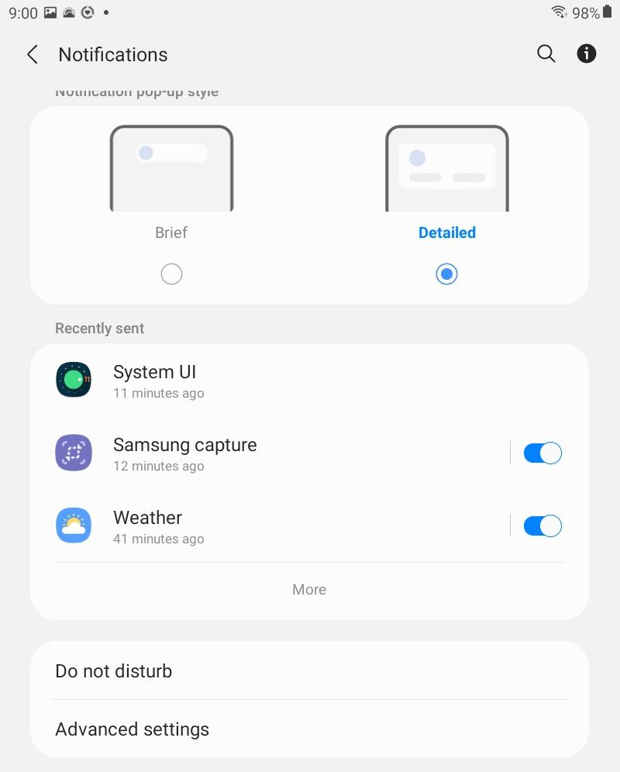
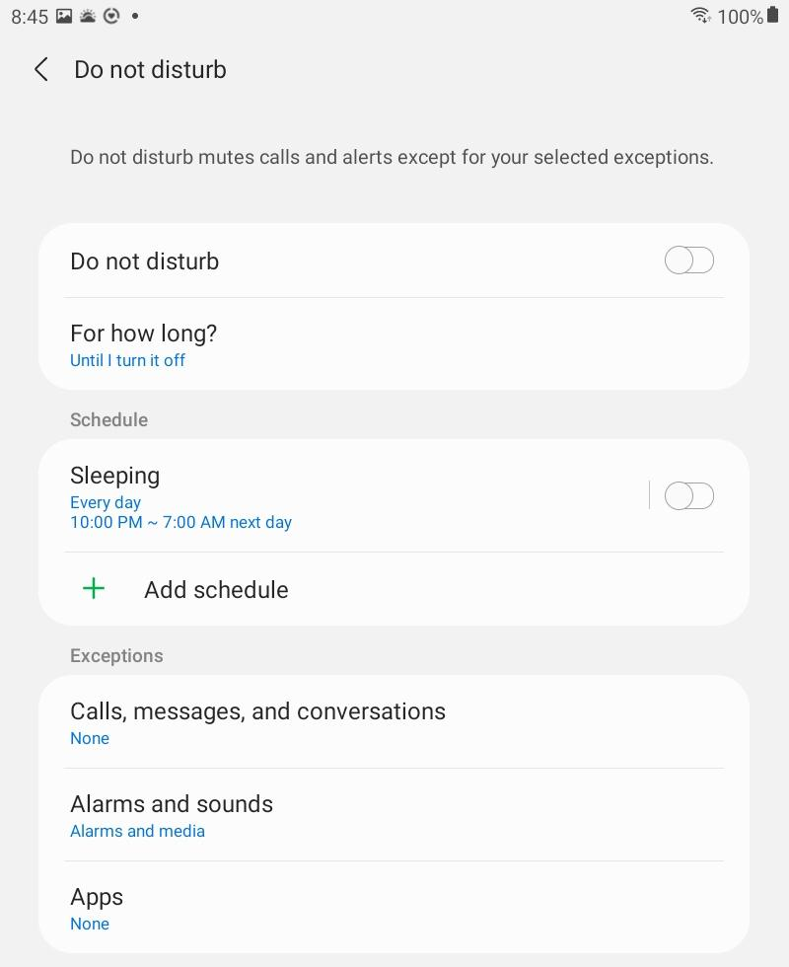
Do Not Disturb Feature (1 of 3)

Slide 22
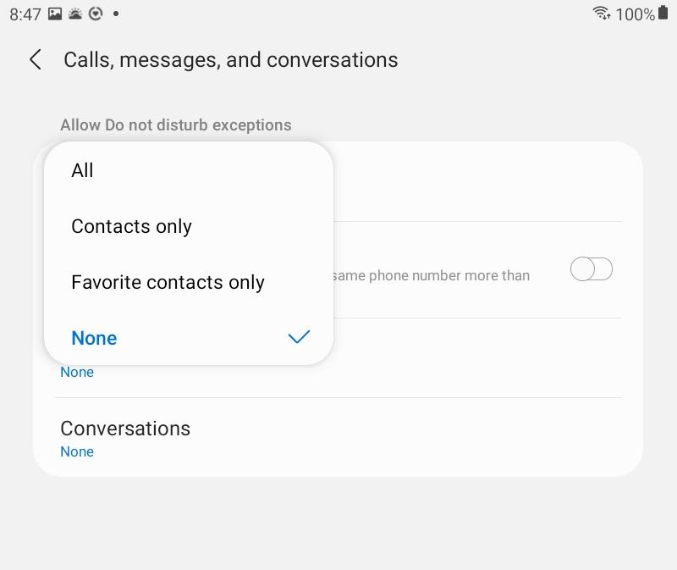
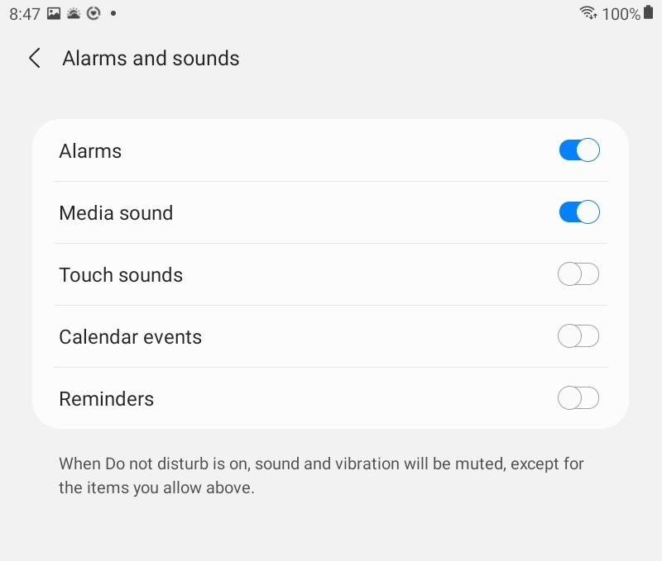
Do Not Disturb Feature (2 of 3)

Slide 23
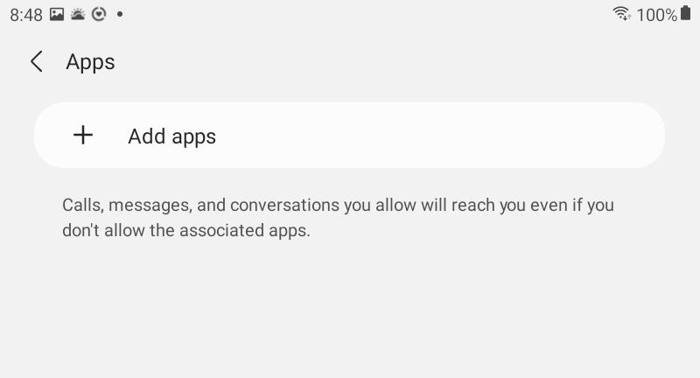
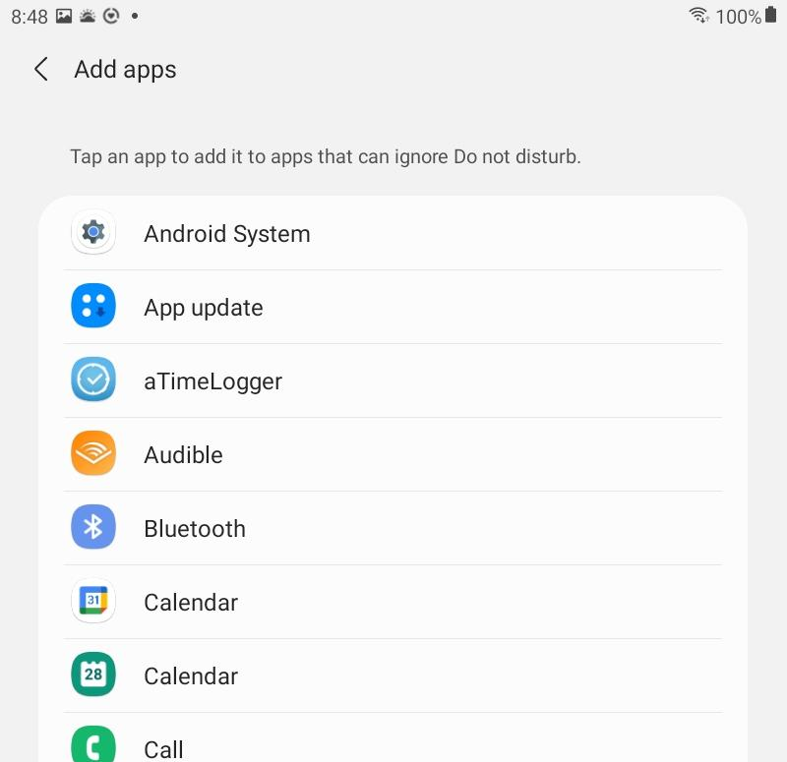
Do Not Disturb Feature (3 of 3)

Slide 24
Chat & Questions (4)

Slide 25
Medications (iOS only)

Slide 26
Medications Feature
Medications feature tracks medications, sets reminders, logs when medication(s) are taken
To access Medications: Health app > Browse > Medications

Slide 27
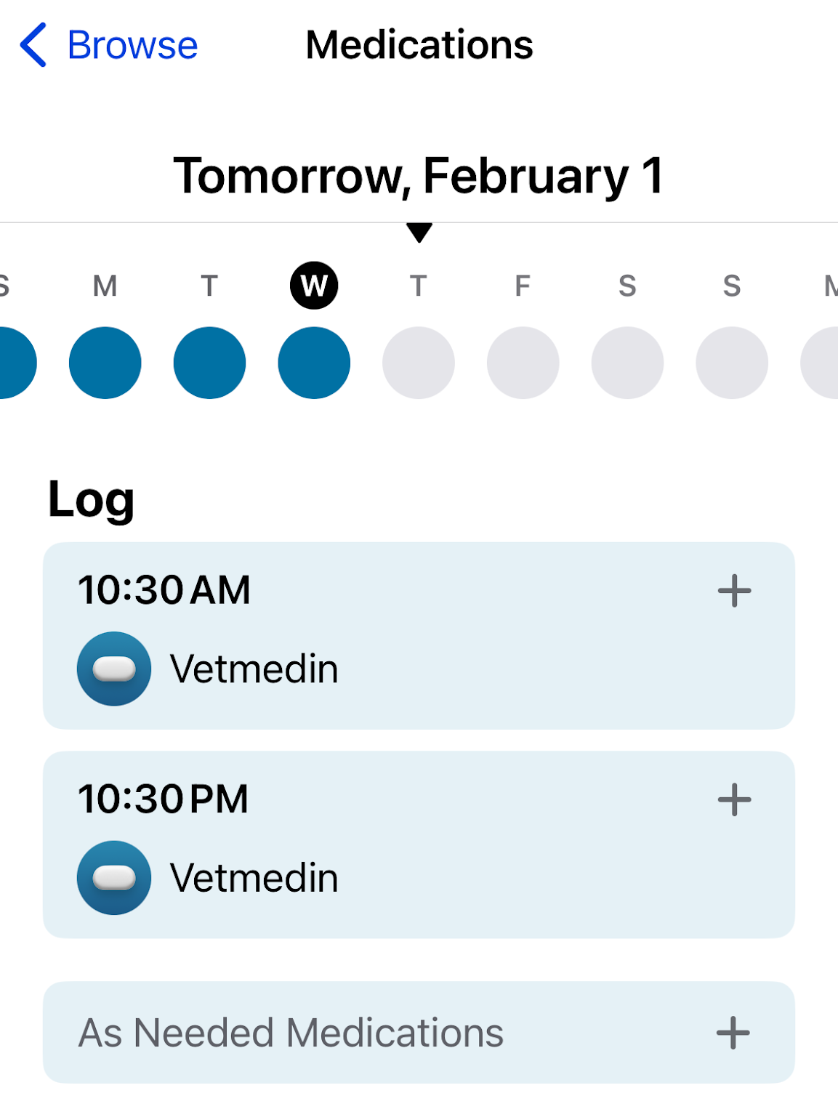
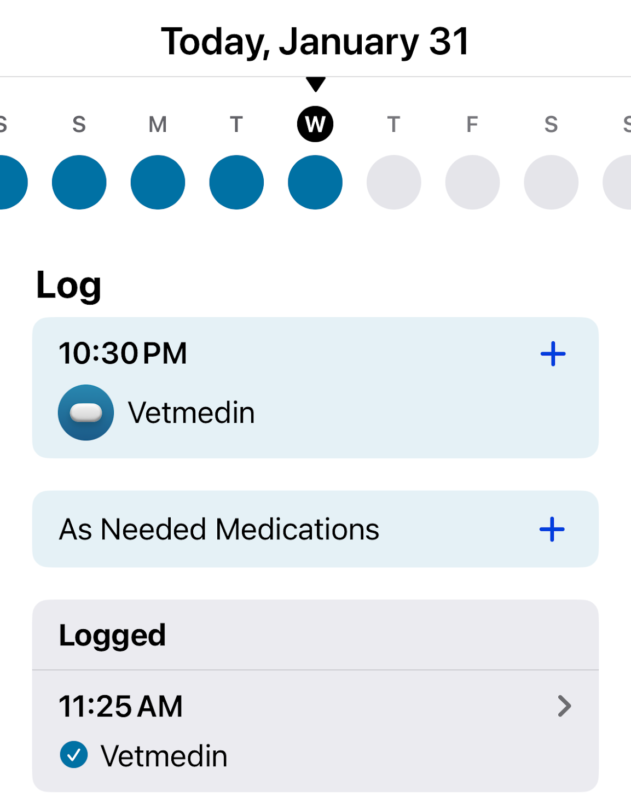
Medication Feature Log

Slide 28
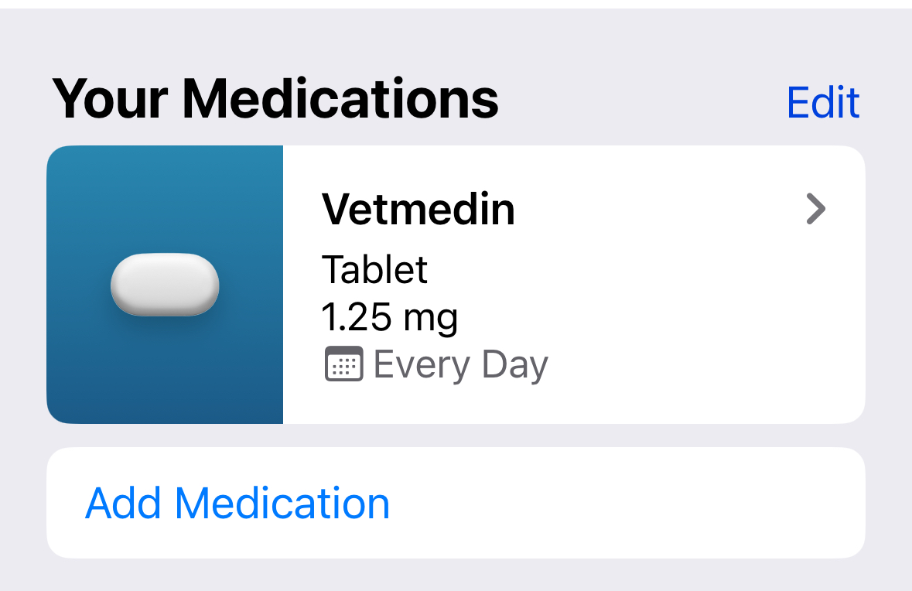
Medication Feature Medication List

Slide 29
Chat & Questions (5)

Slide 30
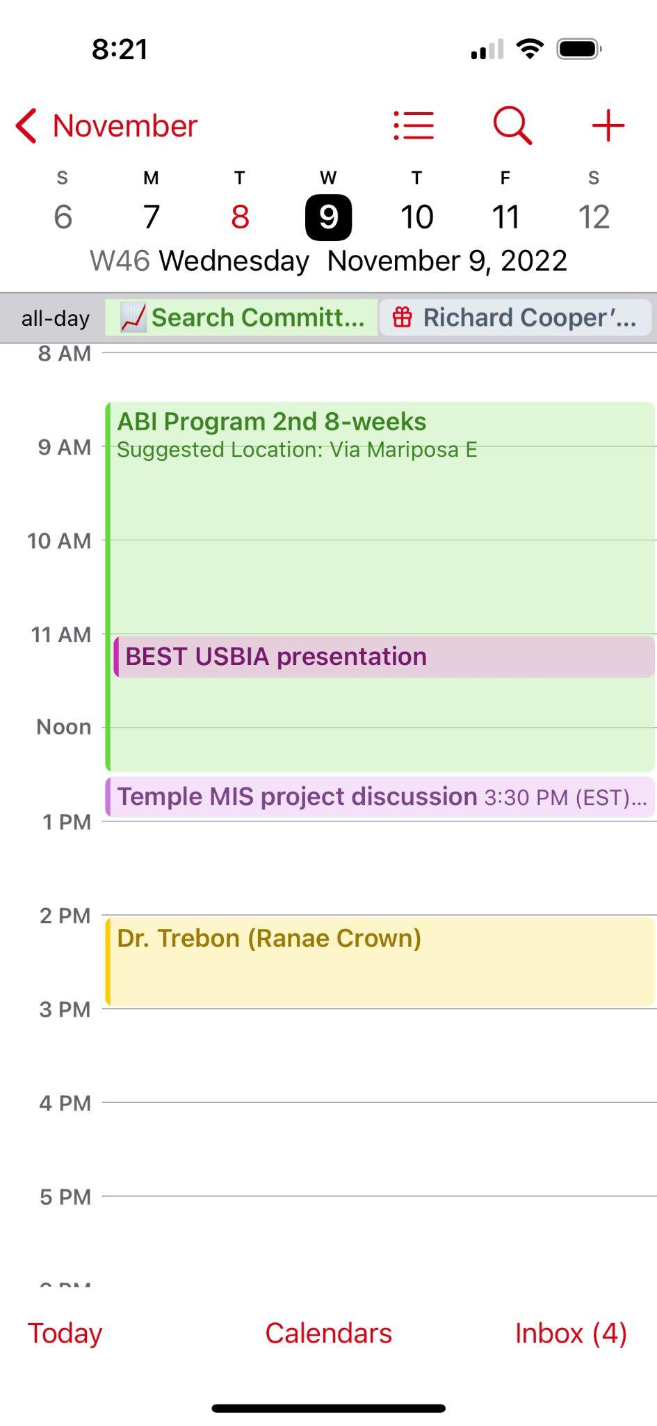
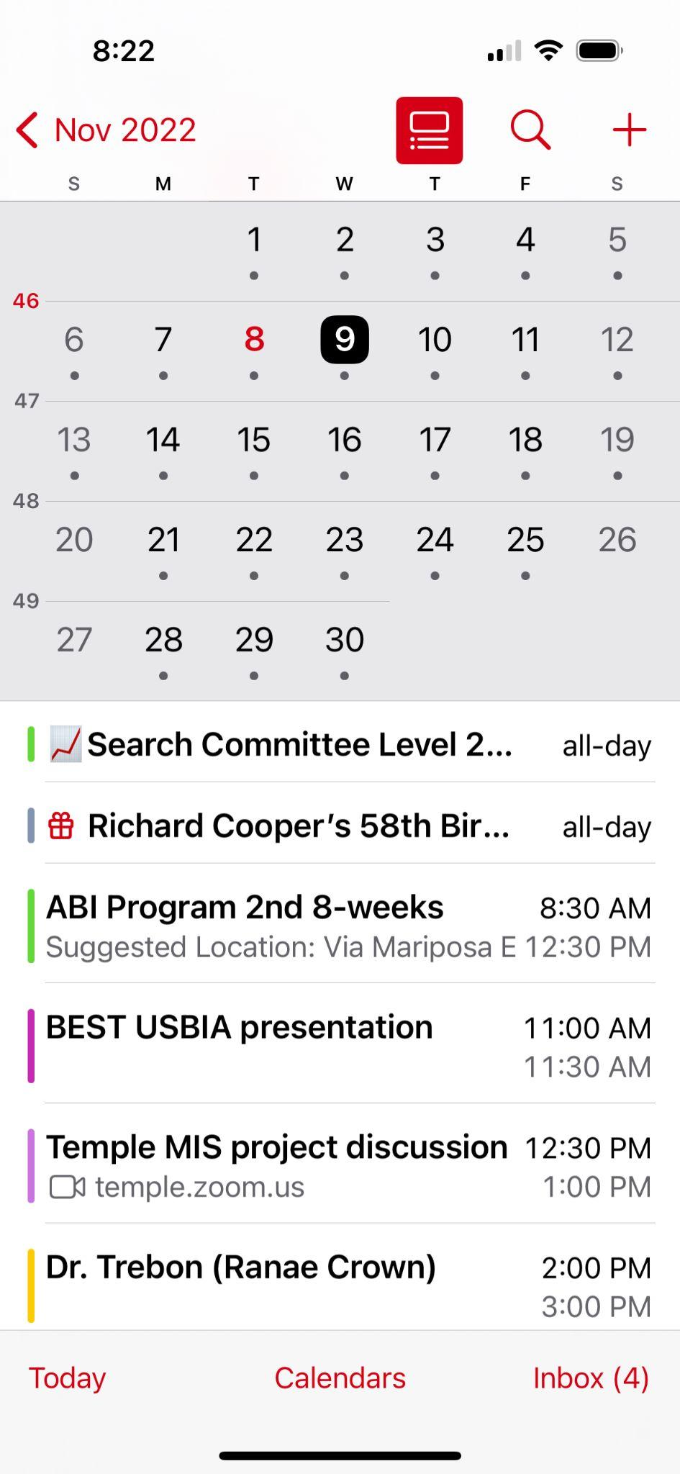
Calendar App Views

Slide 31
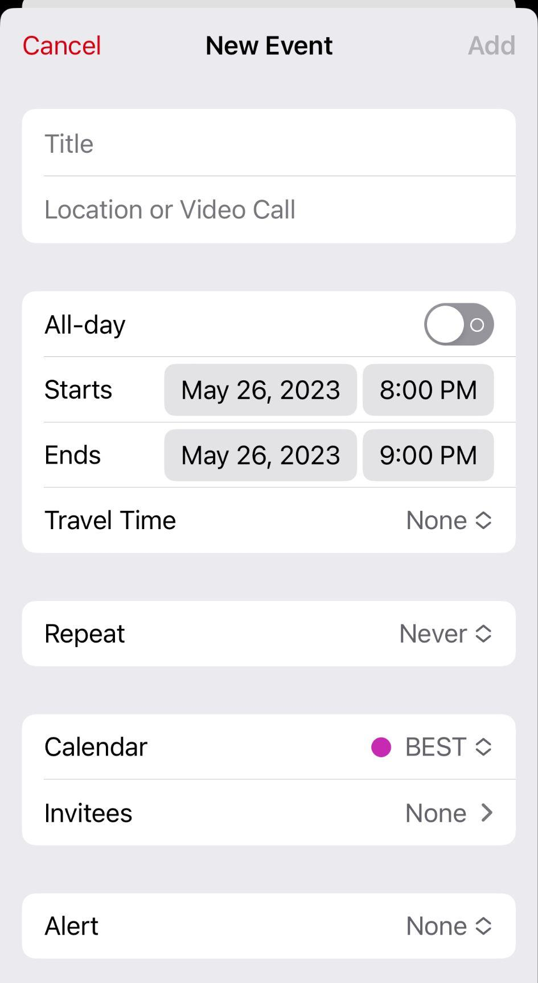
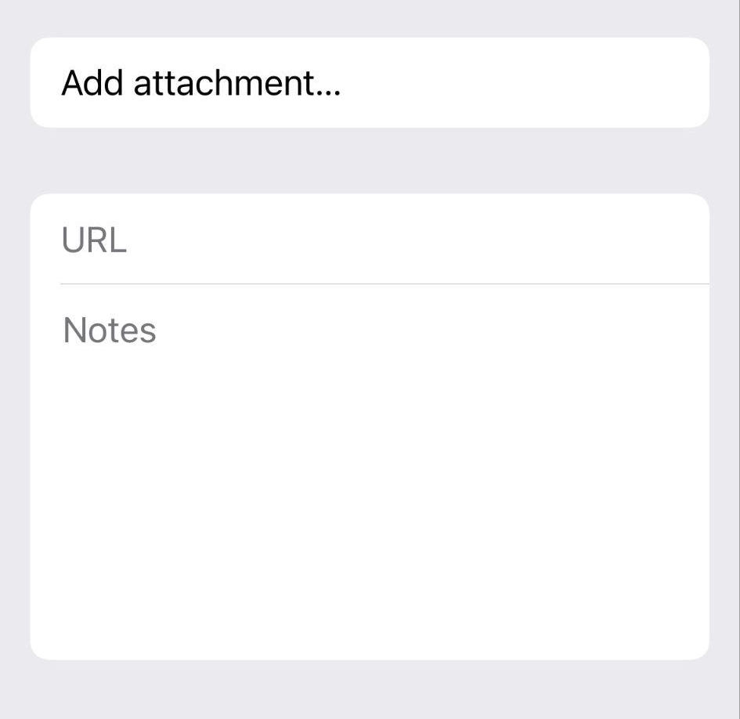
Calendar App New Event Screen

Slide 32
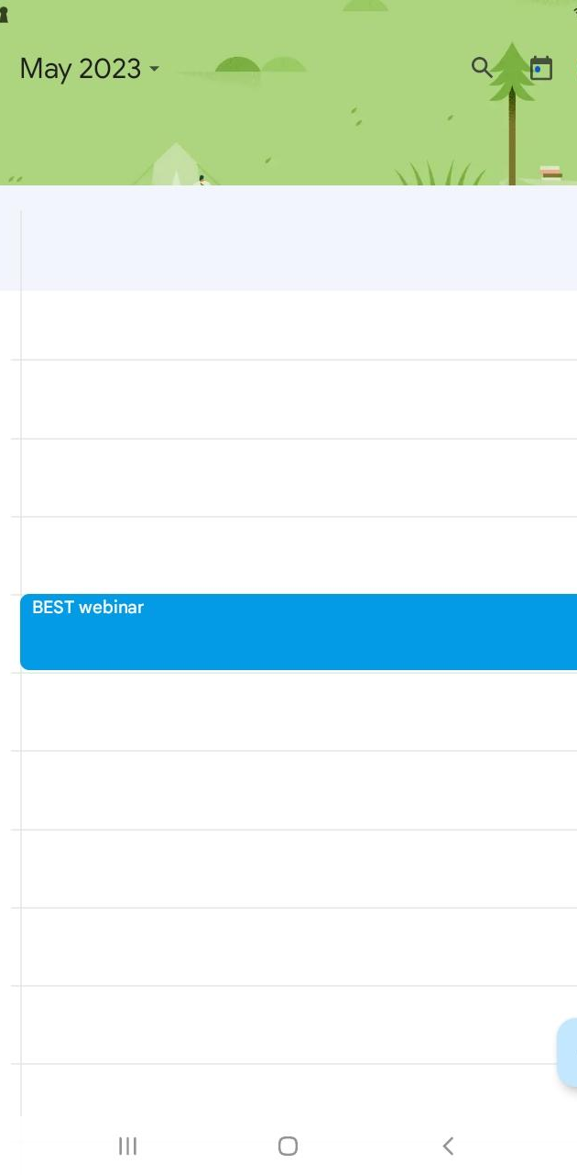
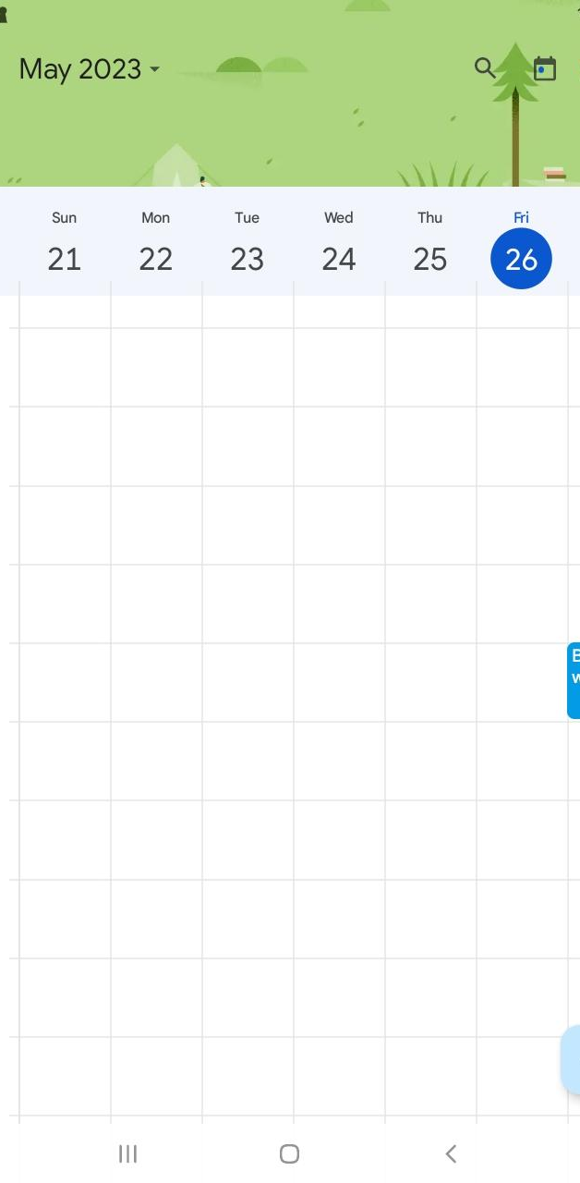
Google Calendar

Slide 33
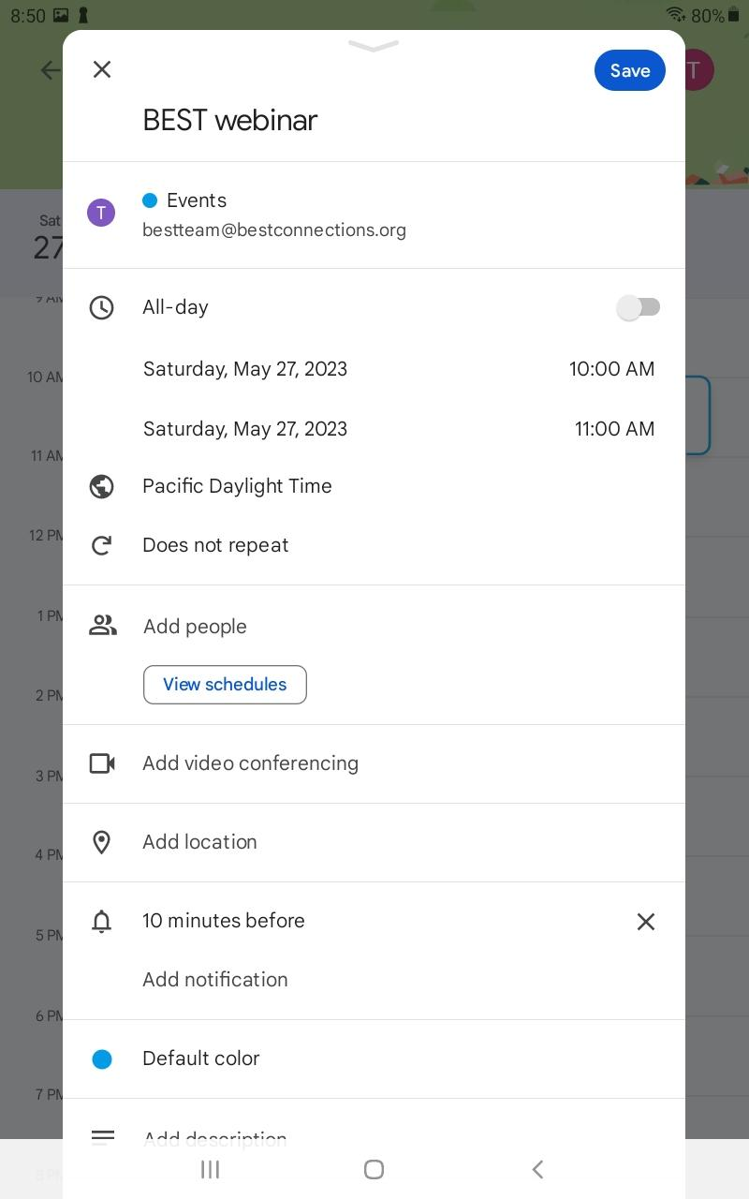
Google Calendar – New Event

Slide 34
Chat & Questions (6)

Slide 35
Web Browsers

Slide 36
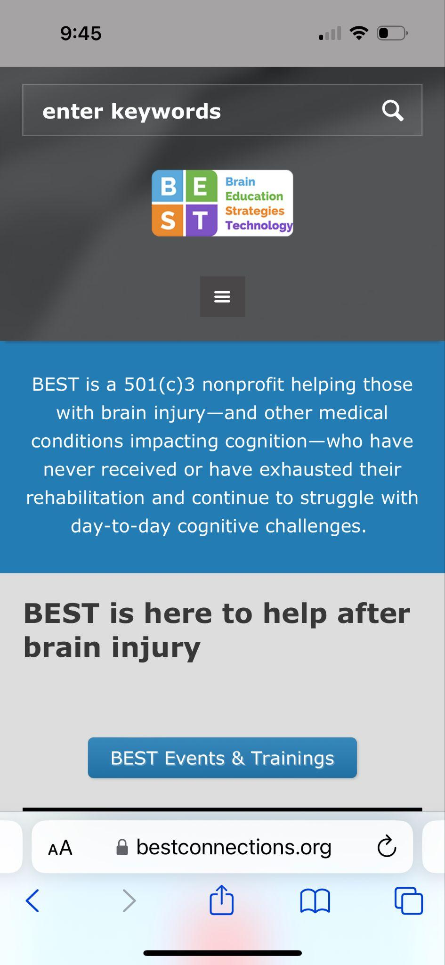
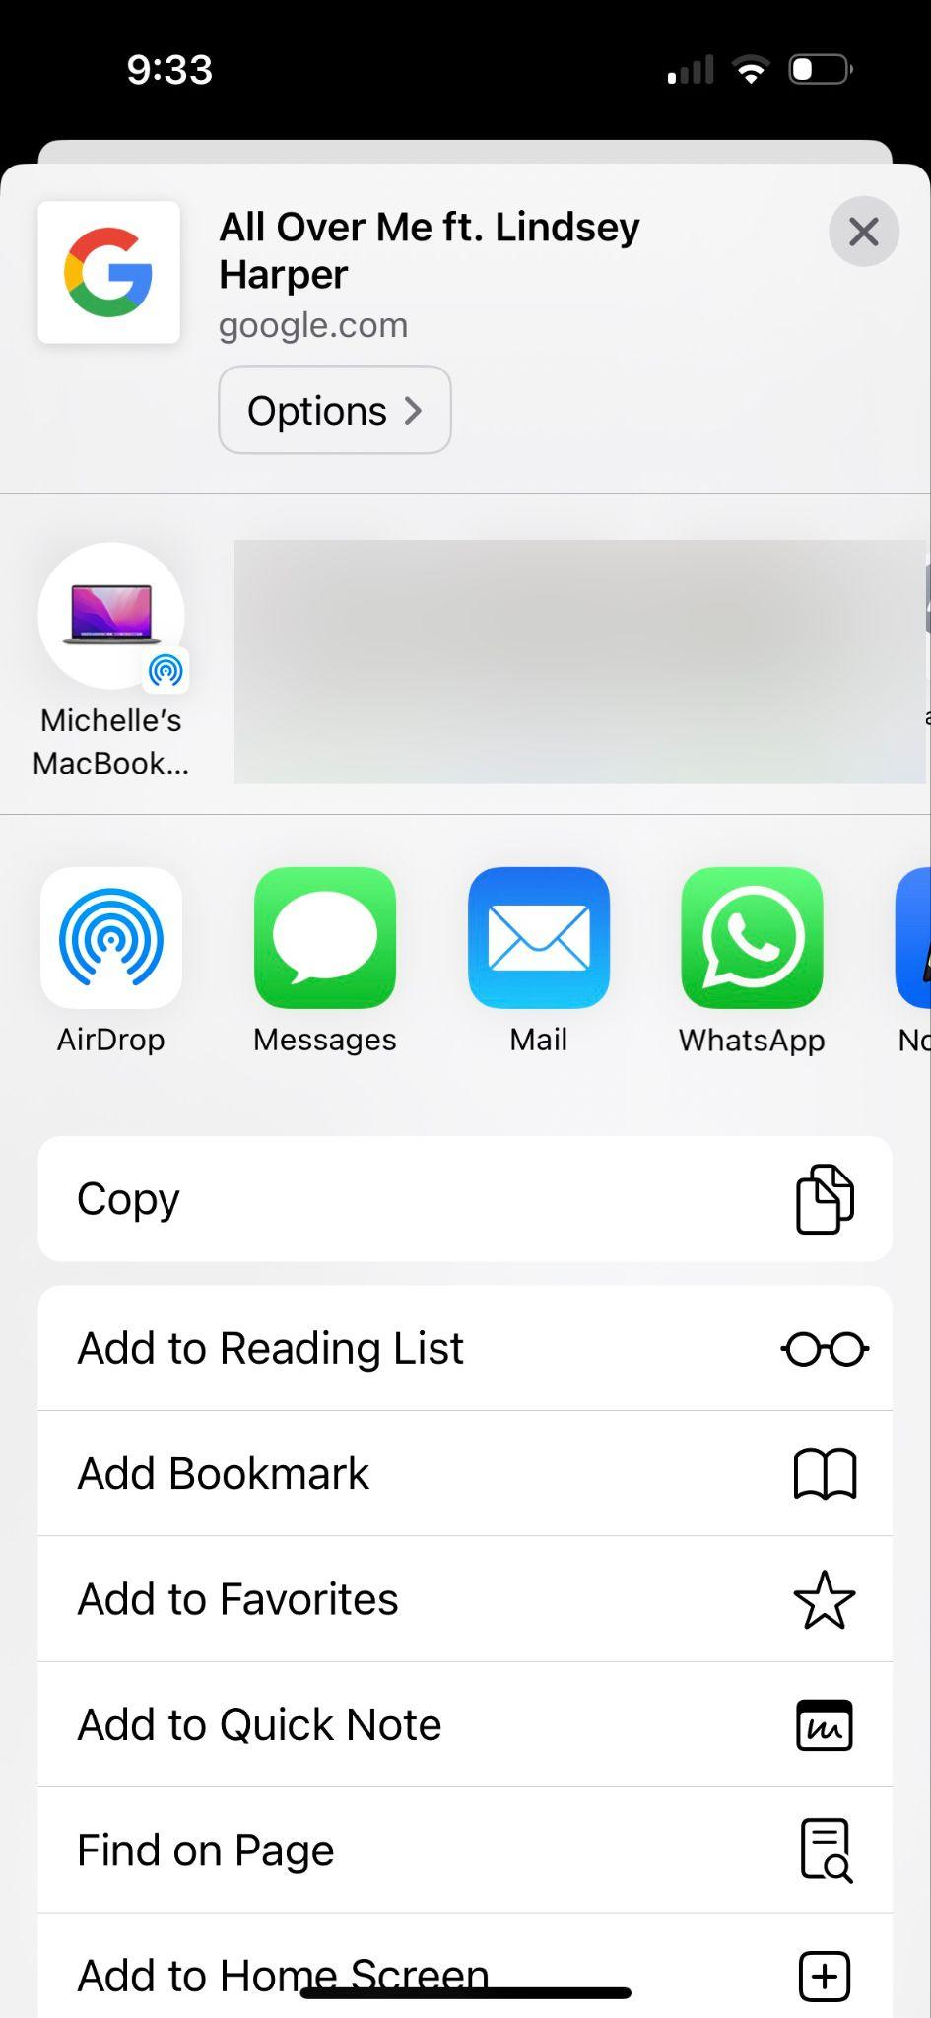
Safari

Slide 37
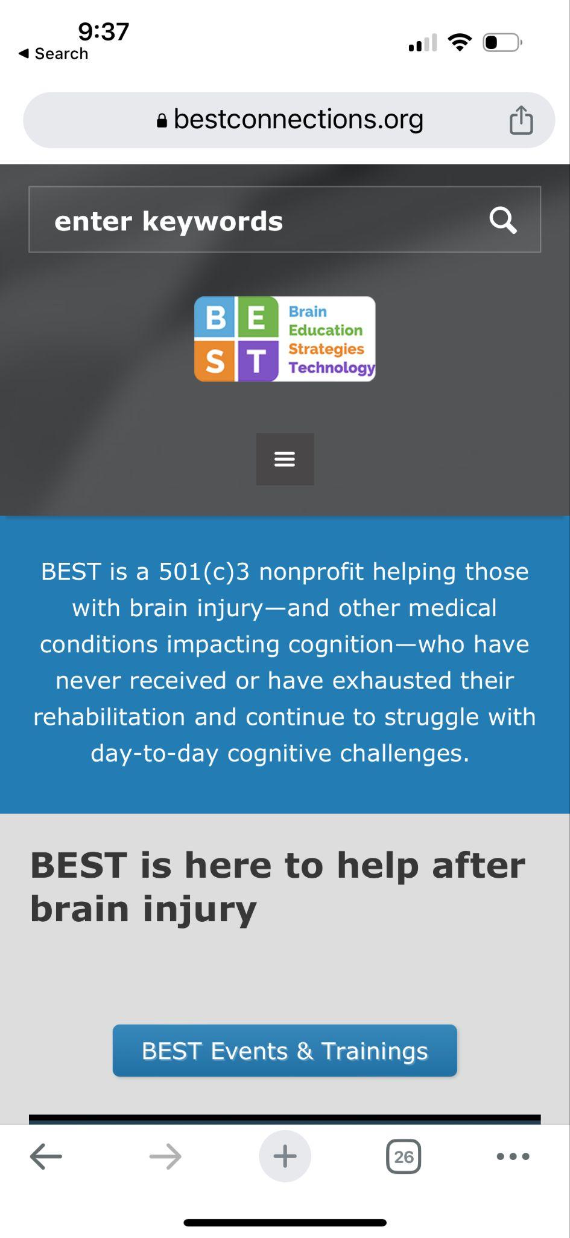
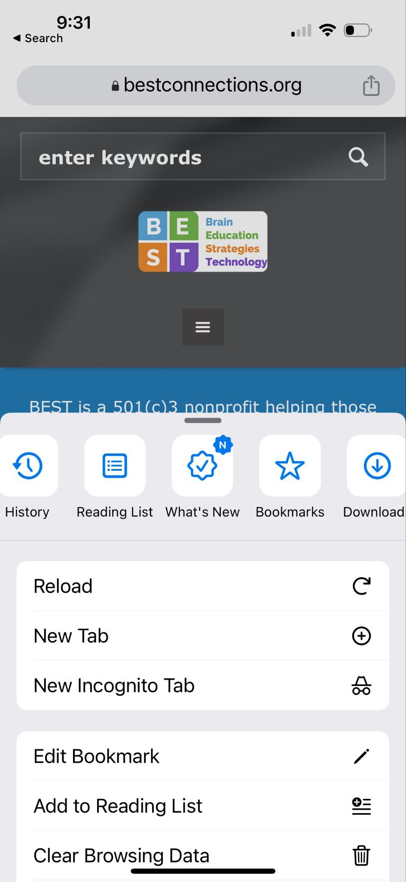
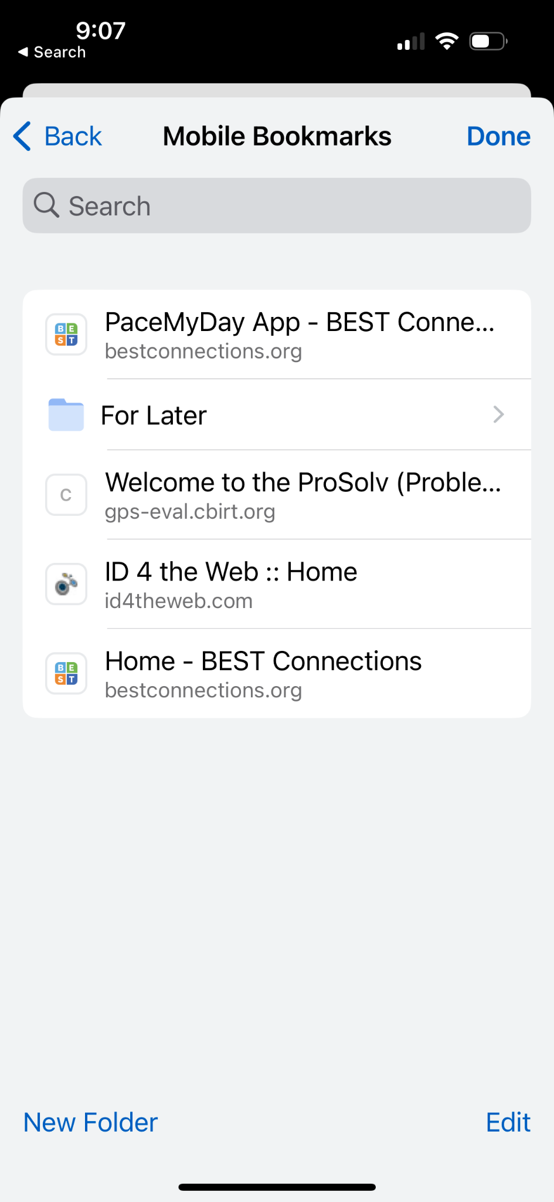
Chrome

Slide 38
Browser Reader Mode

Slide 39
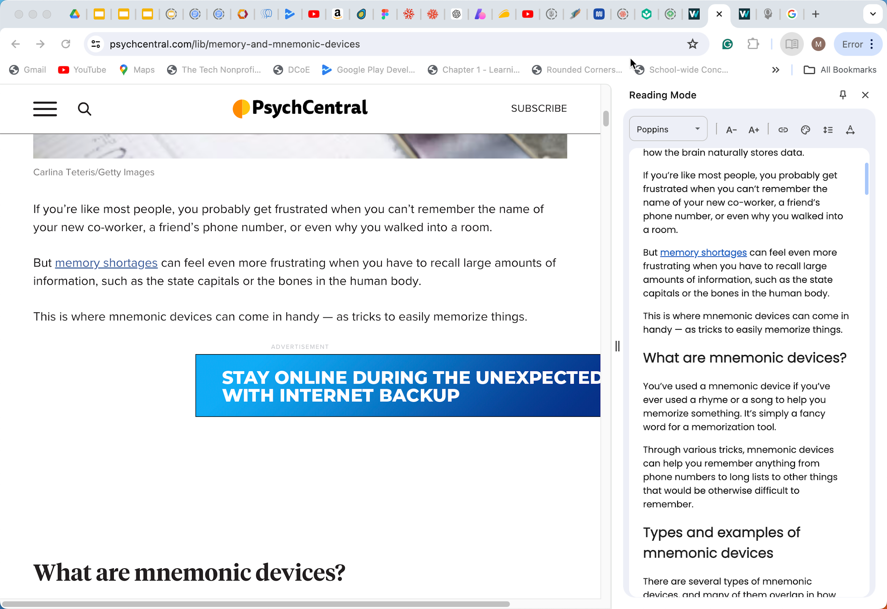
Reader Mode Chrome

Slide 40
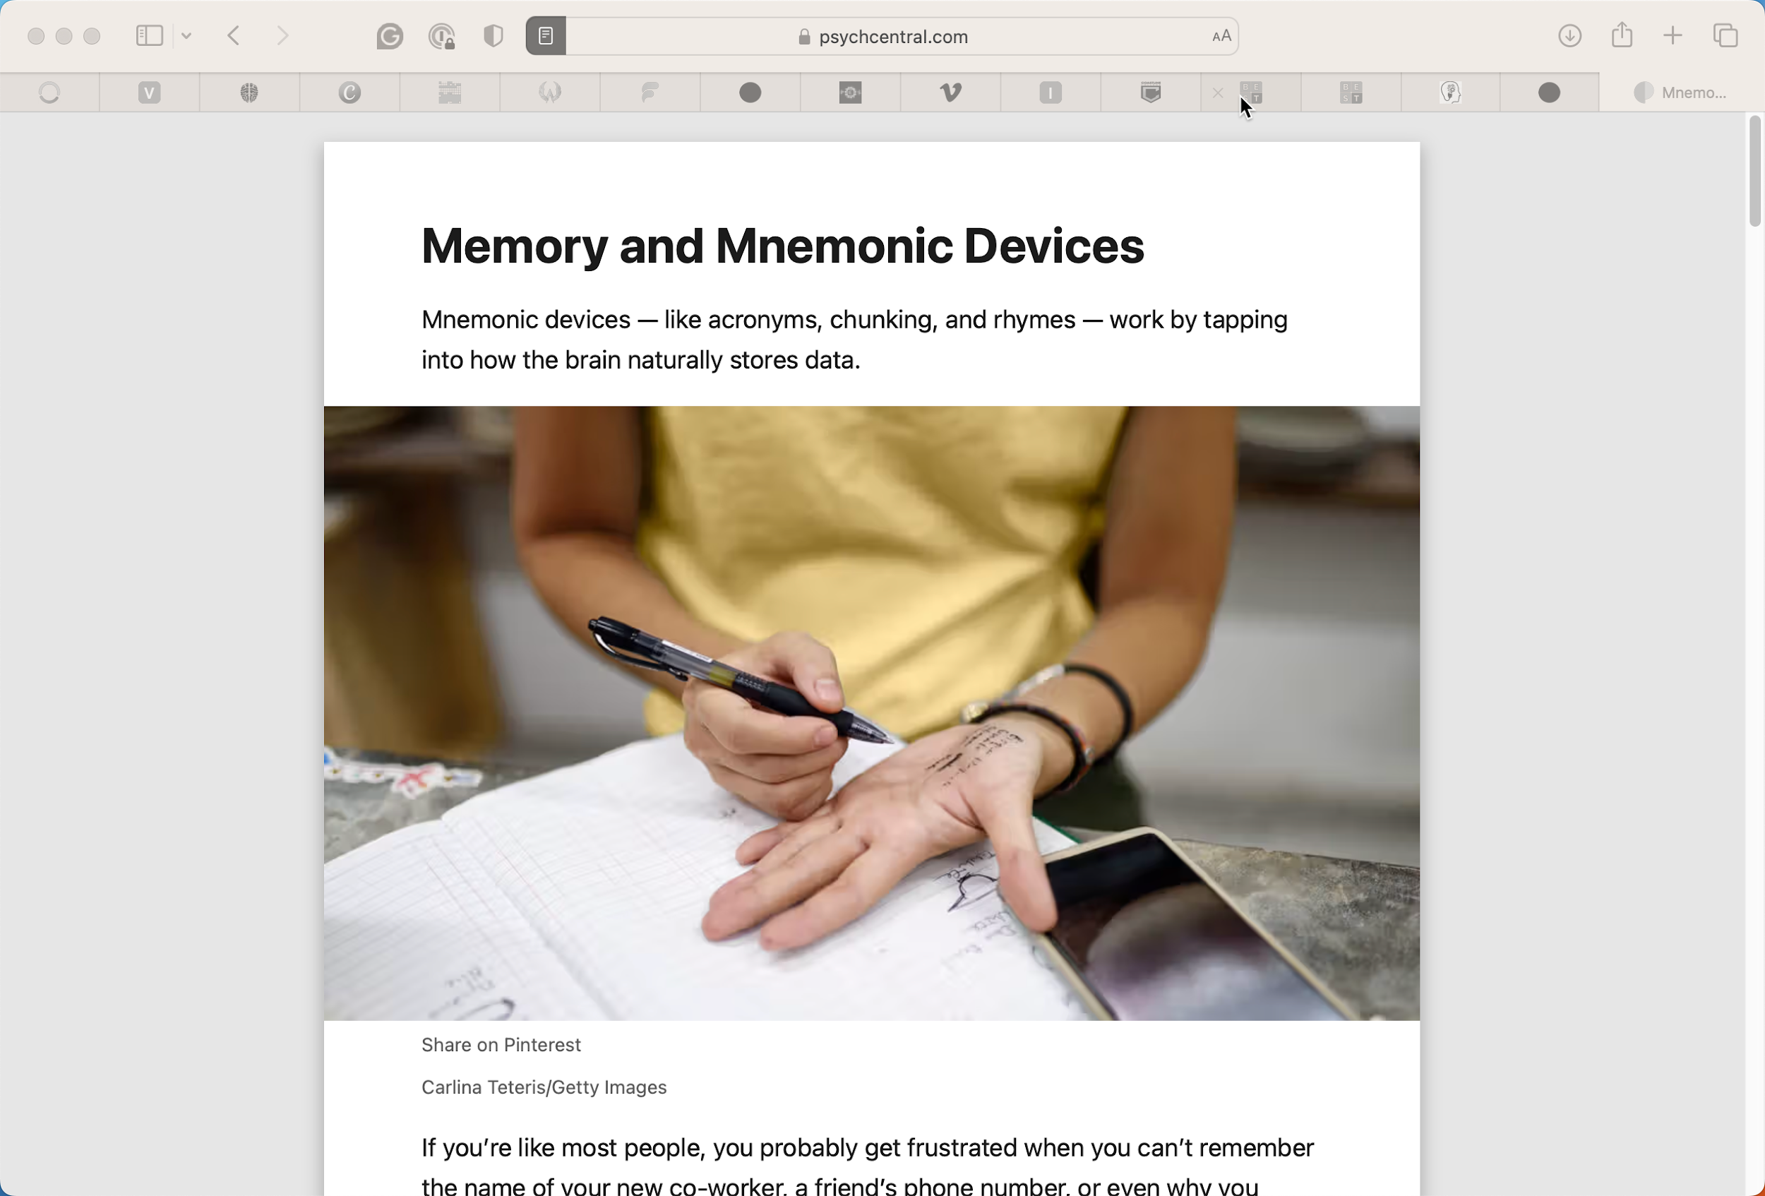
Reader Mode Safari

Slide 41
Chat & Questions (8)

Slide 42
Notes Apps

Slide 43
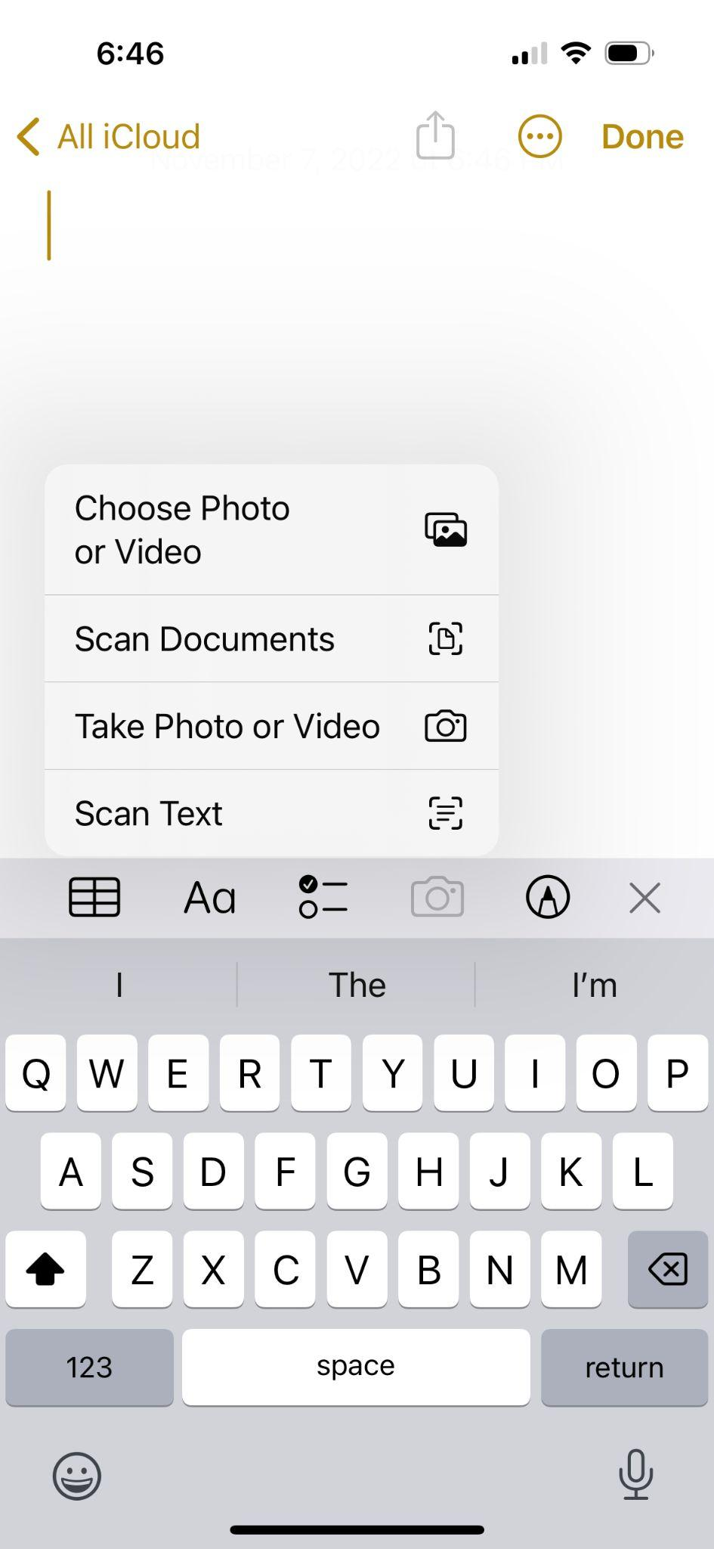
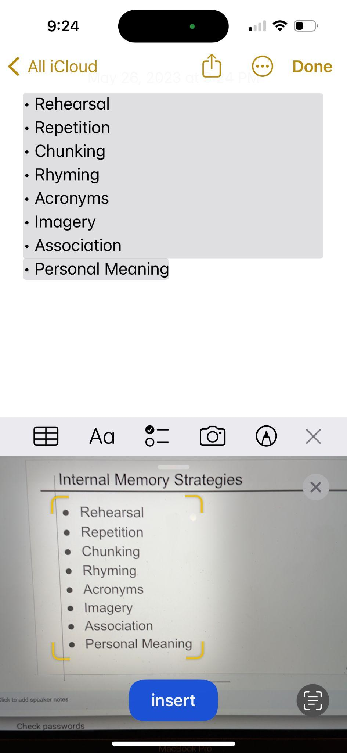
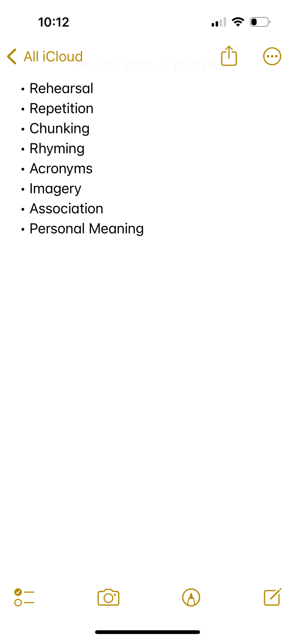
Notes app Scan Text

Slide 44
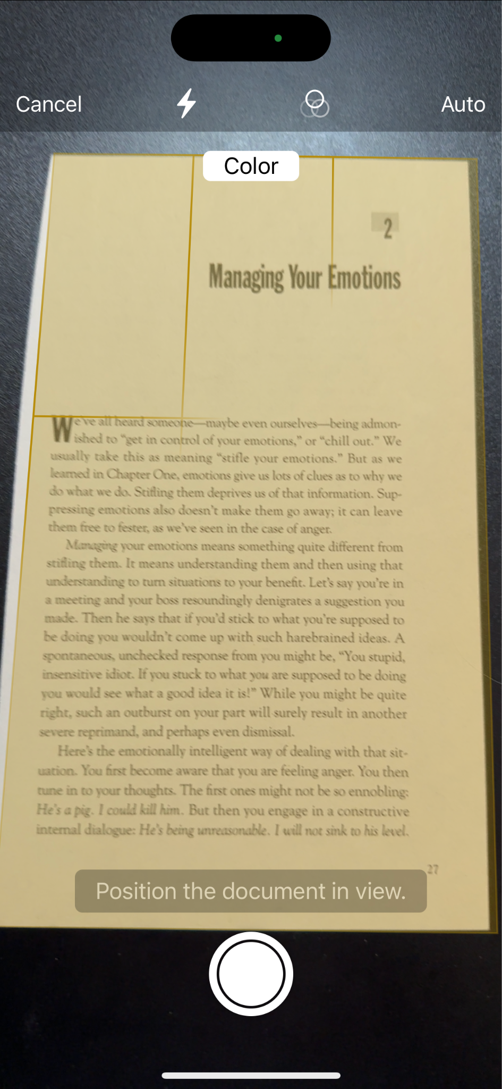
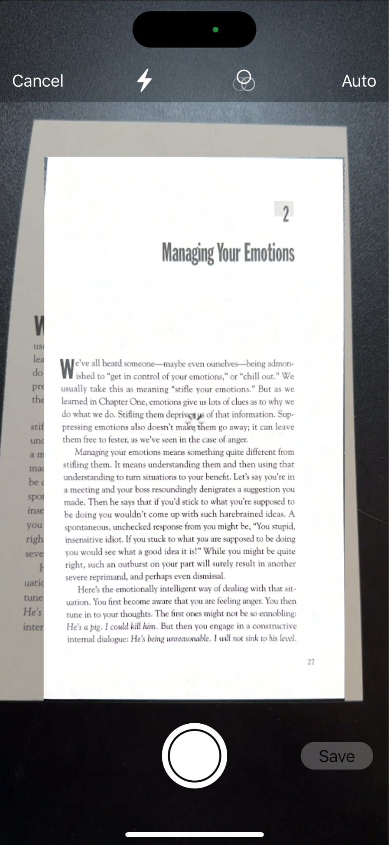
Notes app Scan Documents (1 of 2)

Slide 45
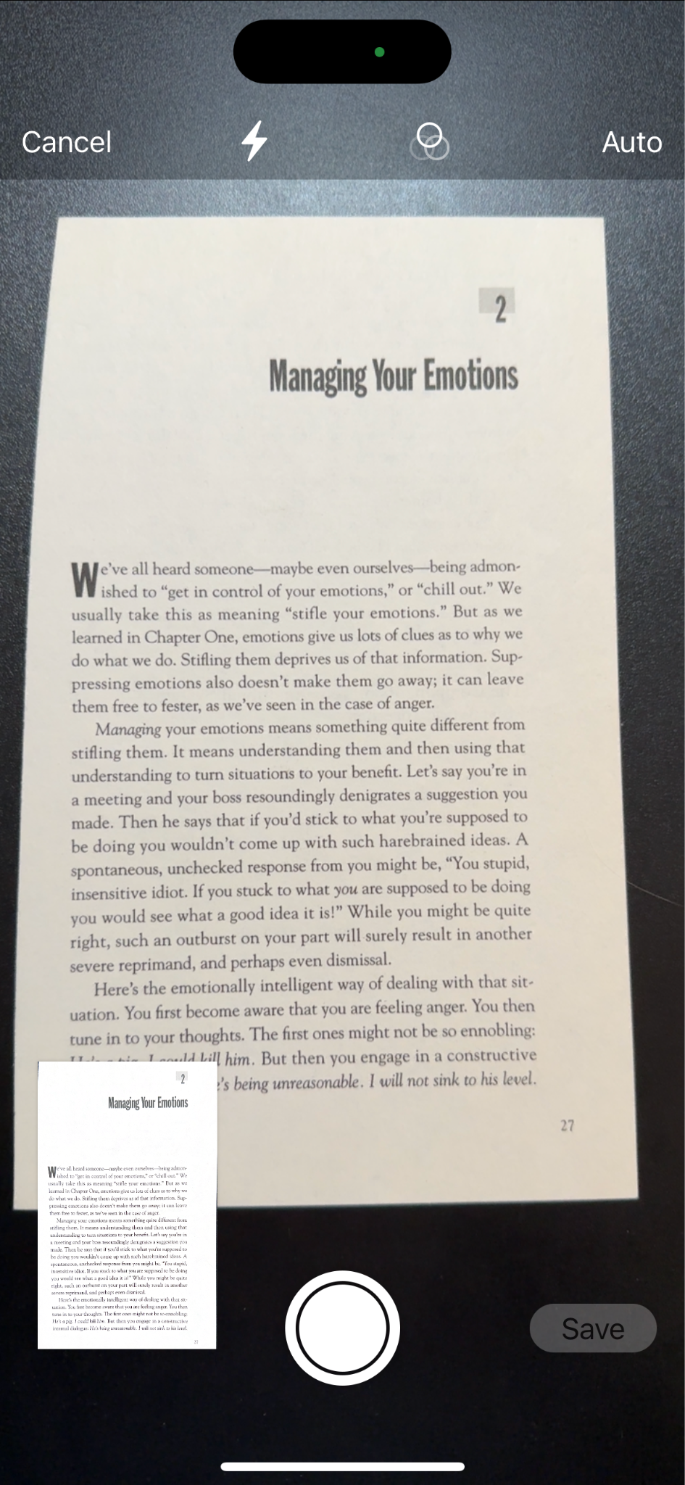
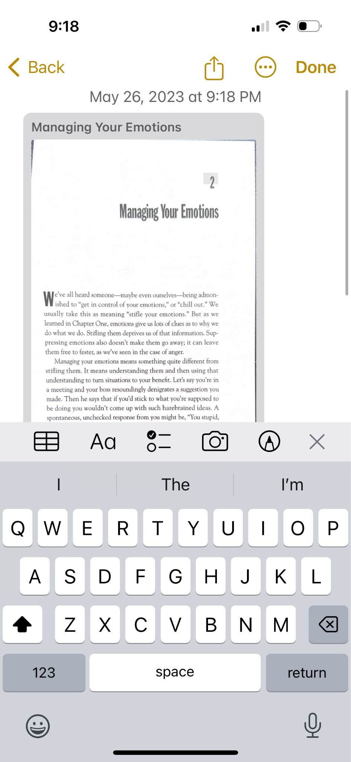
Notes app Scan Documents (2 of 2)

Slide 46
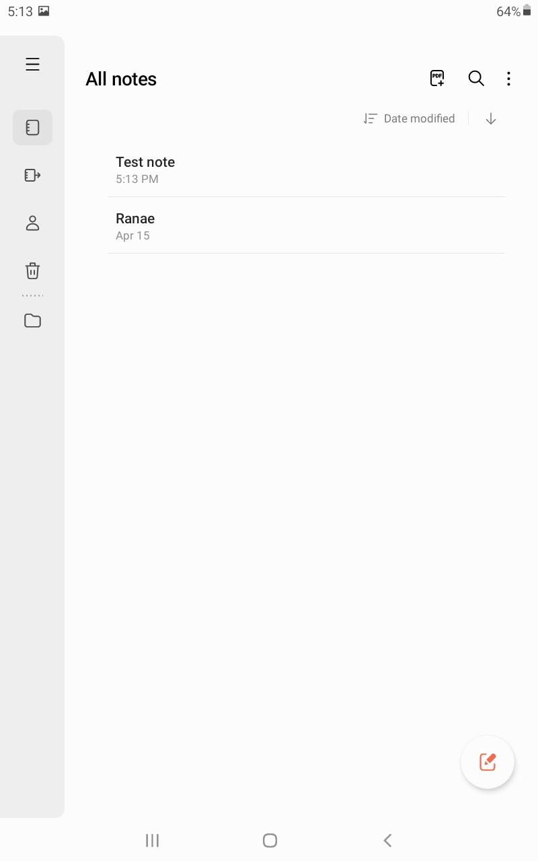
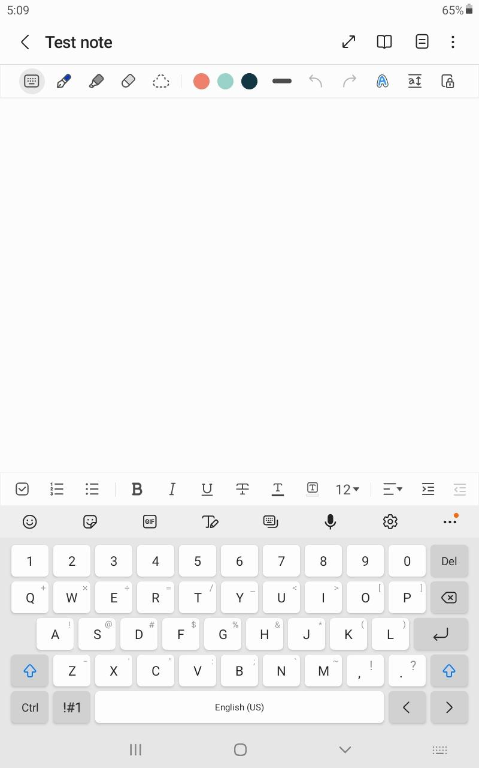
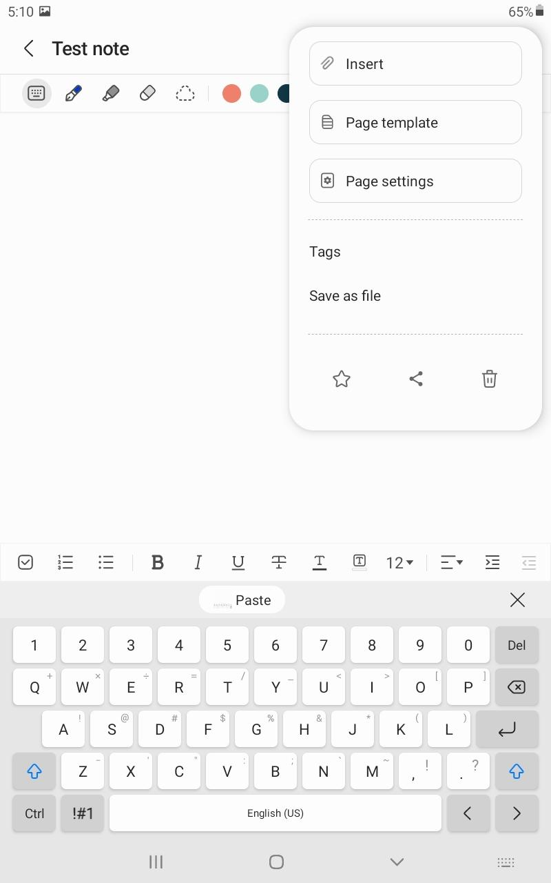
Samsung Notes (Android) (1 of 2)

Slide 47
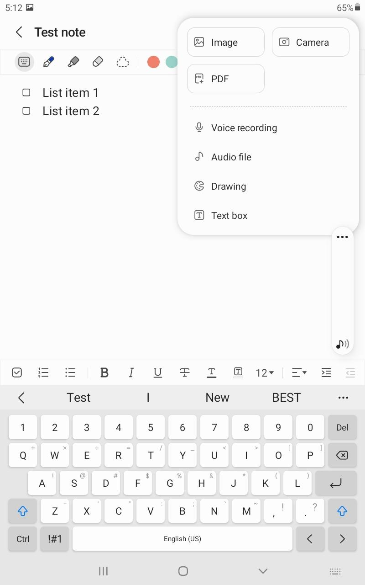
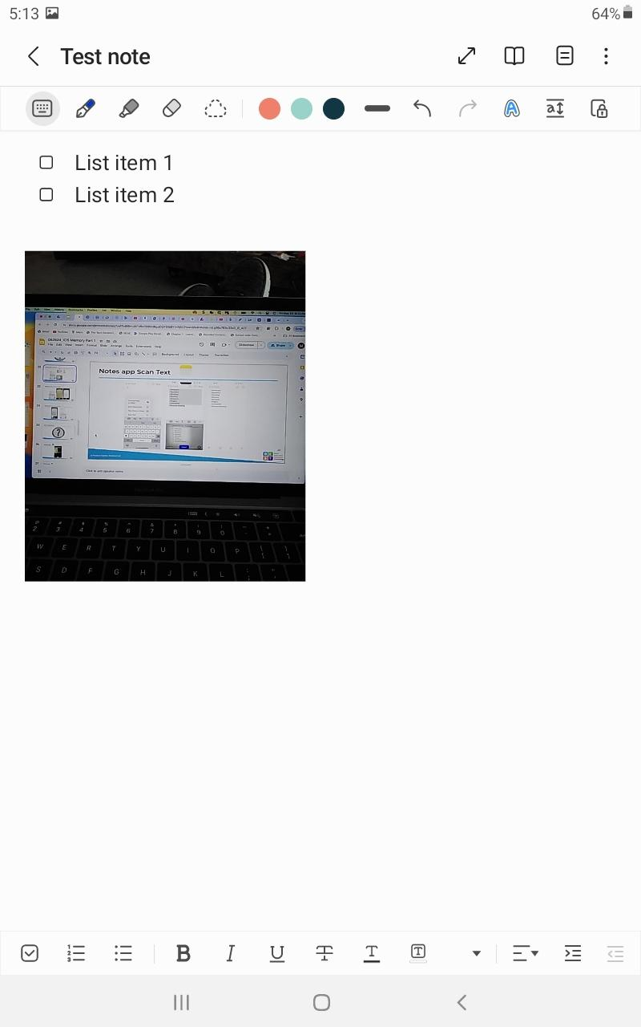
Samsung Notes (Android) (2 of 2)

Slide 48
Chat & Questions (9)

Slide 49
Camera & Photos Apps

Slide 50
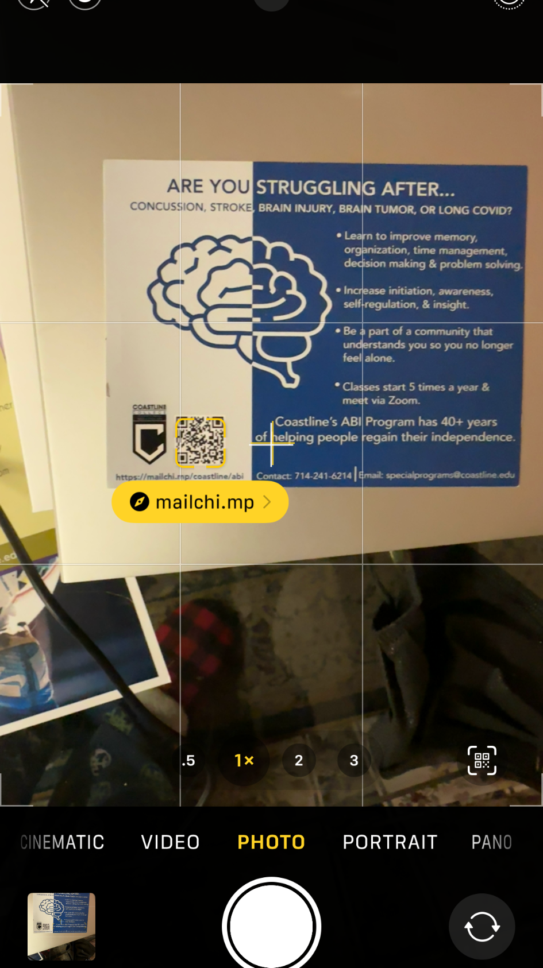
Camera App

Slide 51
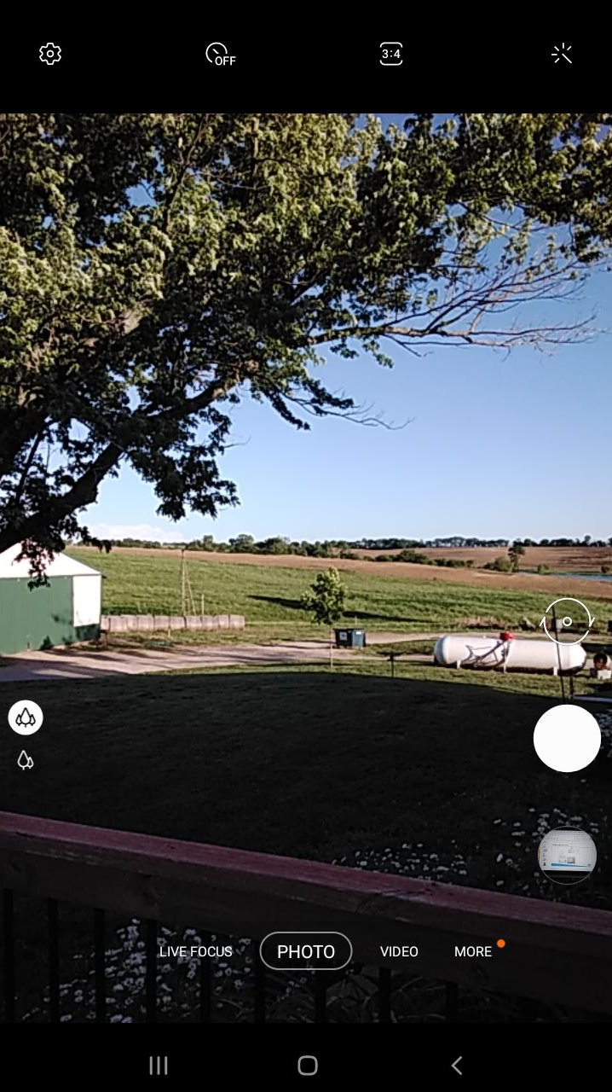
Camera App Android

Slide 52
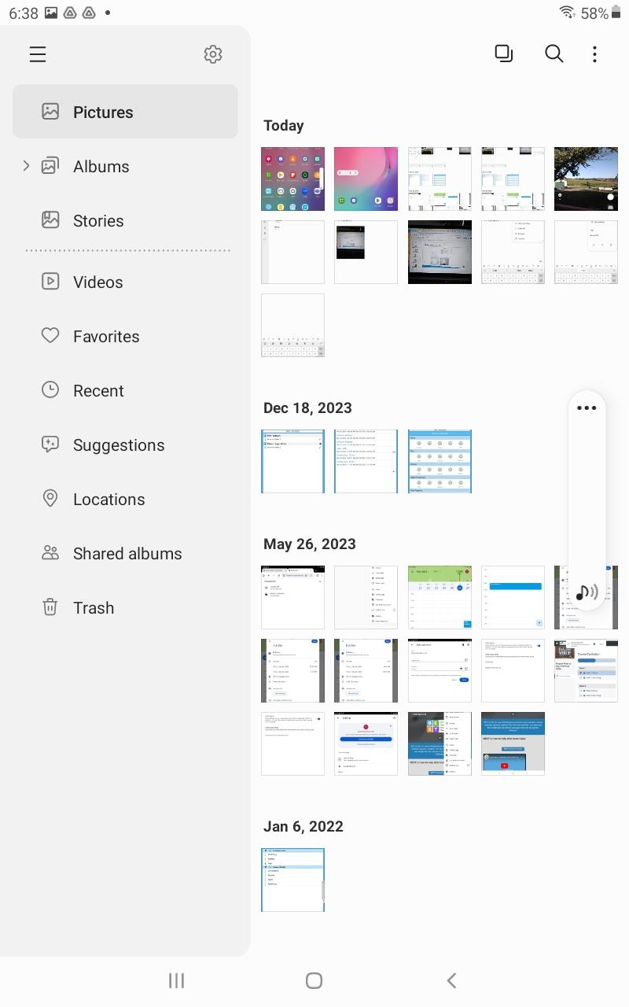
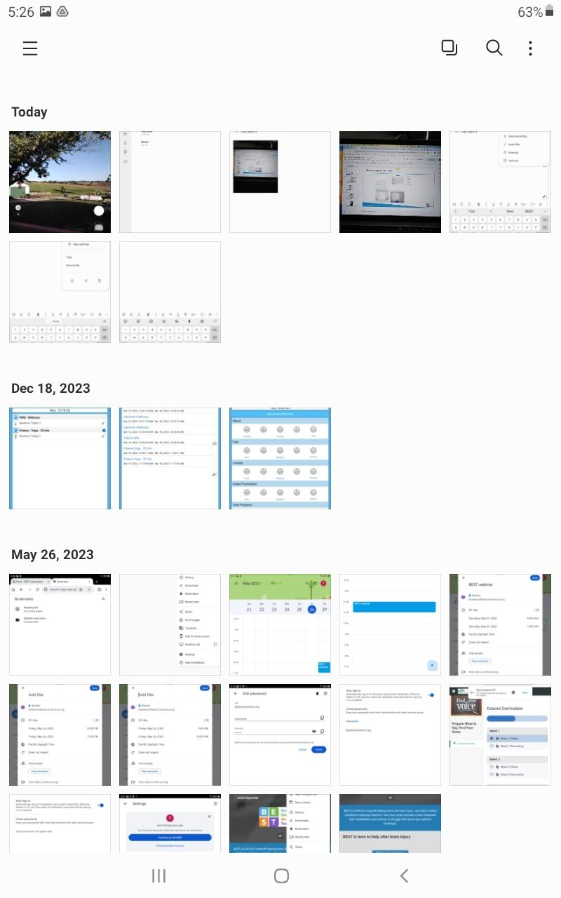
Samsung Gallery App Android

Slide 53
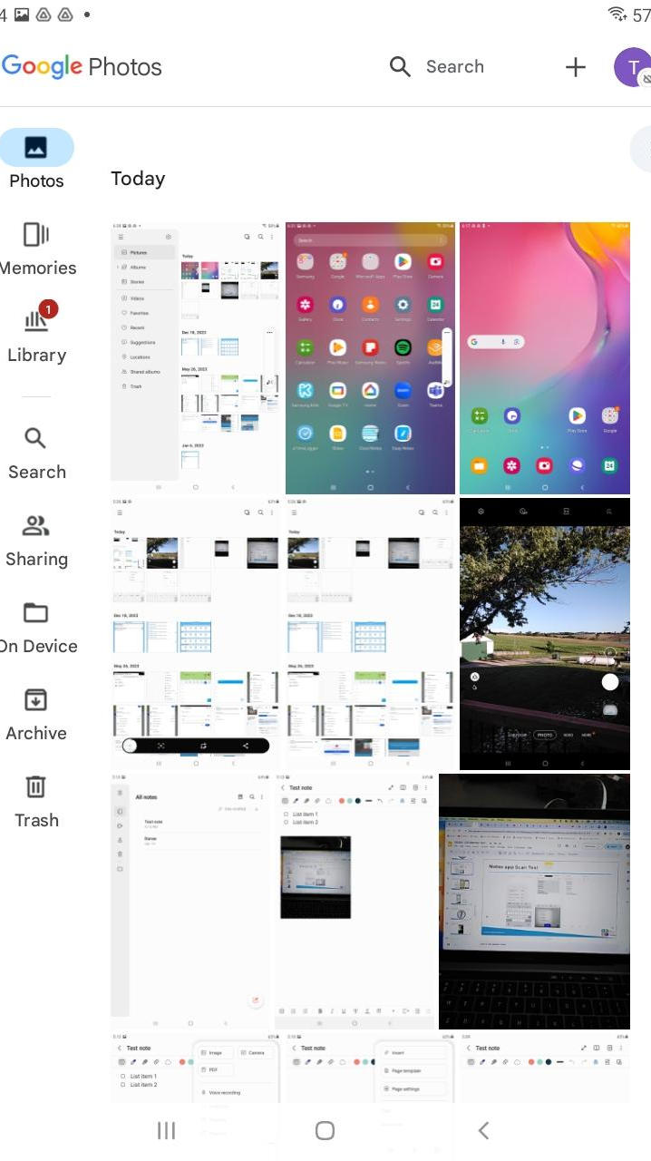
Google Photos App (Android)

Slide 54
Chat & Questions (10)

Slide 55
StrategizeMyLife App

Slide 56
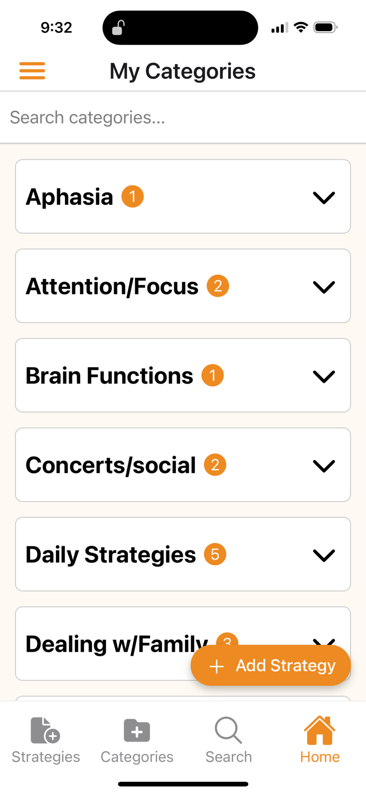
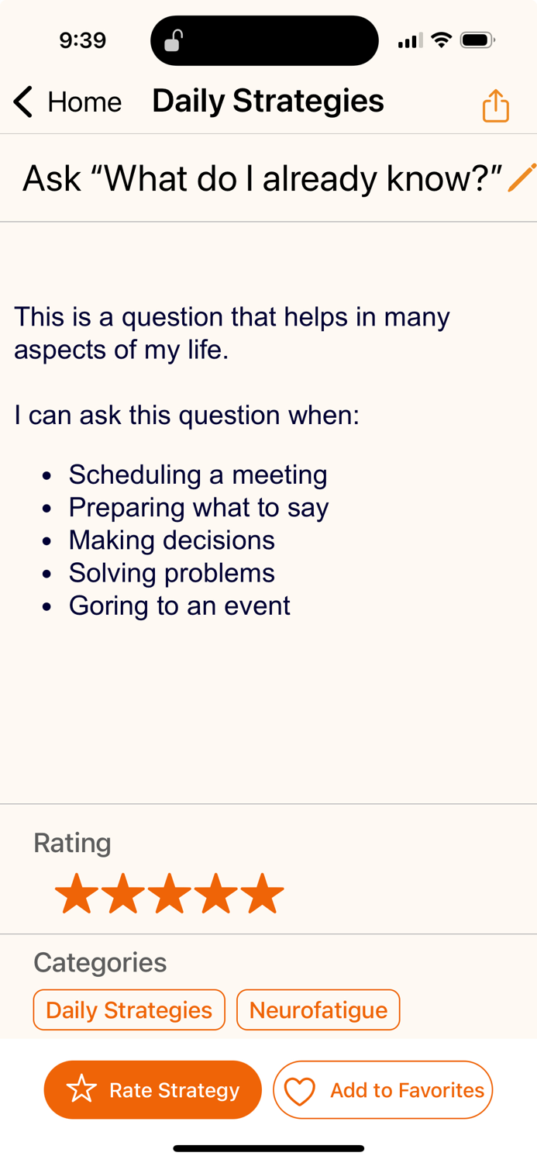
StrategizeMyLife

Slide 57
Chat & Questions (11)

Slide 58

Thank You!
Michelle Ranae Wild
michelle@bestconnections.org
BEST offers free Webinars & Workshops
Visit bestconnections.org for more information

