Slide 1

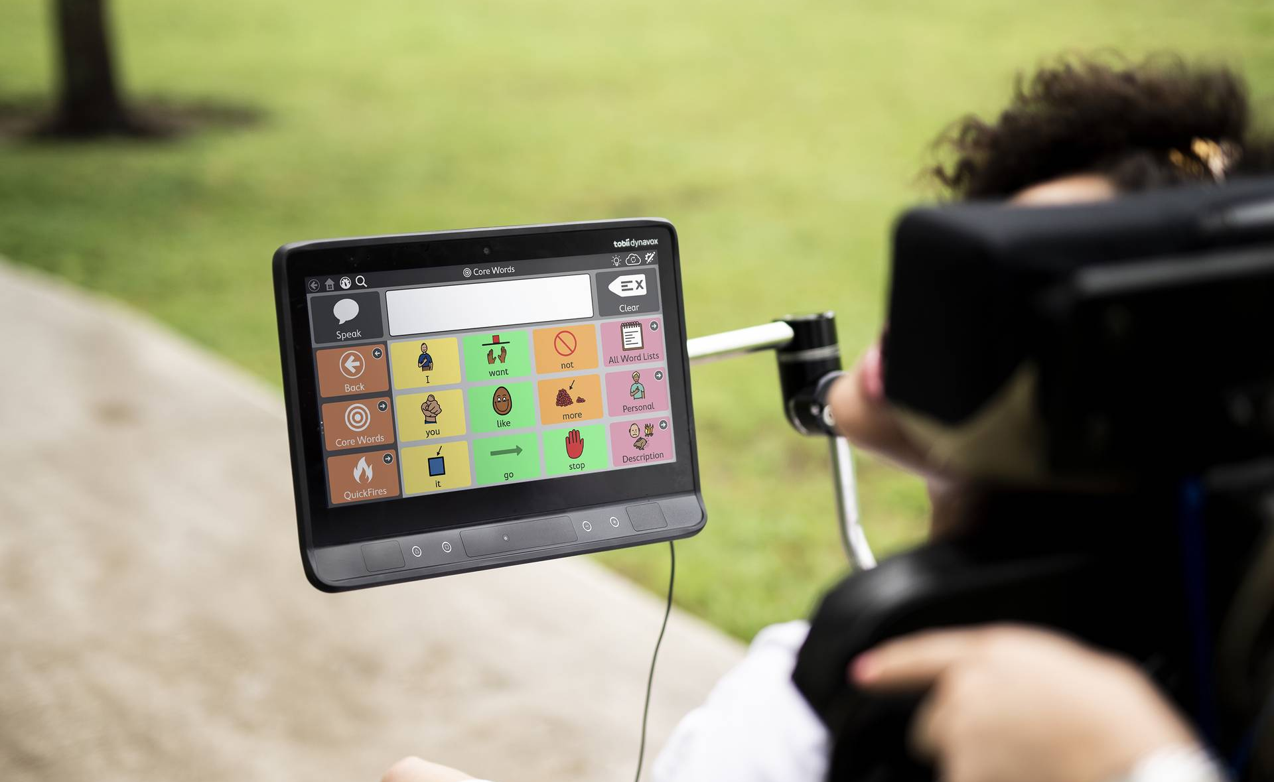
Understanding the AAC Device Funding Process:
A Guide for SLPs, Educators, Families, Caregivers & AAC Users

Slide 2
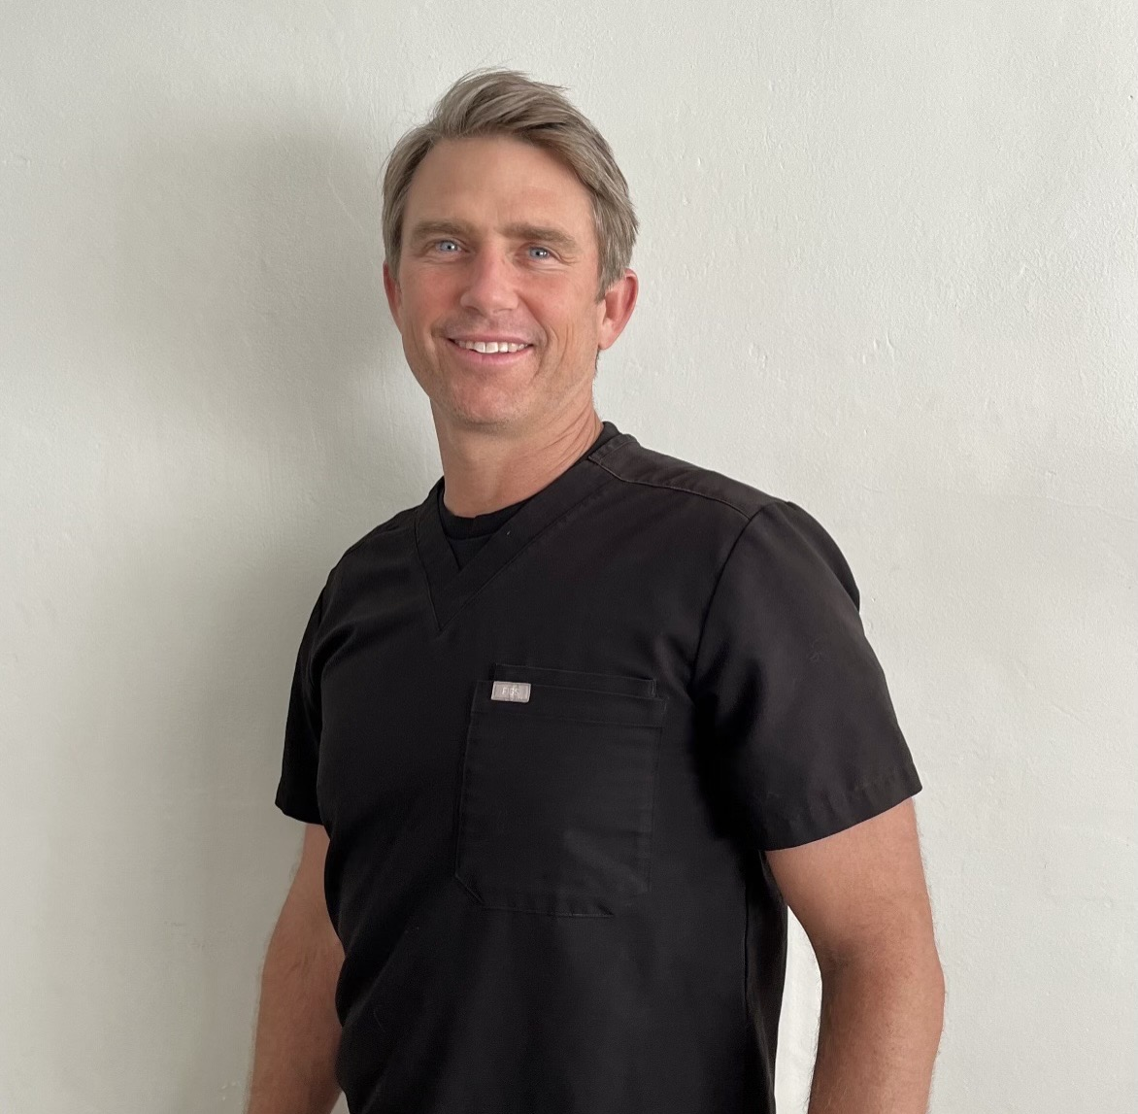
John Pfirman
John Pfirman
M.S. CCC-SLP
New Mexico/West Texas
Experience working with Adults, Pediatrics, Home health, SNF, Telehealth
Solutions Consultant w Tobii Dynavox, Dysphagia Specialist, Adjunct Professor at The University of Texas at El Paso
Passionate about giving everyone a voice and an opportunity to communicate
John.Pfirman@tobiidynavox.com
915-479-3081

Slide 3
Why AAC Matters
• Promotes independence and participation
• Enhances quality of life
• Supports education and employment

Slide 4
Why Funding Matters
SGDs open doors – funding ensures access.
Communication supports independence, inclusion, and quality of life.

Slide 5
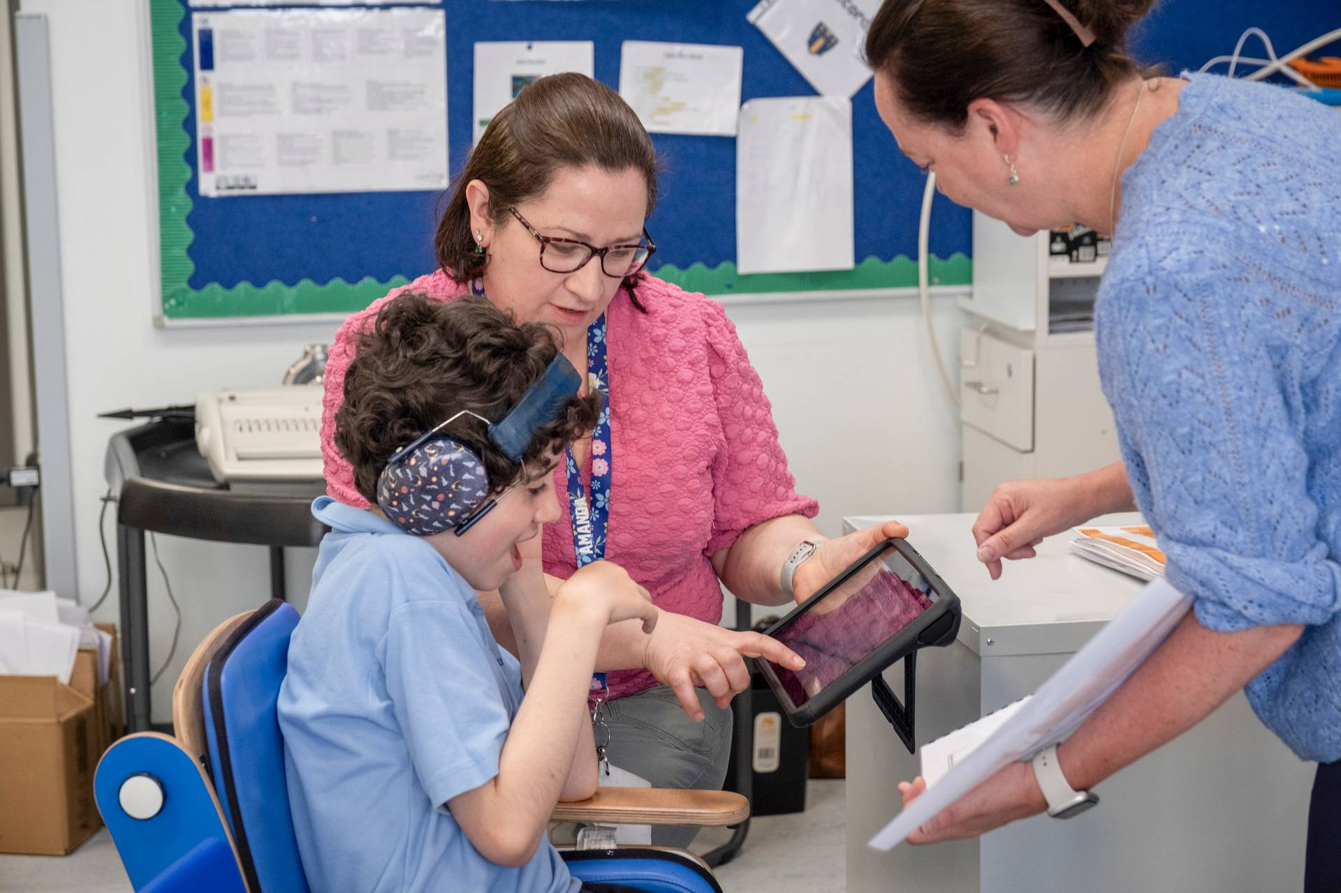
Who Qualifies for Funding?
• Medicaid, Medicare, Private Insurance, School Districts
• Criteria: Medical necessity, functional communication needs

Slide 6
The Funding Process Overview
1. Evaluation by an SLP
2. Device Trial
3. Documentation & Paperwork
4. Submission & Review
5. Approval & Delivery

Slide 7

Who is Involved in the Process?
Speech-Language Pathologist (evaluation, paperwork)
AAC User & Family (trial, input, advocacy)
Physician (prescription, Letter of Medical Necessity)
Funding Source (Medicaid, Medicare, Private Insurance, AT programs)

Slide 8
Role of Families & Caregivers
• Provide input on daily needs
• Support device trial at home
• Advocate during funding process

Slide 9
Role of Educators
• Support AAC use in the classroom
• Provide documentation of academic impact
• Encourage peer inclusion

Slide 10
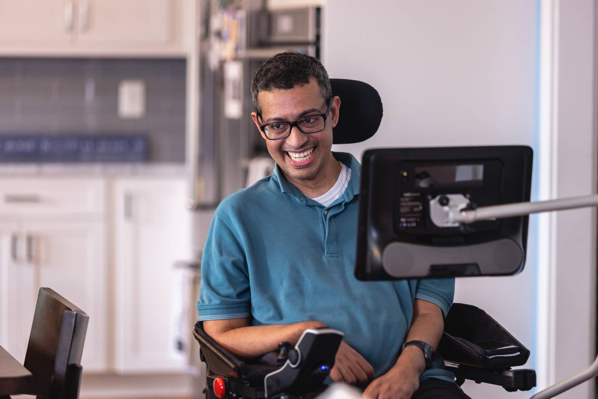
AAC Users’ Voice
• Importance of self-advocacy
• Participation in device selection
• Expressing personal communication goals

Slide 11

Role of the SLP
• Conduct AAC evaluation
• Document communication needs
• Write funding justification letter
• Collaborate with families & educators

Slide 12
Step 1: AAC Evaluation
SLP-led evaluation of communication needs
Device trials and data collection
Evidence of need is required for funding

Slide 13
Step 2: Trials & Device Selection
Trial period with different devices
Document success and challenges
Family and user input is critical

Slide 14
Step 3: Documentation
SLP evaluation report
Letter of Medical Necessity (LMN)
Physician signature required
Tip: Be clear, evidence-based, and user-centered

Slide 15

Step 4: Submitting to Funding Source
Medicaid (most common in NM)
Medicare or Private Insurance
School/AT loan programs
NMTAP (New Mexico Technology Assistance Program) for temporary support

Slide 16
What Happens Next?
Approval → Device delivered & set up
Denial → Appeal process (don’t give up!)
Partial approval → Explore supplemental funding options

Slide 17


efunding.tobiidynavox.com
Create Tobii Dynavox Funding

Slide 18
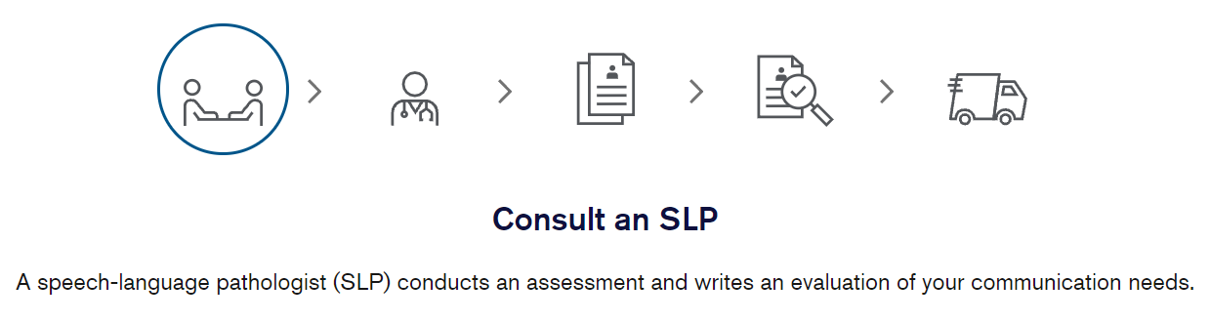
The Step-by-Step
Funding Process
1
Notes:
No matter where you are in the journey to obtaining a solution for your client – we are here to provide the support you need.
The first step of the process is to see a speech language pathologist who will evaluate you to see if a speech generating device will meet you communication needs. If a SGD is needed, your SLP may recommend trialing the equipment for a further evaluation or because it may be required by your insurance who will be reviewing the request.

Slide 19
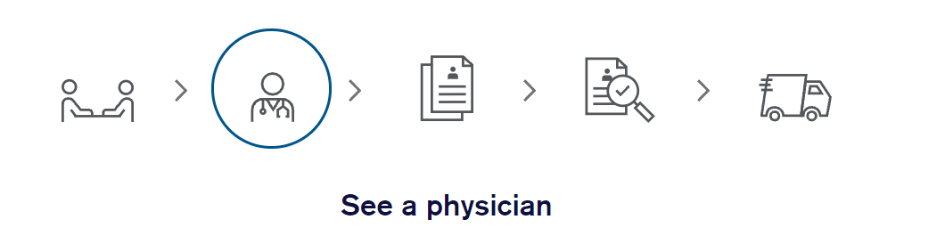
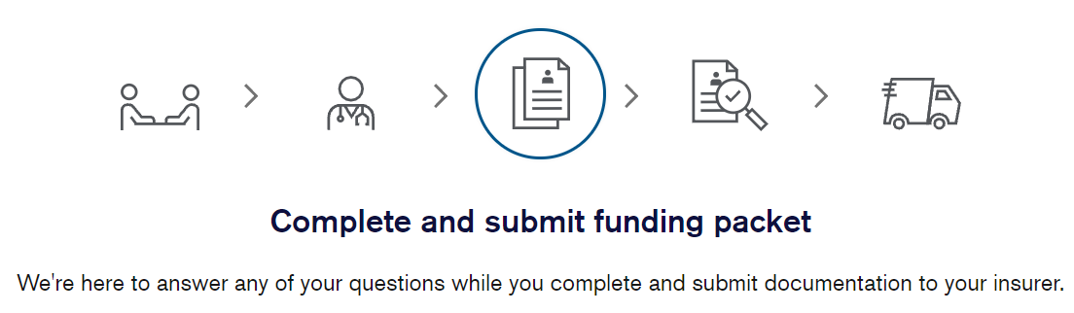
2
3
Notes:
Step 2: Is it important that you see your physician for a face-to-face visit within the last 6 months. In some cases, a video visit (video and audio) will meet the criteria as well. During the visit, it is important that the doctor notes that he is treating you for the condition in which is causing your speech issues. This is a major requirement for Medicare and many insurances follow suit.
Step 3: Your SLP will write the evaluation recommending the equipment needed and then will submit that documentation to the funding team. Our funding team reviews the documents received against the insurance criteria. Your funding consultant will reach out for any revisions to documents submitted to meet criteria and will help reach out for any other missing information, such as a prescription, and chart notes from your physician.
Note: Your prescription must be dated after the SLP evaluation is written, and your last face to face visit with your doctor must occur within 6 months of the date of the prescription.

Slide 20
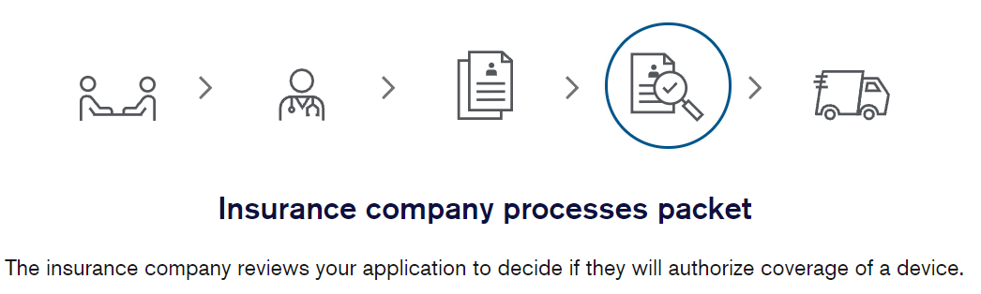
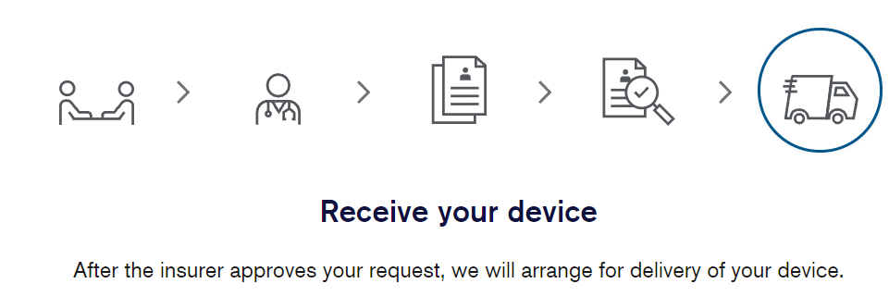
4
5
Notes:
No matter where you are in the journey to obtaining a solution for your client – we are here to provide the support you need.
Step 4: Our funding team will send in all the documentation to your insurance(s). During this process, our funding team will check in regularly with the insurance for the status of the request with hopes for an approval.
If we receive an approval, we may not be able to ship the equipment right away. If we are not contracted with the insurance, we must work on getting a single case agreement on the rates of the equipment (one time contract), once we obtain this, we can work on shipping the information
If your request is deferred – the funding consultant will work the SLP to obtain any other information the insurance is requesting
If the request is denied – we have a dedicated appeals team who will work with you and your SLP to file an appeal on your behalf with the goal to overturn the denial to an approval.
Step 5: Once we get an approval, we should be able to ship out your equipment. Our funding team will reach out to you before shipment to verify we have the correct shipping address and to review shipping details. Additionally, they may ask some additional questions that are required before shipping out the device if you have a Medicare plan.

Slide 21
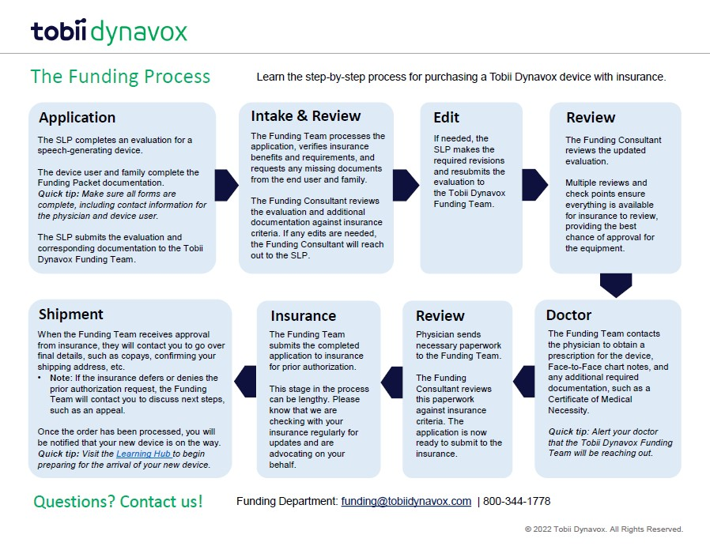
Tobii Dynavox Funding Process

Slide 22
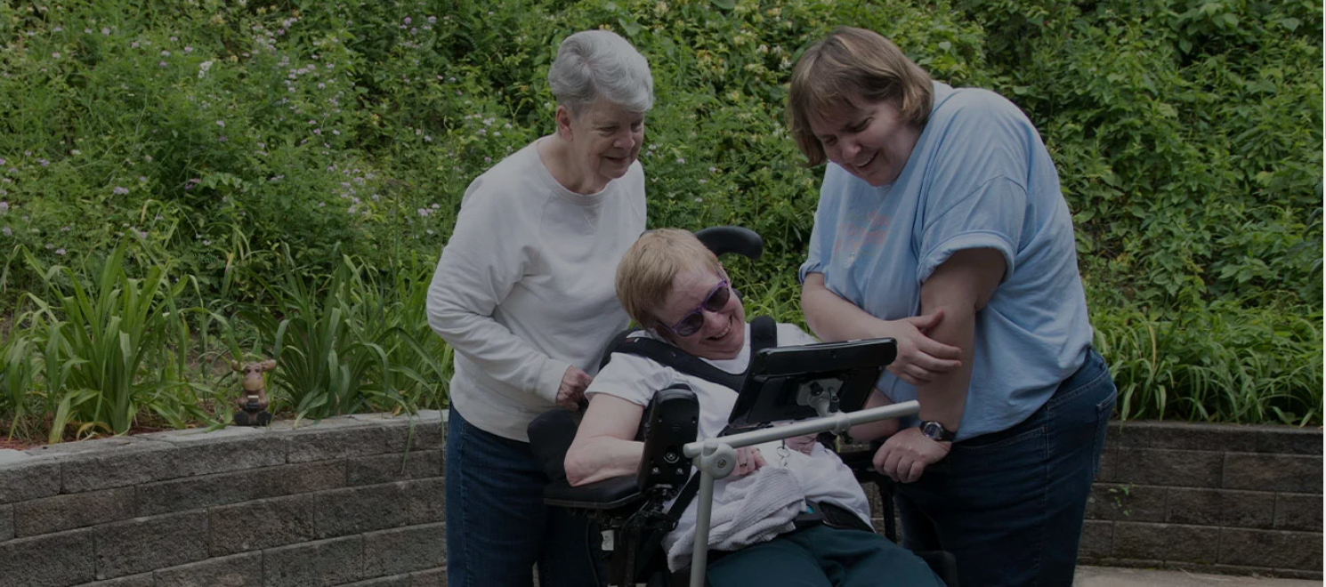

Using E-Funding
Notes:
No matter where you are in the journey to obtaining a solution for your client – we are here to provide the support you need.
We will have a hub course like Lindsey notes, that we can link here too that is about our supports.

Slide 23

Funding Resources
Notes:
No matter where you are in the journey to obtaining a solution for your client – we are here to provide the support you need.
We have many funding resources to help set you up for success during the report writing process.
We have many templates that can be used in conjunction with your e-funding portal.
Additionally, we have many tips and tricks to help consider before you start the report writing process.

Slide 24
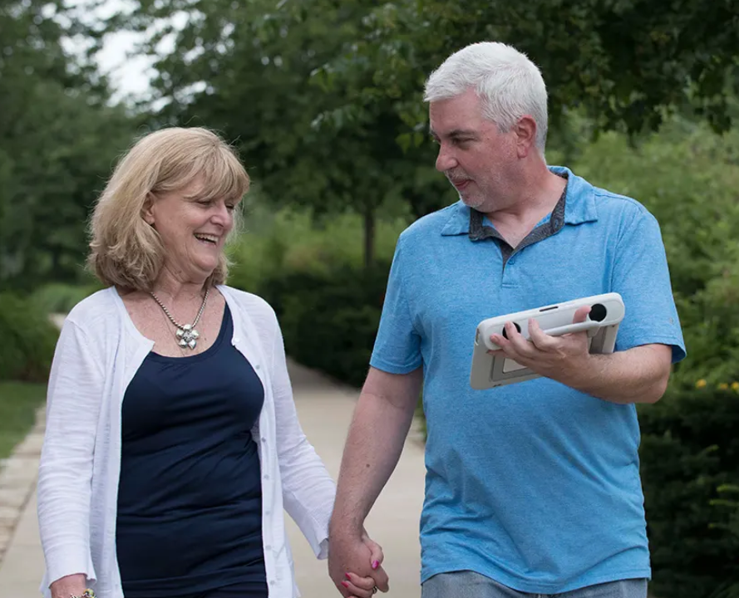
Funded Trials
It is possible to rent a device from us for up to 4 weeks and pay for it directly yourself. This is a good way to try a device before committing to it.
Direct-pay rentals are not covered by insurance, but funded trials are also possible. Forms are available in English and Español.
Trial Program
Notes:
It is possible to rent a device from us for up to a maximum of 4 weeks and pay for it directly yourself. This is a good way to try a device before committing to it. Direct pay rentals are not covered by insurance, but funded trials are also possible. Forms are available in English and Español.
Depending on your insurance, you may be required to trial a device before they will consider payment of the purchase of a device. In this case, please complete the funded trial paperwork to help get your trial started.

Slide 25

Trial a Device
A trial may be required before a funding source agrees to cover the cost of a speech generating device.
Many of our devices are available for trial, offering the opportunity to test an AAC device in your primary environment (home, community, school) for a period of up to four weeks. Application forms available in English and Español.
Trial Program
Notes:
A trial may be required before a funding source agrees to cover the cost of a speech generating device.
Many of our devices are available for trial, offering the opportunity to test an AAC device in your primary environment (home, community, school) for a period of up to four weeks. Application forms available in English and Español.

Slide 26
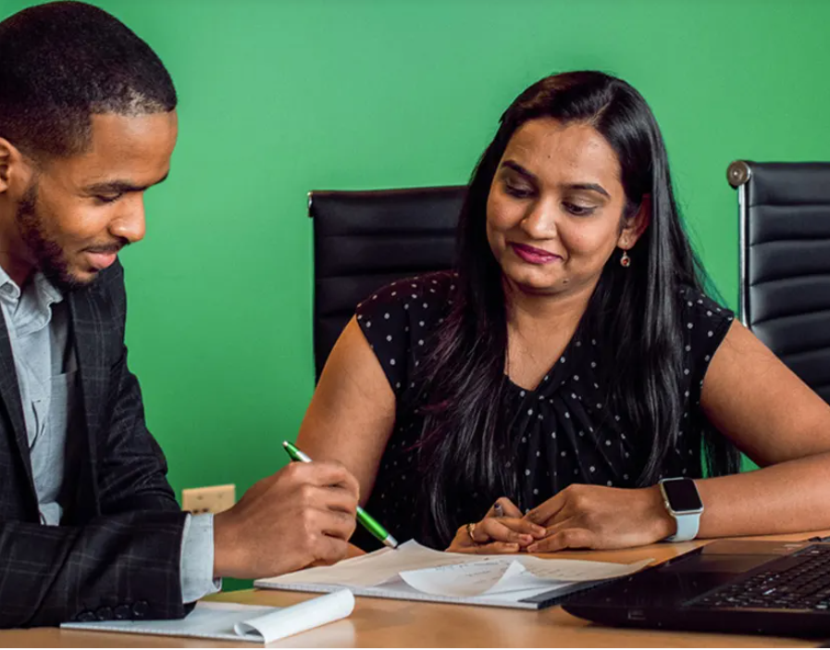
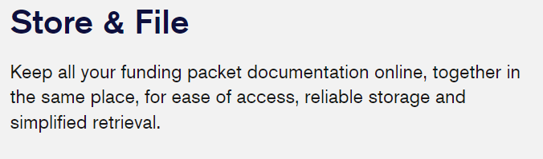
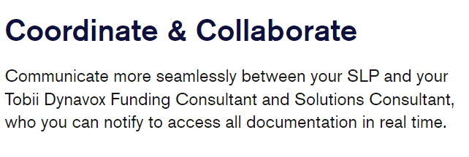
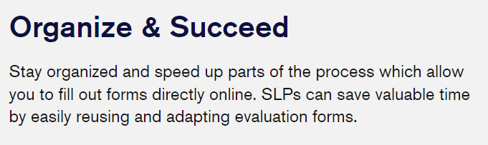
What is E-Funding?
Notes:
E-Funding is a dedicated site that lets you store and file your funding packet documentation online, in one place. It enables your speech-language pathologist (SLP) to coordinate and collaborate more seamlessly with you and your Tobii Dynavox Funding Consultant and Solutions Consultant, helping you stay organized and efficient.
The funding process can be complicated, so we’ve simplified it with a dedicated e-funding site, accessible to everyone involved in your application.
e-funding helps to ensure that the payer guidelines are being met and encourages funding approvals the first time. Funding is daunting. This site while not perfect for every funding source is a great way to eliminate the need to do paperwork over again.

Slide 27
Role of the SLP & Team after the SGD arrives
Advocacy, education, training
Support family through appeals if needed
Ensure carryover in school, home, and community

Slide 28
Tips for Families & Caregivers
Keep all documents organized
1
Stay in contact with SLP & funding coordinator
2
Don’t be afraid to ask questions or appeal a denial
3

Slide 29
Common Funding Challenges
• Denials & appeals
• Insurance limitations
• Documentation gaps
• Delays in processing

Slide 30
Tips for Successful Funding
• Be thorough in documentation
• Include real-life examples
• Collaborate with the funding team
• Use manufacturer resources (Funding Coach)

Slide 31
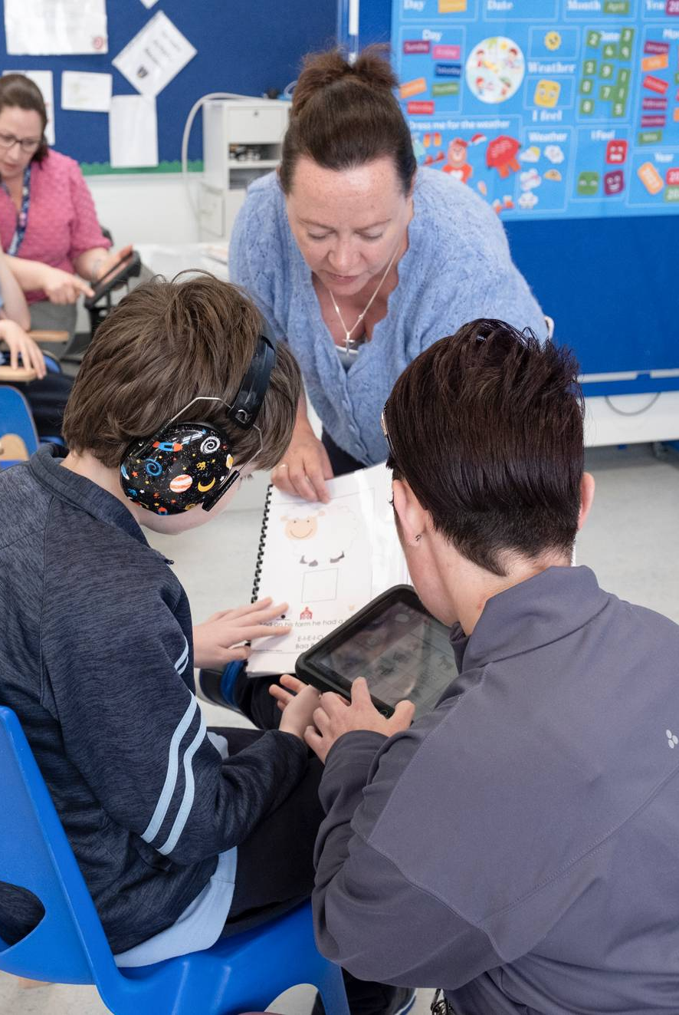
Case Example
Example of a child receiving an SGD through Medicaid:
Eval → Trial → Submission → Approval → Device delivery

Slide 32
Resources in New Mexico
NMTAP: Device loan & support
Medicaid guidelines (online resources)
Parent advocacy groups & disability organizations
Tobii Dynavox Funding Portal (efunding)

Slide 33
Key Takeaways
Funding takes teamwork
Documentation is critical
Families & users are at the center of the process
Support is available – you are not alone

Slide 34

Questions & Discussion
What challenges have you faced in AAC funding?

Slide 35
Thank You
Every voice deserves to be heard.
Contact your local AAC support team or visit NMTAP for resources.

Slide 36
Contact Information
John Pfirman
M.S. CCC-SLP
New Mexico/West Texas
John.Pfirman@tobiidynavox.com
915-479-3081

