Slide 1


Supporting Food Growers with Assistive Technology
Assistive Technology Conference – 2025
Empower Yourself with Assistive Technology
NM Technology Assistance Program
Mary Thelander, MOT OTR/L ATP; Carmen McClelland, MOT OTR/L
Disclosures: Neither Mary nor Carmen have any financial relationship with any products in this presentation
Pictured: Logos for the UNM OT Graduate Program and for the NM AgrAbility Program

Slide 2
Learning Objectives
Learners will relate at least two concepts in the Human, Activity, Assistive Technology (HAAT) model to the activity demands of food producers
Learners will evaluate at least four pieces of low-technology AT to support food growers with health conditions.
Learners will evaluate at least four pieces of high-technology AT to support food growers with health conditions.
Learners will examine at least two supports for professional food producers in New Mexico

Slide 3
HAAT – Human, Activity, Assistive Technology
Activity
Human
Assistive Technology
Pictured: a pie chart that shows the relationship of the human, the activity and the assistive technology within the context of the person.
Context:

Slide 4
HAAT – Food Producers
Assistive Technology
Activity
Planning
Sewing
Watering
Harvesting
Carrying
Bending
Balancing
Mending
Vaccinating
Inseminating
Grooming
Trimming hooves
Loading
Sheering
Hearding
TBD
Human
Determined
Not stopped by pain
Dedicated to their land
Generational ties to land
Professional farmers and ranchers have a higher risk of
Arthritis
Spinal Cord Injury
Back Injury
Stress, Depression and sleep disturbances
Amputation
Respiratory Disease
Hand Injuries
Context: muddy, brambles, sandy, thorny weeds, uneven terrain

Slide 5
Cultivating Accessible Agriculture
Tomatoes
Ergonomics
Chili
Alfalfa
Tractors
Farm Site Mobility
Heat and Senses
Sewing and Harvesting
Implements
AT Evaluation
Pictured: Tomatos, Chili, Alfalfa, a tractor and a Track Master chair

Slide 6
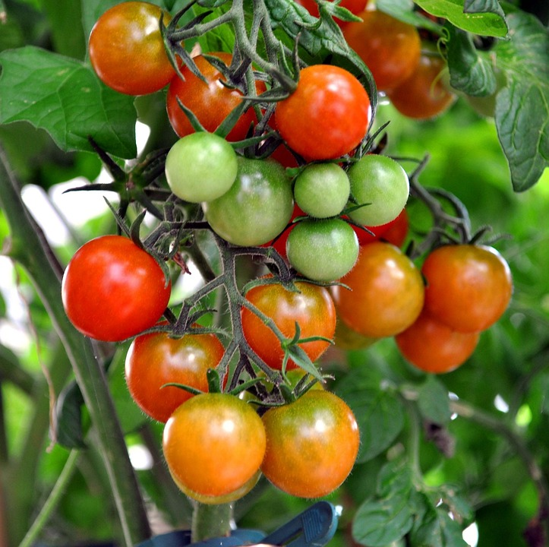
Tomatoes and Ergonomics
Difficulty Lifting
Difficulty transferring to the ground
Difficulty Carrying
Hand, wrist, elbow, shoulder pain
Back Pain
Balance
Joint Protection
Pain with Bending
Pictured: a vine covered in ripening tomatoes

Slide 7
Assistive Technology For Ergonomics – Back Pain
Raised Garden Bed
Grandpa’s Weeder
@ NMTAP
Peta Easi-Grip Long Reach
Pictured: a roll-in raised garden, a long-handled weeding device and a handle for shovels
Notes:
https://homemaking.com/hannah/raised-plant-bed-wheelchair-accessible/

Slide 8
Assistive Technology For Ergonomics - Balance
Garden Kneeler
@ NMTAP
Garden Rocker
@ NMTAP
Garden Scoot
Pictured: a folding garden stool, a mushroom bottom garden rocker and a garden wagon with a built-in seat

Slide 9
Assistive Technology For Ergonomics – Joint Protection
Big Grip Handle
Telescopic Loppers
@ NMTAP
Peta Easi-Grip Long Reach
Pictured: a large-diameter bucket handle, long-armed loppers and a long-reach cultivator
Notes:
https://homemaking.com/hannah/raised-plant-bed-wheelchair-accessible/

Slide 10
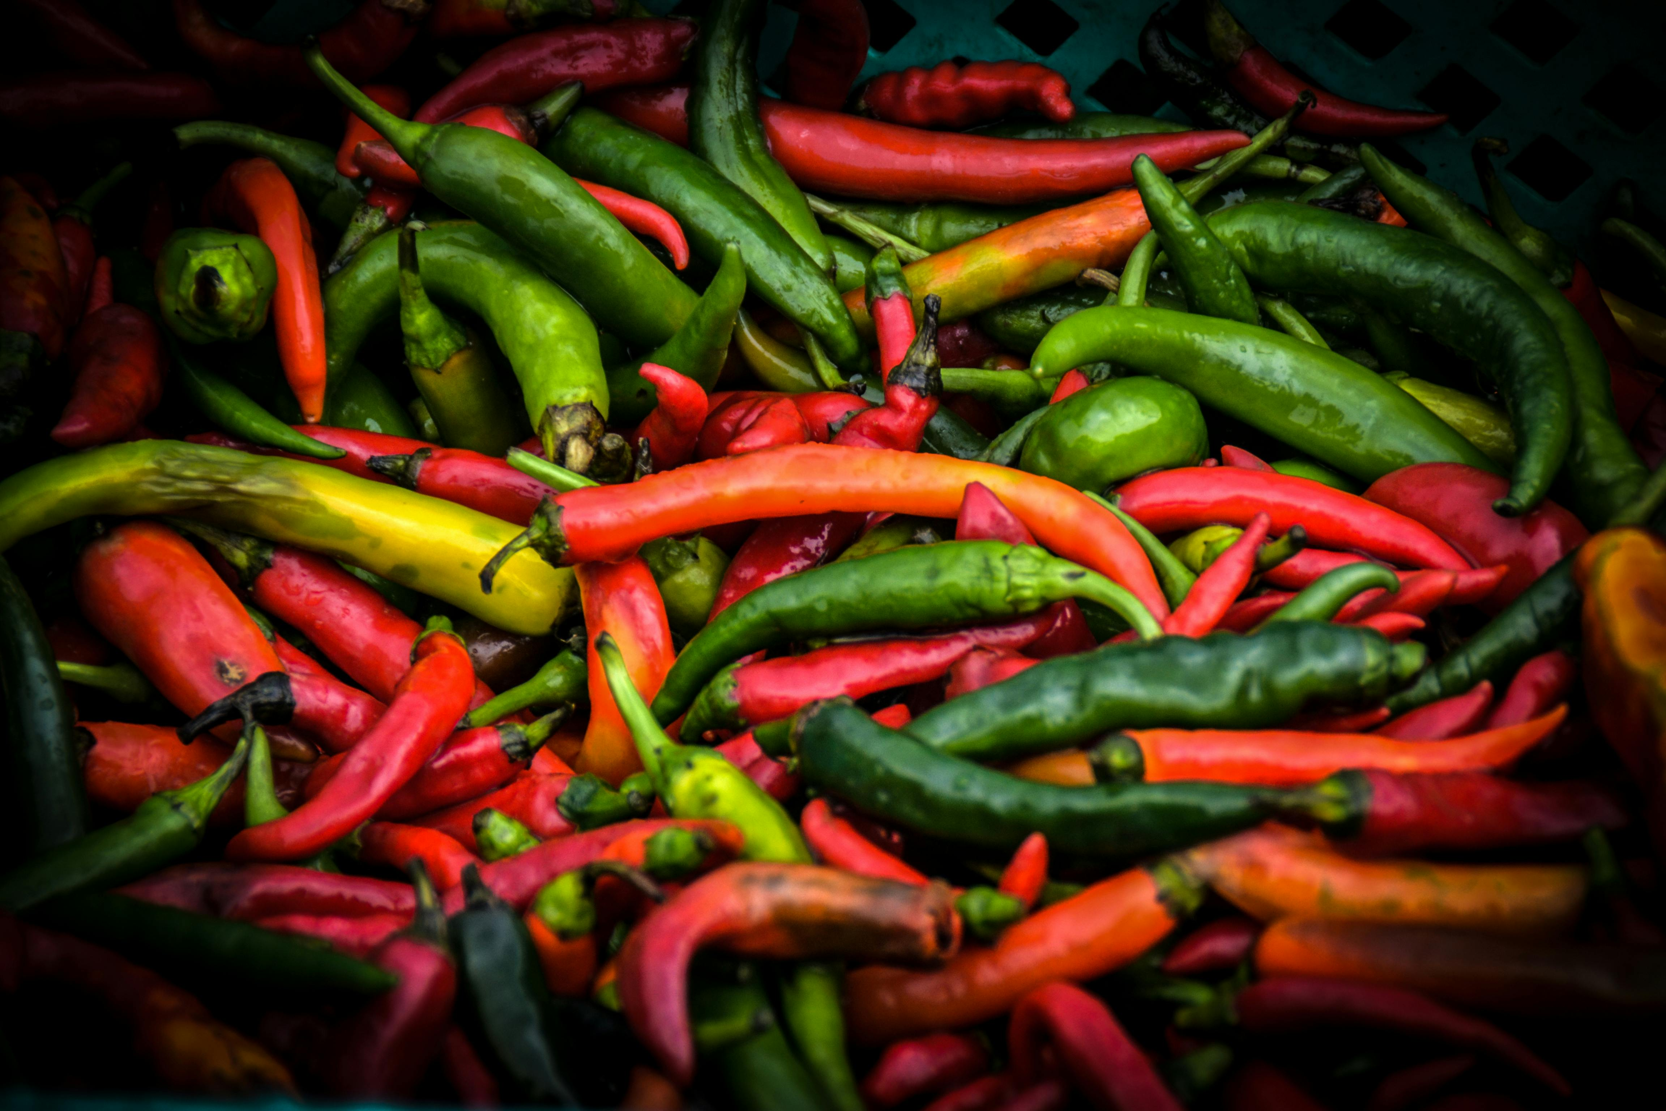
Chili and Heat & Senses
Difficulty regulating temperature
Vision Loss
Heat
Senses
Pictured: a basket of chili

Slide 11
Assistive Technology Temperature Regulation
Cooling clothing/vests
8 Ounces every 15 minutes
Cooling Scarf
Pictured: a cooling scarf, a cooling vest and water bottles

Slide 12
Assistive Technology Vision Loss
@NMTAP
Human ware Explore 8
Big-Read Rain Guage
@NMTAP
Cell Phone Magnification Apps
Pictured: A rain gauge with large numbers, Cell Phone Apps for magnification and an AT device that can enlarge and change contrast of images
Notes:
https://homemaking.com/hannah/raised-plant-bed-wheelchair-accessible/

Slide 13
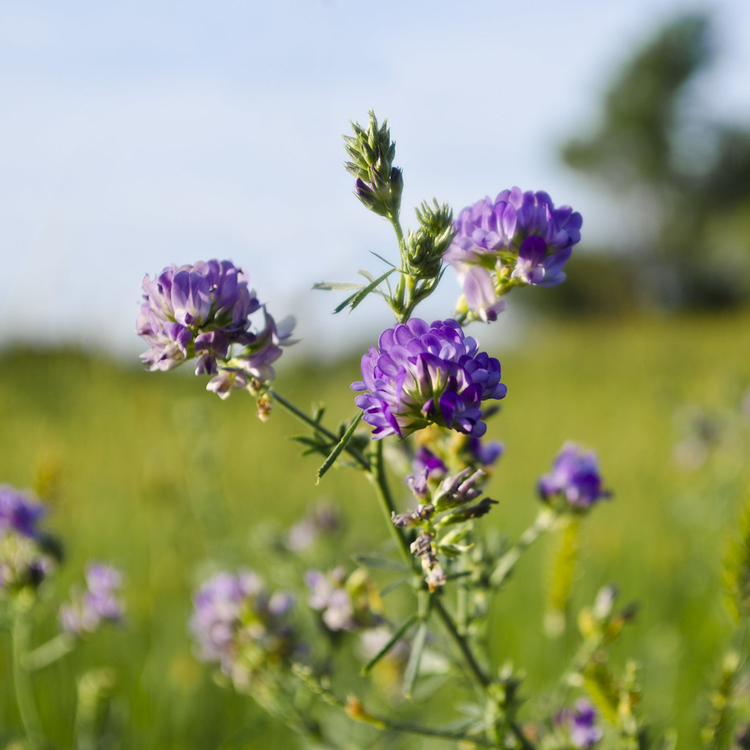
Alfalfa: Sowing and Harvesting
Bending
Lifting
Twisting
Carrying
Pulling
Fine pinch
Pictured: purple alfalfa in a green field

Slide 14
Alfalfa: Sowing and Harvesting Cont.
Power Wheelbarrow
Seeding Square
(Dimple Board)
@NMTAP
Stand ‘n Plant Seeder
Pictured: a square with various diameter holes for easy planning of different seeds, a reaching tool for planning seeds and a wheelbarrow with a power-dump

Slide 15
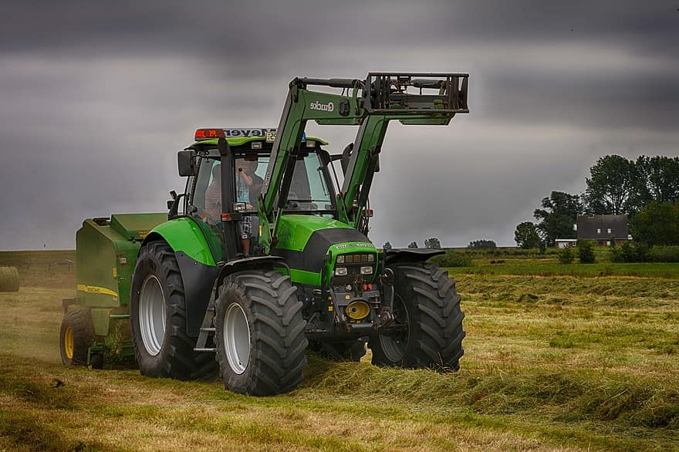
Tractors and Implements
Task requirements
Head range of motion
Hitching / Unhitching
Climbing stairs or ladders
Pictured: a green tractor on a grey, cloudy day

Slide 16
Tractors and Implements Cont.
Garmin deziCam
Hand Controls
Platform Lifts
@NMTAP
Pictured: hand controls by the steering wheel of a tractor, a lowered step for the ladder of a tractor, a camera and monitor to support backing-up farm equipment

Slide 17
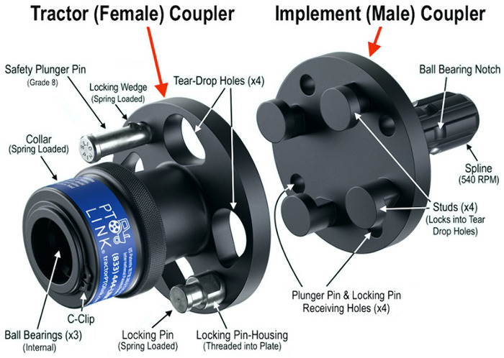
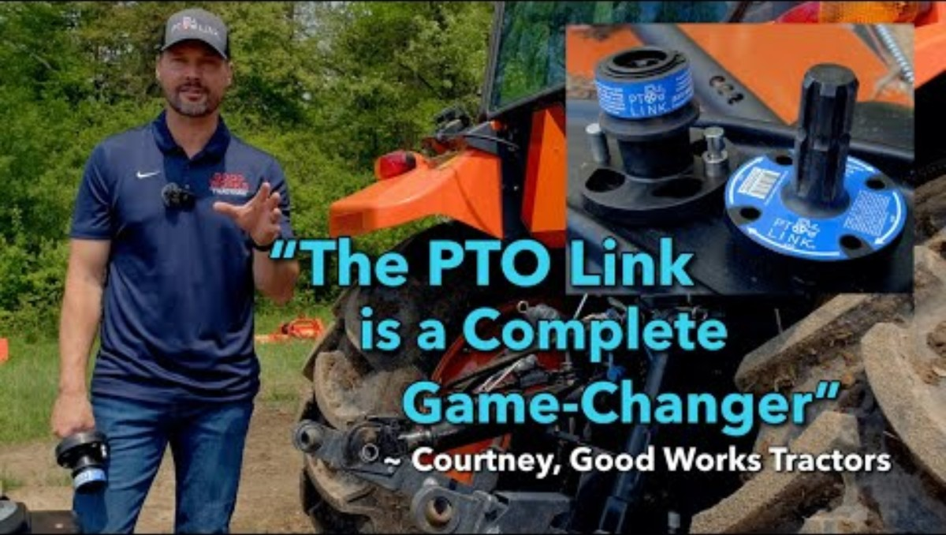
Tractors and Implements Power Take-Off Link
Pictured: A power take off device – two halves of a large black-metal hitch that allows for easy attachment and removal of farm implements
https://youtu.be/dhNU5pGh2-M?si=OqFuKukYmAjMhDKQ

Slide 18
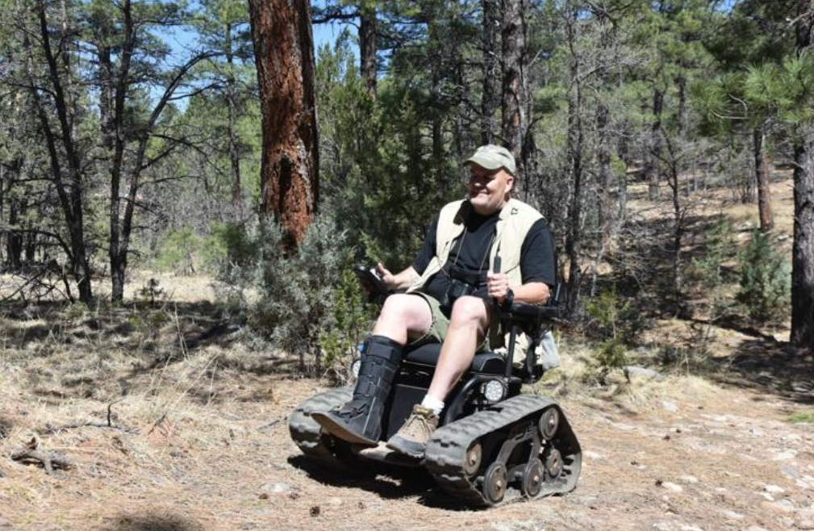
Farm Site Mobility
Factors influencing Mobility
Heart / Lung health problems
Heart Failure
Respiratory Insufficiency
Foot/limb health problems
Sores
Amputations
Joint paint
Joint replacements
Nervous system health problems
Spinal Cord Injury
Amyotrophic Lateral Sclerosis
Multiple Sclerosis
Brain Injuries (CVA, TBI, Hypoxic…)
Pictured: A track chair in ponderosa forest.

Slide 19
Farm Site Mobility Cont.
Truck Med Mounted
wheelchair Lift
Track Chair
@Monzano Mountains State Park
Life Lyfts
Truck Bed Mounted Lift
Pictured: A track chair in ponderosa forest, a truck bed mounted person lift, a truckbed mounted wheelchair lift.
Notes:
https://homemaking.com/hannah/raised-plant-bed-wheelchair-accessible/

Slide 20
NM AgrAbility No-Cost Evaluation
https://agrability.nmsu.edu/
Social/emotional factors
Functional limitations
Accessibility, safety
Maintenance, management
Manual production
Machine use
Home accessibly, daily living activities
Assistive Technology Evaluation

Slide 21
Free Resources Available to Food Growers
NM AgrAbility Program: https://agrability.nmsu.edu/
No cost farm/ranch site evaluation for food growers who earn $1000/year
call toll free: 1-855-AGRABLE (1-855 247-2253)
NM Technology Assistance Program (NMTAP): https://tap.gcd.nm.gov
Free services to New Mexicans with disabilities to help them get need assistive technology (AT).
Device Loans, Device Demonstrations, Device Trainings
Low interest financial loans to obtain assistive technology devices
Division of Vocational Rehabilitation (DVR): https://www.dvr.state.nm.us/
Assisting New Mexicans with disability achieves their employment goals and thrives in their communities.
Vocational Counseling, Job Development, Vocational Rehabilitation Technology, Employment Training and more.
Cooperative Extension https://extension.nmsu.edu/
Master Gardeners, Soil Testing, Water management…. all things farming and ranching

Slide 22
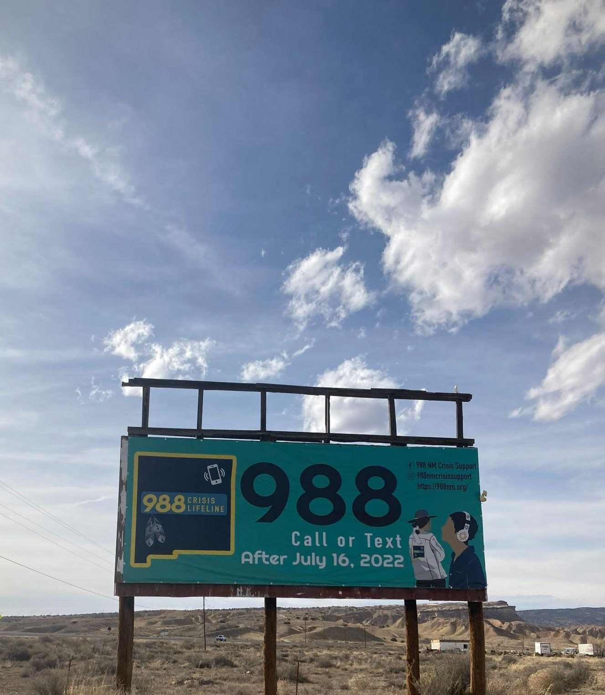
More Resources
Dial 988 / https://988nm.org/
24/7 Lifeline for Emotional, Mental, or Substance Misuse Support
NM Farm and Rural Stress Hotline
1-800-691-4336 / https://farmstress.us/
Run by the Western Regional Agricultural Stress Assistance Program
Offers funding opportunities and support in navigating resources and education
NM Farm Bureau - Here to Help NM
https://www.nmflb.org/Get-Involved/Here-To-Help-NM; 1-575-532-4700
Farm Aid
https://www.farmaid.org/our-work/resources-for-farmers/
Farmer Resource Network provides immediate and effective support services to farm families in crisis
Pictured: Dial 988 Billboard encouraging NM residents to call for emotional, mental health or substance misuse support on a blue-sky day with fluffy clouds.
Notes:
Pictured: Dial 988 Billboard encouraging NM residents to call for emotional, mental health or substance misuse support on a blue-sky day with fluffy clouds.

Slide 23
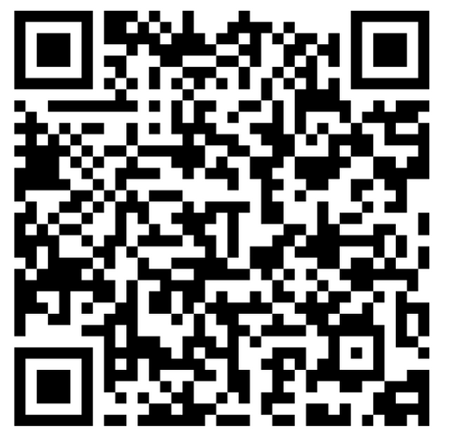
QR Code to Pain and Fatigue Resources*
Resources:
Cook, A. M., & Polgar, J. M. (2020). Cook & Hussey's assistive technologies. Elsevier Health Sciences.
Damroth et al., (2019). Farm injuries: Animal most common, machinery most lethal: An NTDB study. The American Surgeon.
Johnson et al., (2021) Agricultural Injuries among Farmers and Ranchers in the Central United States during 2011-2015. Journal of Agromedicine,
Mattila, T. E., Perkiö-Mäkelä, M., Hirvonen, M., Kinnunen, B., Väre, M., & Rautiainen, R. H. (2022). Work exposures and mental and musculoskeletal symptoms in organic farming. Ergonomics, 65(2), 242-252
The AgrAbility Project (n.d.) The Toolbox; Assistive Technology Database. Retrieved on 9/3/2025 from https://www.agrability.org/toolbox/
Wilhite et al., (2020). Agriculture for Life: A Guide for Health Promotion and Participation for Farmers with Health Challenges. Journal of Consumer Health on the Internet
Back Pain
Back Exercises
Hand / Joint-Conservation
Energy conservation
Contrast Baths for Hands or Feet
*Ask your medical provider for a referral to OT if any of these exercises or adaptions cause pain.
Resources Link: https://drive.google.com/drive/folders/1MfjNTwY4Lgfxtz6WhJvTmefg9QvuXlop?usp=drive_link

