Slide 1
Clinical Rehabilitation Engineering & Collaboration in the Assistive Technology Space
Hank Madden, MS, CRE & Andrew Schlosser, OT
Raymond G. Murphy Veteran’s Affairs Medical Center
Spinal Cord Injury/Disorder Unit
Albuquerque, NM

Slide 2
About Us
Hank
Clinical Rehabilitation Engineer
Andy
Occupational Therapist

Slide 3
Clinical Rehabilitation Engineering
What is CRE?
Subset of Biomedical Engineering much more focused on direct patient care
Application of science & tech to improve quality of life for individuals w/ disabilities
Overall goal to look at clinical problems through engineering lens
Works with other team members to approach needs holistically
Utilizing engineering principles to develop, implement and train on assistive technology products
Address issues that exist for both clinicians and end users in a standardized engineering way

Slide 4
Involvement in NM VAMC
Part of SCI/D Unit but assists with other departments, such as PM&R, Education, Biomed, Dental, and Safe Patient Handling
Wheelchair seating and mobility
Medical Device Development/Modification
Medical Device Research
Device Implementation

Slide 5
Wheelchair Seating and Mobility
Setup and Implementation
End user training
Putting heads together to develop ideal mobility and seating solutions

Slide 6
Product Development/Modification
Many needs for people w/ SCI/D are not met by existing products or are difficult to get
Assistive technology needs increasing among general population as well and processes in general not keeping pace with needs
3D Printing and other manufacturing techniques for Class 1 Medical Devices
Consumer-centric & participatory design focused

Slide 7
Medical Device Research
In a constantly changing medical landscape it can be difficult to stay up to date with devices coming out
Collaborates with other CREs and conducts medical journal and device research independently
Coordinates vendor trials and provides general education on new medical devices coming out
Examples in NMVAMC

Slide 8
Device Implementation & Training
Both for locally developed and industry products
Provides training to end users, caregivers and clinical staff
Multi-step and multiple meetings to ensure use understood
Examples in NMVAMC

Slide 9
Human Factors Engineering and AT Ideation
Identify issues and opportunities within department
Watches patients and discusses w/ therapists to mention where deficits may exist
Look at issue through a “different lens”
Examples

Slide 10
Collaboration in Assistive Tech Space
Key importance of CRE within overall therapy space
Leads to development well-designed “for life” products
Creates unique solutions for unique needs

Slide 11
Case Study Example
Patient Info:
72 y.o. Purple Heart Recipient Vietnam Vet
Long term spinal cord injury patient that has transitioned to power mobility
Acute injury to foot while driving chair

Slide 12
Holistic Patient Review
Considered individuals preferences related to assistive technology
Discussed existing options as team; “storyboarding”
Interests and needs of patient first and foremost in plan development
In an ideal world what would this patient like the most

Slide 13
First Steps for Solution
Market Research first and foremost
See what’s out there and try to find what works with patient needs
Don’t reinvent the wheel if you don’t have to!

Slide 14
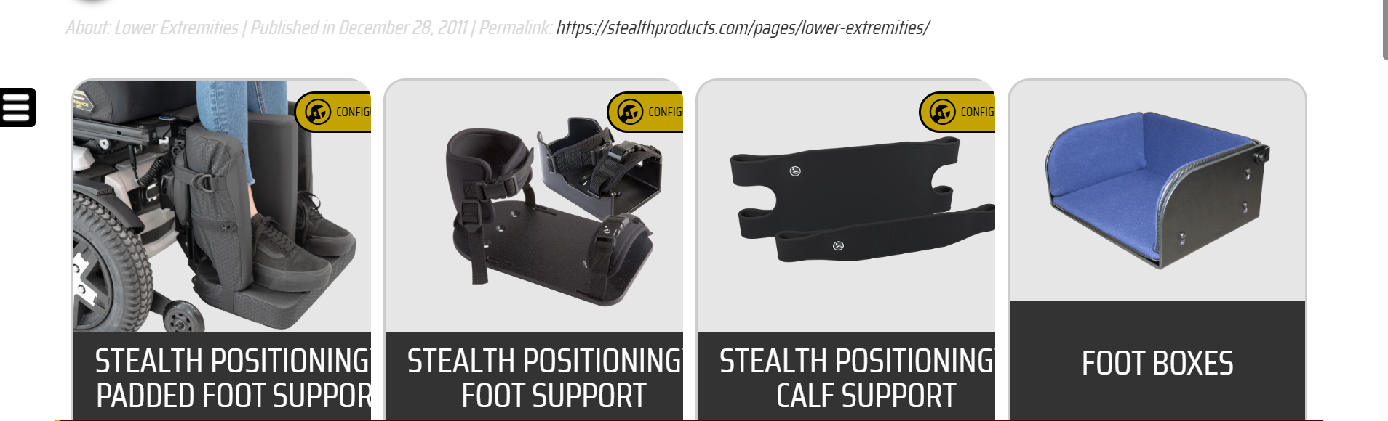
Market Research
Source: https://stealthproducts.com/p/6/

Slide 15
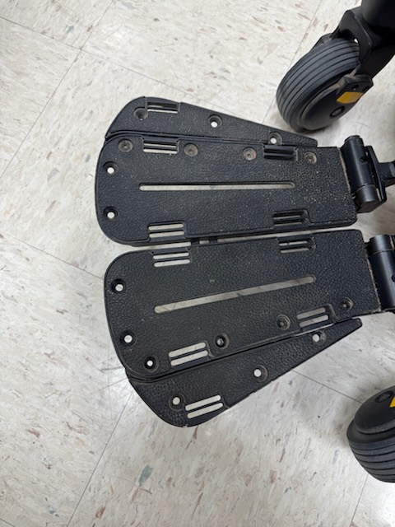
Patient need considerations and devices that exist
Considerations:
Patient has solid proprioception related to angle changes around knee
Doesn’t want to be “boxed in” and wouldn’t use device if he was
Left hand function issues so would struggle with a clip or other type of restraint that involves fine motor control
We want to avoid putting the foot in pronation/supination for extended periods of time

Slide 16
What to do when device not on the market
Design Process!
Think through patient needs, anthropometric setup and ease of use
First do no harm
Have to consider usability and “coolness factor”
Discuss ideation with patient to ensure it meets expectation and needs
Have to heavily consider AT adoption from the beginning

Slide 17
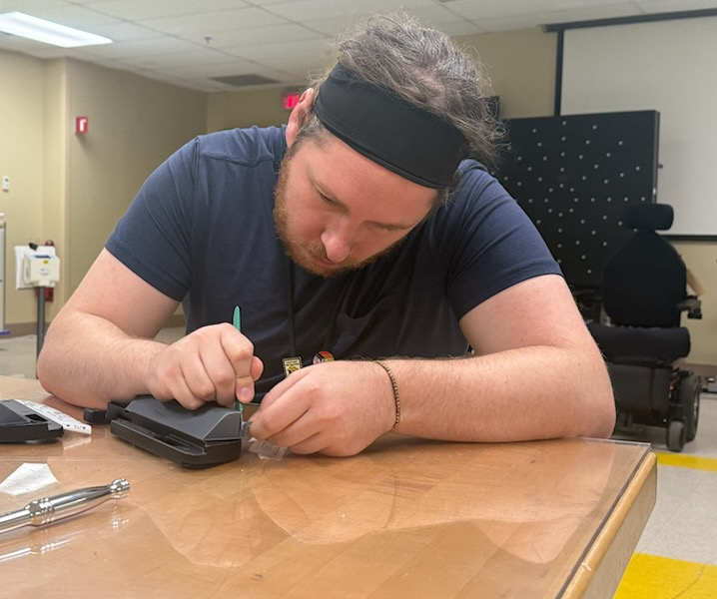
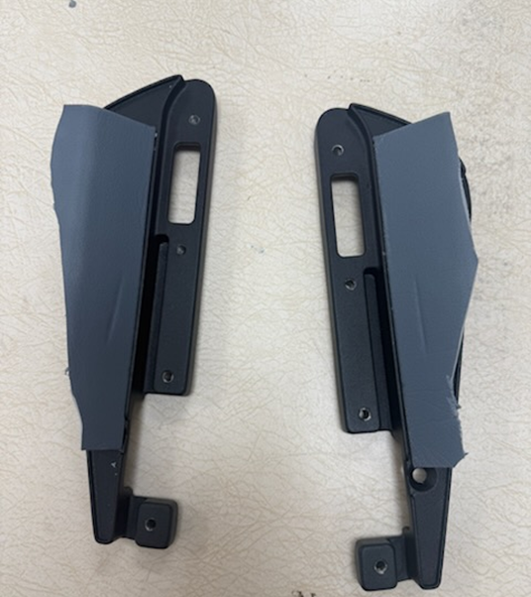
Rapid Prototyping

Slide 18
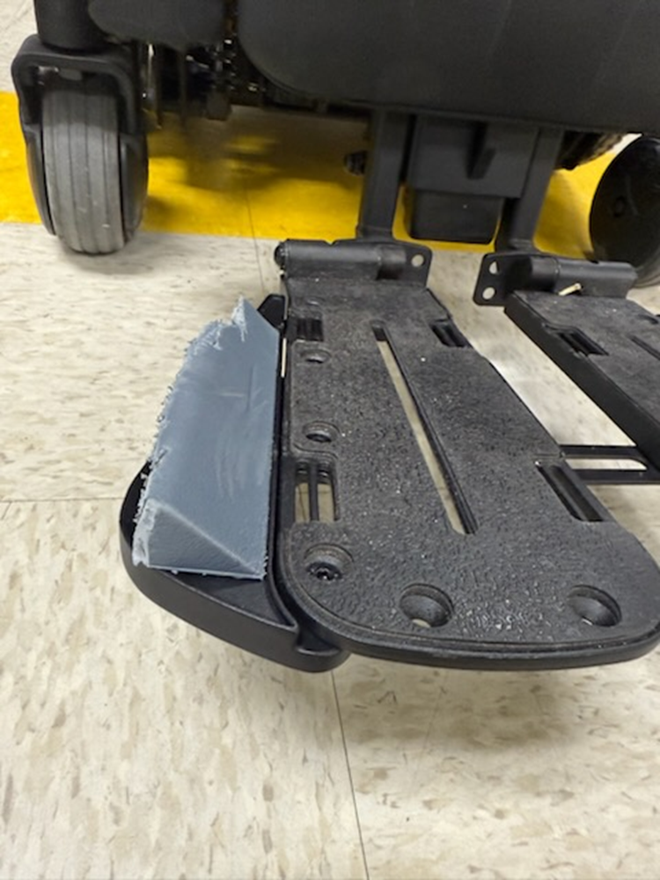
Rapid Prototyping Cont.

Slide 19
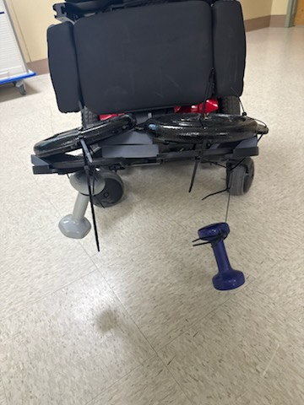
Concept Testing
Trying to break it!
Find blind spots in design
Try to put it under more stress than it would see in real life
Implementation of engineering design principles

Slide 20
Iterative Design Improvement
Initial test often reveals specific issues with a product that can’t be guessed
What are drawbacks of our initial design?
Where would the “real world” failure points likely be?
What needs to be done to make this “patient ready”?
How can it look more streamlined and like it belongs on the chair?

Slide 21
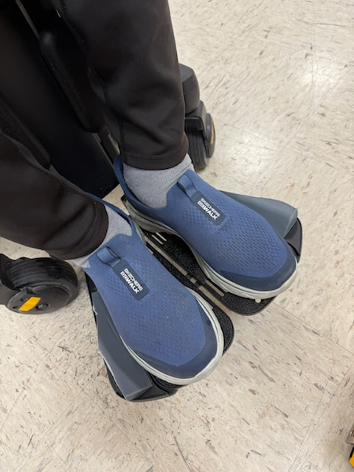
Patient Implementation

Slide 22
Long Term Follow Up
Fortunate that patient is on site often for continuous physical therapy
Able to discuss issues, likes/dislikes, other factors seen
Make alterations on the fly during visits
Also able to see how patient looks in device
Not a set it and forget it concept!
Developing a product for a patient directly creates a maintenance responsibility

Slide 23
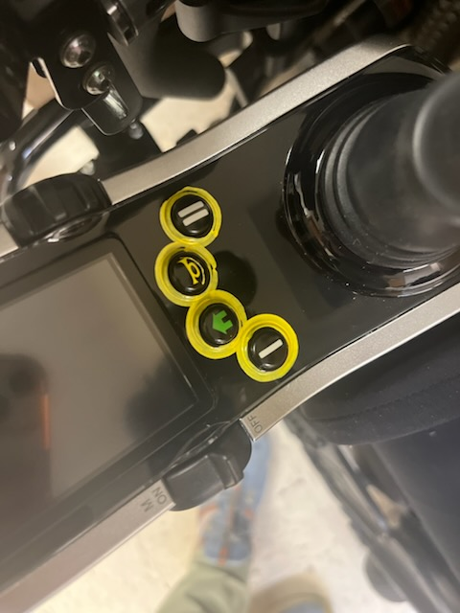
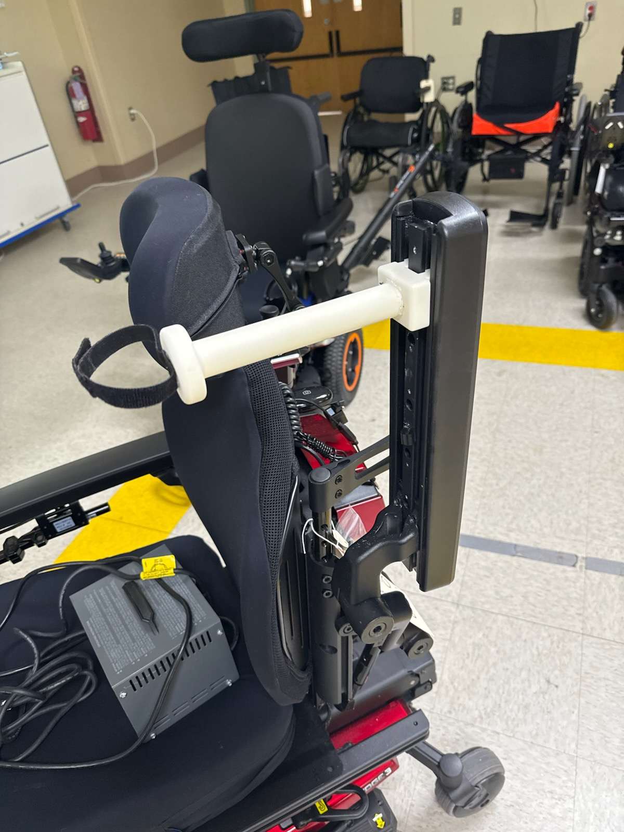
Other Innovations at the ABQ VAMC

Slide 24
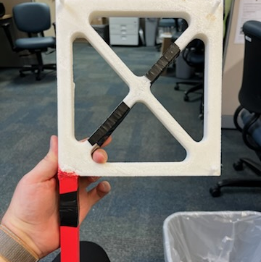
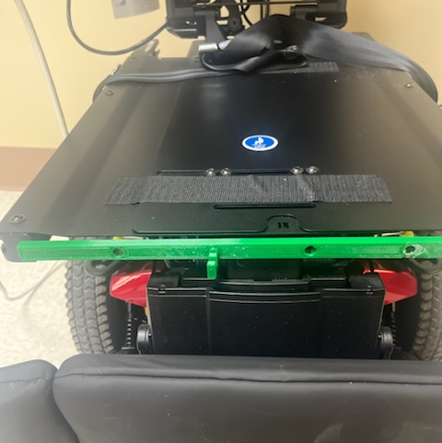
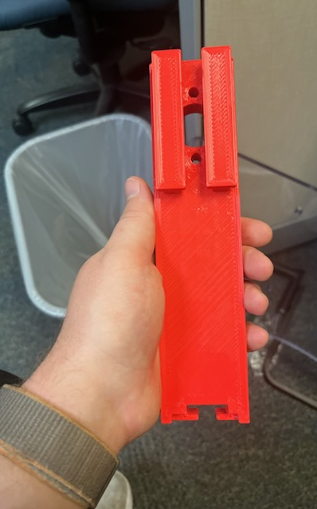
Other Innovations Cont.

Slide 25
Contact Info
Hank
Hank.Madden@va.gov
Andy
Andrew.Schlosser@va.gov

