Slide 1
Creating Meaningful Social Interactions
ATC 2025
Albuquerque, New Mexico
Dr. JL Parker, Ph.D. CCC-SLP, CBIS

Slide 2
About Dr. J
About Dr. J :
Ph.D. Interdisciplinary Health Sciences / Concentration Neurodivergence
Faculty: Central Michigan University, Western Michigan University and Eastern Michigan University
Courses Taught: AAC, ASD, Research, Language, Voice, Phonological Disorders, Com Dis Introduction, Literacy, and clinical modalities
Passion for Neurodivergence, AAC, and TBI
Clinical Settings: outpatient, acute, SNF, LTACH, IRF, residential, outpatient ASD, outpatient TBI.

Slide 3

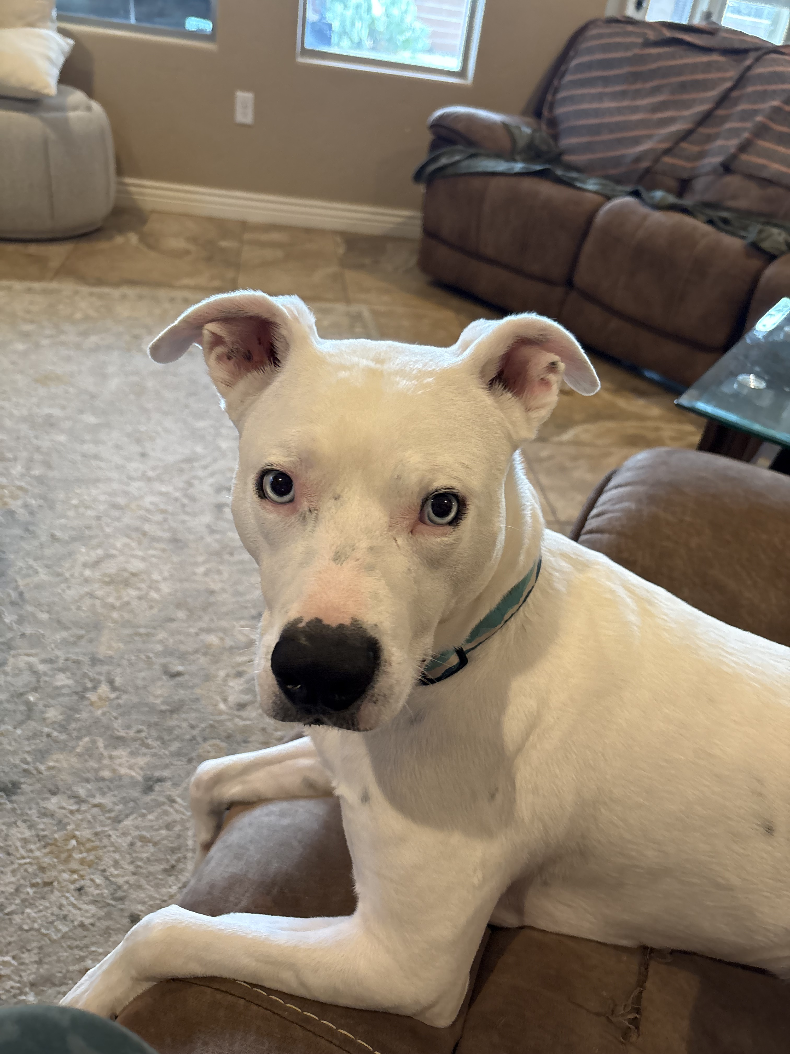

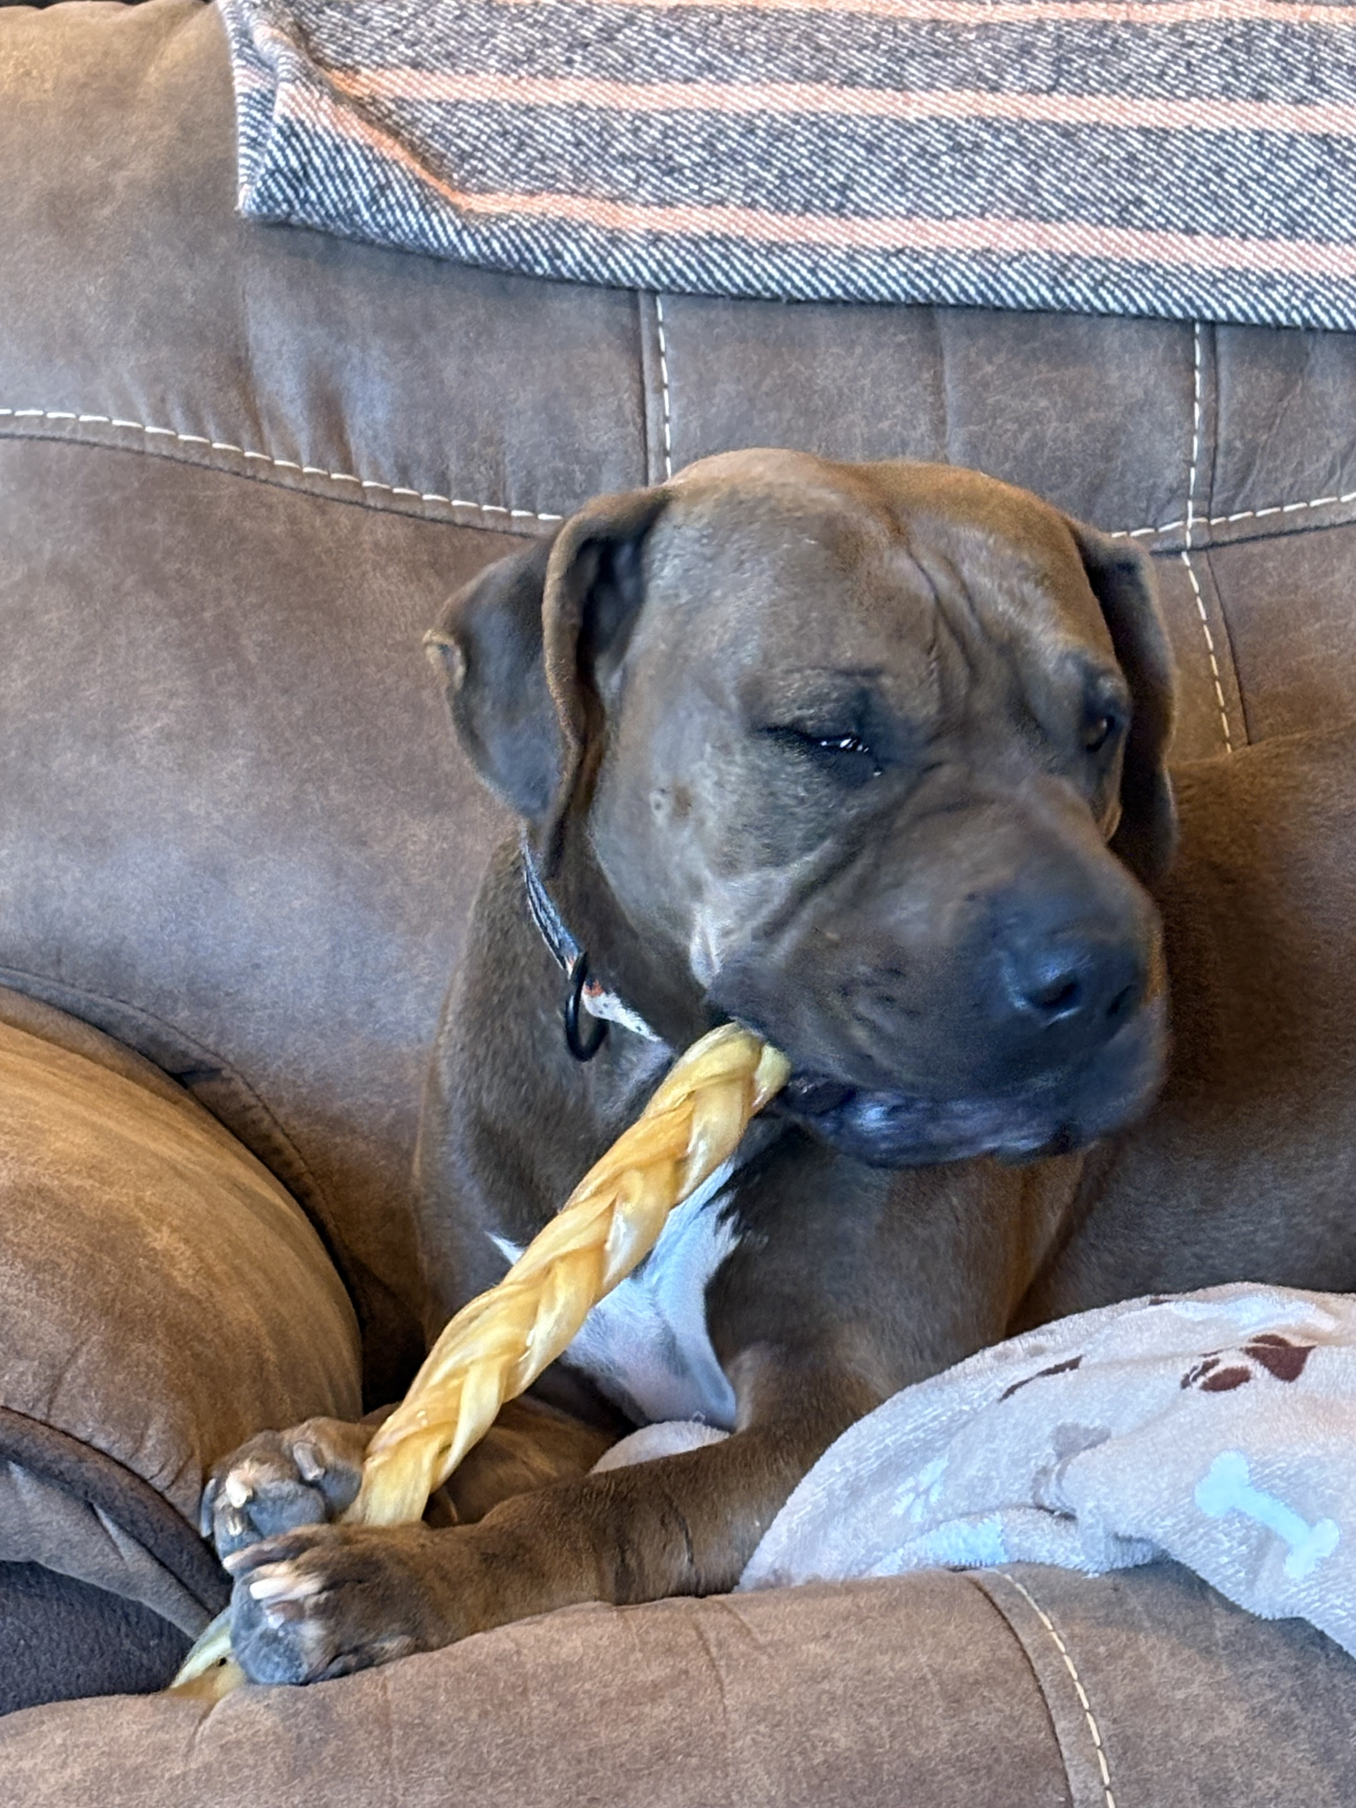


Pictures of my life

Slide 4
Overview
Overview:
1. Defining AAC
2. Assessment Components
3. Social Role of AAC
4. Creating Meaningful Activities

Slide 5
What is AAC?
What IS AAC????
Any non-verbal method of expressing ones’ self
High Tech Devices
Low Tech Communication Board/ ALS
Combination of AAC + Verbal

Slide 6
What isn’t AAC
What it isn’t……………….
Toy
Game
Distraction
Behavioral Reinforcement
Non-dedicated tablet used by entire family/siblings

Slide 7
Main Competencies for Success
Main Competencies for Successful AAC Use:
1. Linguistic
2. Operational
3. Social
4. Strategic

Slide 8
Standard Components of a Quality/Robust Assessment
Standard Components of A Quality/Robust Assessment:
1. Language
2. Cognition
3. Motor
4. Attention
5. Barrier Behaviors
6. DEVICE SELECTION

Slide 9
Other Areas for Data Collection During Assessment
Other important areas for data collection during assessment:
Symbolic Understanding
Vocabulary (level and type)
Rate enhancement techniques
Alternative access needs
Message selection needs

Slide 10
Why Assessment Matters
WHY ASSESSMENT MATTERS
Foundation for successful treatment plan which creates an optimal
opportunity for increasing Quality of Life
Robust data needs to be collected prior to determining the best communication method
If assessments are lacking, our treatment will be lacking as well.

Slide 11
AAC in Social Settings
AAC in social settings
Vocabulary needs to fit ENV
AAC needs to be used in ALL social environments,
with ALL communication partners
The environments /stimulus needs to be highly motivating
The activity needs to fit:
  Cognition
  Language
  Attention

Slide 12
Creating Social Contexts
Creating Social Contexts
At school: Recess, specials, breaks, small group, focused therapy/1:1 time
At home: Siblings, play groups, caregiver/child interactions
In community: grocery store, restaurant, church, salon/barber
TIPS:
Limit Screen Time
Create multiple opportunities for communication for each activity
Utilize variety of communication partners
Choose activities/target items which are meaningful to the AAC users

Slide 13
Target Behaviors for Social Interactions
Target Behaviors for Social Interactions:
1. Protesting
2. Accepting
3. Making Choices
4. Requesting
5. Turn Taking
6. Joint Attention

Slide 14
Scenario Walk Through
Scenario Walk Through:
Scenario 1:
School Age Child
Language Ability: non-verbal
Cognition: WFL
AAC System: PECS
Environment: Recess
TARGET: Requesting
Operationally defined as: exchange of 1 PECS pic for highly preferred item
with the provision of partial physical prompt as needed to initiate the request
Communication Partner: classmate + adult facilitator/mediator
Activity: Swing (highly preferred item)

Slide 15
Scenario #2
Scenario 2:
Adult- Middle Age
Language Ability: Limited verbal (Parkinson’s Disease)
Cognition: WFL
System: ACCENT 1000
Environment: Weekly social event with friends
Target: Reciprocal Conversation
Operationally defined: as answering questions and asking questions based on the
content of the conversation
Com Partners: 6 of the same friends every week
Activity: Book Club

Slide 16
Scenario #3
Scenario 3:
Older Adult (80+)
System: 2 sided communication board
Language Ability: Limited verbal / 2 word utterances
Cognitive: Moderate-Severe Deficit/ Dementia diagnoses
Environment: Skilled Nursing Facility
Target: Protesting
Operationally defined as refusing non-preferred: tasks, people, food, objects
By pointing to the corresponding icon versus yelling/kicking/screaming
Com Partners: RNs, CNAs, MDs, CNPs, Therapy, other
Activity: Free Choice in Day Room

Slide 17
Summary
Summary:
Quality therapy begins with quality assessment
Utilize the person’s interests and strengths to reinforce AAC use
during social situations
Remember low-tech options are just as effective
Be creative, communication happens every where
HAVE FUN!!!!!

Slide 18
Questions?
THANK YOU
AND
QUESTIONS

