Slide 1

Assistive Technology
for pALS
(Persons with Amyotrophic Lateral Sclerosis)
UNIVERSITY OF NEW MEXICO HOSPITALS

Slide 2
About Us
Stephanie McDougle, MS, CCC-SLP
Master of Speech Pathology from UNM in 2012
13 years experience with Acute inpatient, ALS clinic, and Head & Neck Cancer Clinic
Jacqueline Chacon, MS, CCC-SLP
Master of Speech Pathology from UNM in 2014
11 years experience with home health, adult outpatient for the neuro and geriatric population primarily, and acute inpatient
Charlotte Caruth, MOT R/L
Master of Occupational Therapy in 2021
3.5 yrs experience in acute adult/pediatric rehab
Jessica Wood, OTD, OTR/L
Occupational Therapy Doctorate (OTD) from Washington University in St. Louis (2012)
12 years experience with ICU, subacute, and pediatric rehabilitation and ALS clinic

Slide 3
Disclosures
Stephanie, Jacqueline, Charlotte, and Jessica are employed through the University of New Mexico
They have no financial interests or relationships to disclose with regard to the content that will be presented today

Slide 4
Objectives
Understand the basic pathophysiology, symptoms, progression, and functional implications of ALS
Understand the Speech Therapy role, domains of function they cover, common assistive technology they recommend for pALS, and funding resources
Understand the Occupational Therapy role, domains of function they cover, and common assistive technology they recommend for pALS

Slide 5
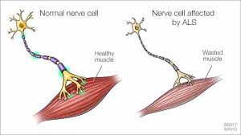
Amyotrophic Lateral Sclerosis (ALS)
A-myo-trophic (Greek) = no muscle nourishment
Lateral = to the side
Sclerosis = hardened
Notes:
When a muscle has no nourishment it atrophies
Lateral = the area of a person’s spinal cord where portions of the nerve cells that signal/control muscles are located
As degeneration occurs, it leads to scarring and hardening of the region

Slide 6
ALS Stats
Neurodegenerative disease that affects both Upper and Lower Motor Neurons
Typical life expectancy:
3-5 years
Few individuals live up to 10-20 years
Two primary types:
Bulbar onset
Limb onset
Note: Respiratory onset can occur, but is more rare
Primarily Sporadic; 5-10% of cases are hereditary
May present with cognitive and/or behavior change
May present with pseudobulbar affect
Notes:
Motor neurons send messages from the brain to our muscles to control movement
The average age of onset is 55 and ALS is 20% more common in men
Bulbar onset impacts facial muscles, speech, chewing, and swallowing
Limb onset begins with weakness, stiffness, or atrophy in the arms and/or legs
We’ll discuss the cognitive and behavioral impact in more detail shortly

Slide 7

Spectrum of Symptoms
Muscle weakness in arms, legs, neck, diaphragm
Muscle fasciculations in the arms, legs, tongue
Muscle cramps, spasticity, tone, or general muscle tightness
Slurred speech (dysarthric progressing to anarthric)
Difficulty chewing and swallowing
Difficulty breathing
Cognitive/behavior changes
*PROGRESSION VARIES SIGNIFICANTLY*
Notes:
Fasciculations = involuntary, brief muscle spasms that can look like twitches or “ripples” under the skin
Starts with weakness, middle varies, ends with difficulty breathing – presents differently in each patient in terms of function
Limb onset – may start with muscle weakness noticed with increased instances of tripping, dropping things more frequently, abnormal fatigue of arms or legs

Slide 8
Characteristics of Speech in ALS
Mixed Flaccid/Spastic Dysarthria
Slowed rate of speech
Hypernasality
Dysphonia or Voice changes
Laryngeal weakness (hoarse, breathy)and/or spasticity (strained/strangled voice) may be present
Paradoxical Vocal Cord Motion may be present
Respiratory weakness
Reduced breath support

Slide 9
Cognitive and Behavior Changes and ALS
15 years ago: Believed cognition was unaffected
Now:
50% of ALS patients present with intact cognition
15-25% of ALS patients present with Frontotemporal Lobe Dementia
About 25-35% of ALS patients present with a degree of change in cognition and behavior
Screening for changes
ALS Cognitive Behavior Screen (ALS CBS)
Others

Slide 10
Frontotemporal Lobe Dementia (FTLD)
Behavior: childlike, inappropriate or uncharacteristic, lack of concern for others, increased aggression
Eating: begins to prefer sweets or a single type of food, overstuffs, loses table manners
Hygiene may become poor
Loss of judgment and insight
Inability to shift focus
Language difficulties: Inability to follow instructions, reduced ability to answer yes/no questions, anomia, spelling and grammar difficulties

Slide 11
Pseudobulbar Affect
Unexpected and uncontrollable laughing or crying spells
Emotional mismatch
Emotional incontinence
Expressed emotion may be more exaggerated than what the person is actually feeling
Can occur with or without cognitive or behavioral changes
Provider can treat with medication
Side effects of medication

Slide 12
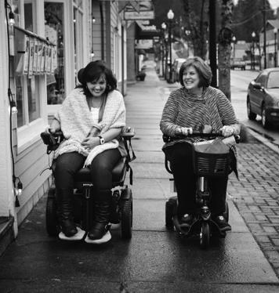
Impacts on performance
Weakening muscles affect all aspects of daily life
Balance
Strength
Range of Motion
Movement
Energy levels/fatigue
Eating/drinking
Communication/directing care
Cognitive function
Pain/comfort levels (stiffness, muscle cramps)
Breathing

Slide 13
Prognostic Factors
Shorter survival times if the following are present at time of diagnosis:
Speech and swallowing problems
Weight Loss
Poor respiratory function
Older age
Cognitive/behavioral changes (significant)
Shorter time from first presentation to time of diagnosis
Lower scores on the ALS Functional Rating Scale (ALSFRS)

Slide 14
Progressive
Bulbar onset can present with limb symptoms over time
Limb onset can present with bulbar symptoms over time
If a muscle is affected, typically function will get worse over time until total function is lost
Notes:
Bulbar onset = ~25%
Limb onset = ~75%
As the disease progresses, individuals may have a similar presentation as an individual with C1-2 tetraplegia
Death, often from respiratory complications, typically occurs between 3-5 years but can be shorter or longer depending on the individual.

Slide 15
General OT / SLP Roles
We have the unique role of providing support to pALS and cALS across a wide spectrum of function
Assess changing level of function
Make recommendations:
Adaptive equipment/assistive technology
Adaptive/compensatory strategies
Energy conservation strategies
pALS/cALS training
Priority is quality of life
Notes:
We assess about every 3 months

Slide 16
Augmentative and Alternative Communication for Patients with ALS

Slide 17
Spectrum of AAC Needs
Progressive nature of disease
Rapidly changing needs
Changes in communication status
Changes in mobility and motor control
Bulbar presentation/involvement
How intelligible are they? What will this look like in three months?
Timing is everything
Respiratory Involvement
Regular pulmonary function testing completed at each clinic.
Consider breath support for voicing and speech.
Energy conservation is important

Slide 18
Communication Needs
Communicate needs/wants
ALERTING!!!
Participate in care
Participate in plan of care and discharge planning
Participate in End of Life discussions
Family assistance
Social closeness

Slide 19
Considerations/Barriers
Motivation to use an alternative method
Cognitive status
Physical barriers like motor control, eye gaze involvement (nystagmus etc)
Most convenient and efficient options
Voice and message banking
When should a dedicated SGD be pursued?
Consider level of severity
What is their motor control like?
If it’s too early for a device, it may sit in the closet
Family support for setup and use
Consider co-pay cost (usually not an issue with this population as there are programs to offset this)

Slide 20
SLP Role in the Evaluation and Treatment of ALS
Evaluation and treatment of:
Dysphagia
Dysarthria/Anarthria
Dysphonia/Aphonia
Screen for:
Cognitive and Behavioral Changes
Providing recommendations for referrals for AAC evaluations and neuropsychological evaluations
Providing education and directing families to ALS Association, ALS Clinic, and the VA if they have any service affiliation

Slide 21
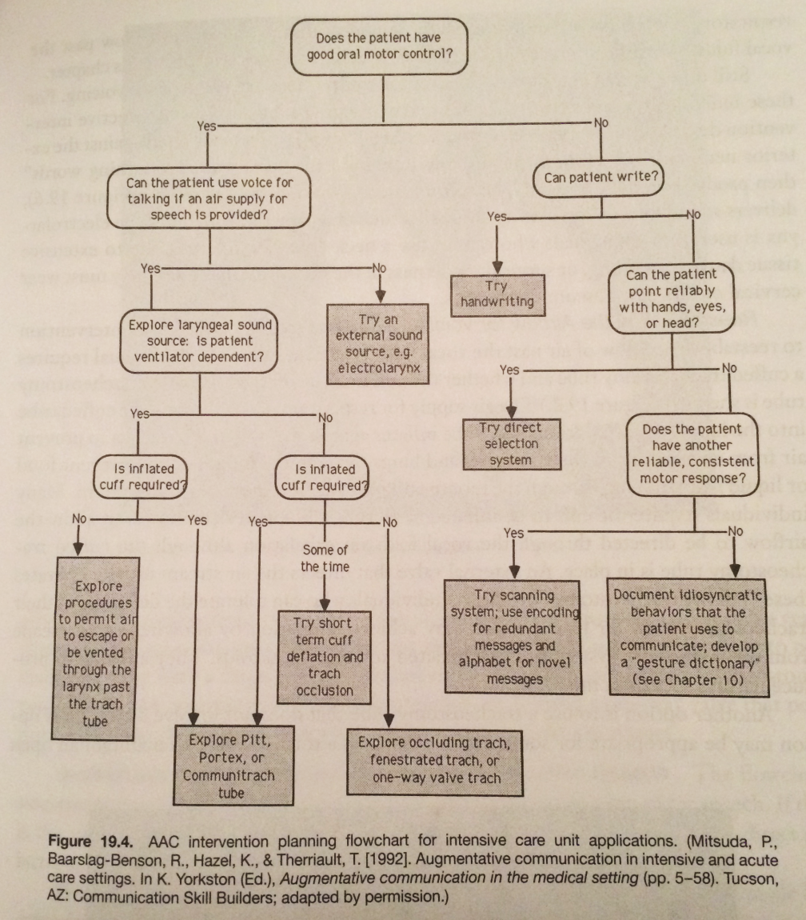
Assessment cont.
Adapted from Figure 19.4 in Beukelman, D. R., & Mirenda, P. (2005). Augmentative & alternative communication: supporting children & adults with complex communication needs (3rd ed.). Baltimore: Paul H. Brookes Pub. Co.

Slide 22
Types of AAC and Strategies
Unaided – gesture, motor movements, vocalizations
Low Tech Options
Higher Tech – when/if available
Strategies
First letter cueing (dysarthria, apraxia, voice impairment)
y/n questions
Scanning, eye gaze, tag questions, modeling
Additional time

Slide 23
Unaided AAC
Gestures, facial expressions, motor movements, vocalizations
Useful with y/n questions
Can represent agreed upon messages
Should be reliable and consistent
Ensure that communication partners are aware of meanings
Education with family and staff
Include information in EMR
Post the meanings at bedside
(above pt and in pt’s view)
Yes = 2 eye blinks
No = 1 finger

Slide 24
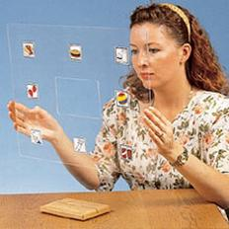
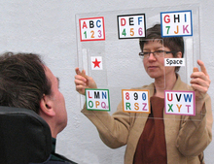
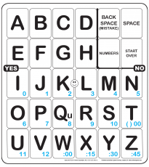
Low Tech
“Rapid Access”
Writing
Pen/Paper, whiteboard, boogie board
Objects
Picture, word, or letter boards
Direct selection
Partner assisted scanning
Eye Gaze
Eye-com
E-tran
Eye link
Speech Valve

Slide 25
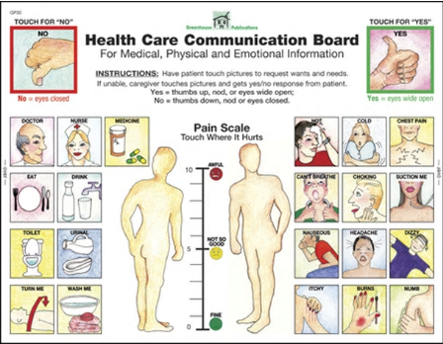
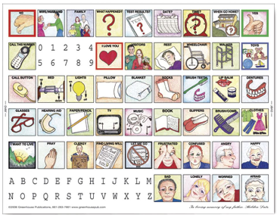
Examples of Low Tech AAC

Slide 26
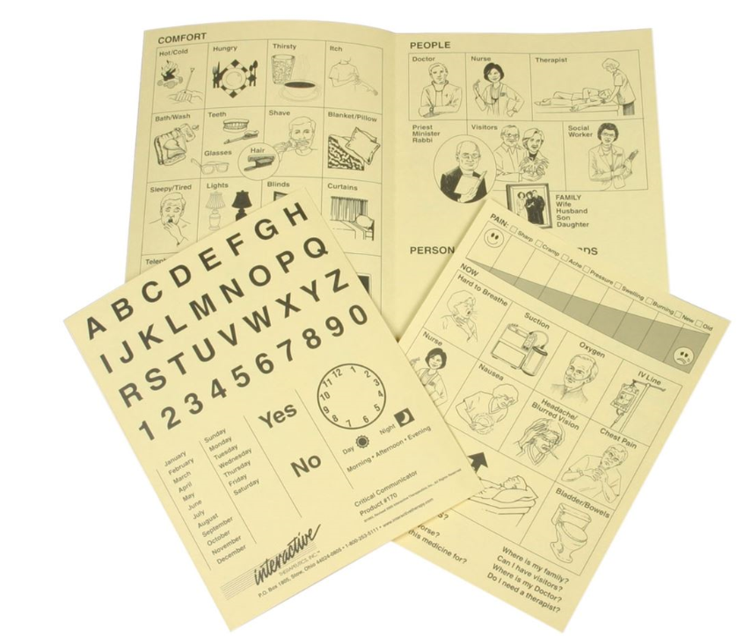
Paper Communication Book

Slide 27
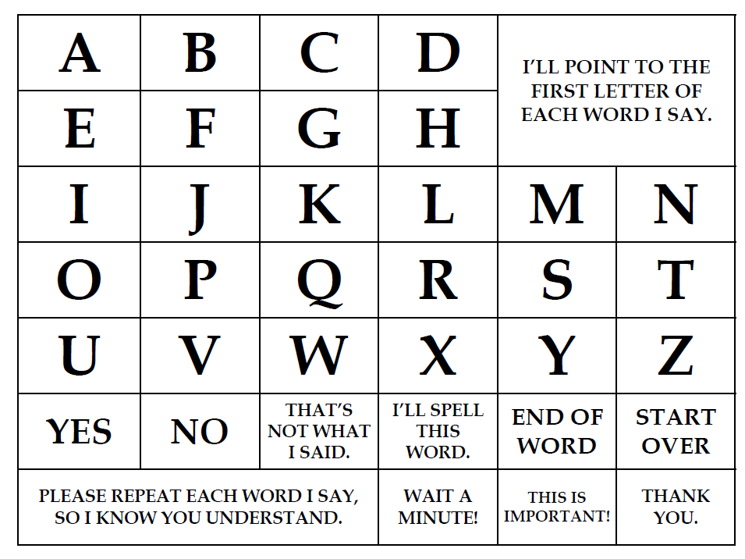
Alphabet Board

Slide 28
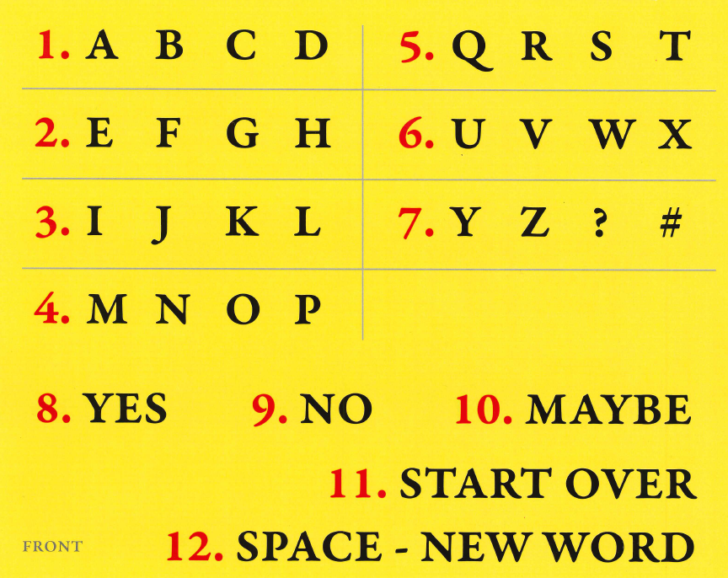
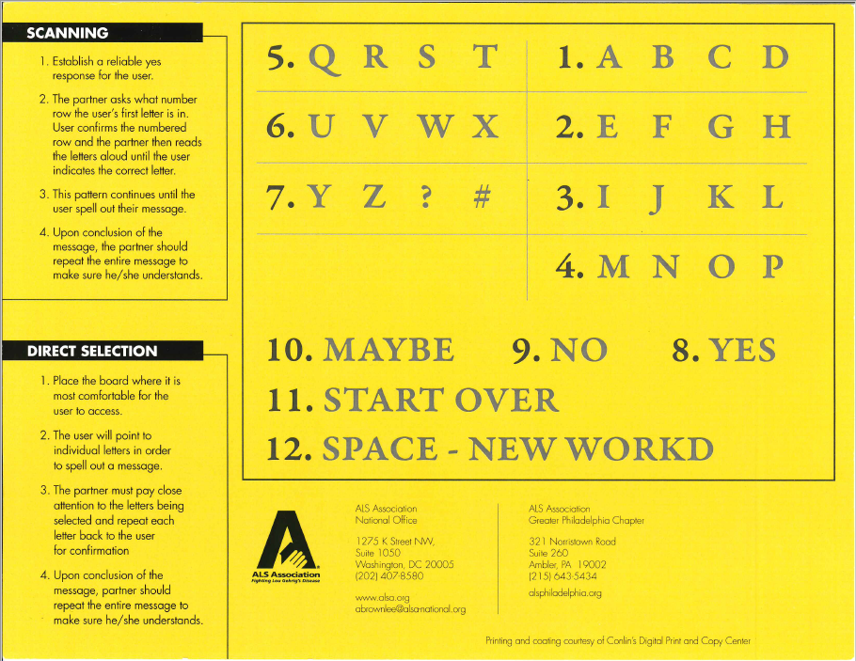
Alphabet Board

Slide 29
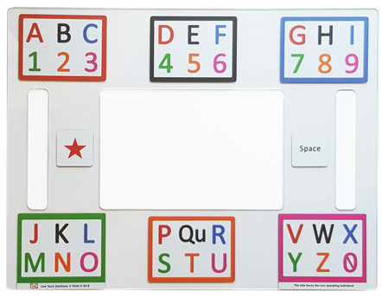
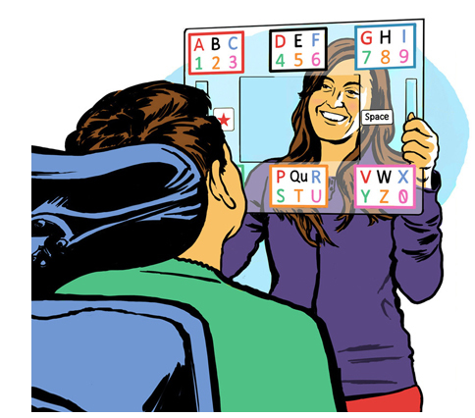
Low-Tech Eyegaze Board
https://youtu.be/lfLuqGAxaz4

Slide 30
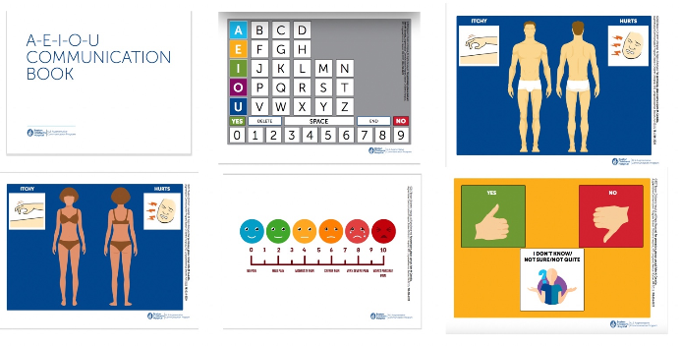
A-E-I-O-U Communication Book

Slide 31
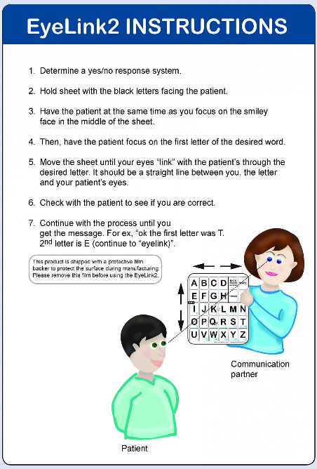
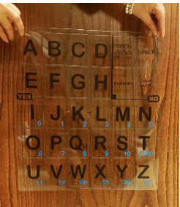
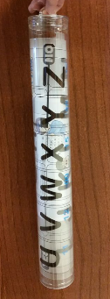
Eyelink 2
https://www.youtube.com/watch?v=UBm0PV9F9H8

Slide 32
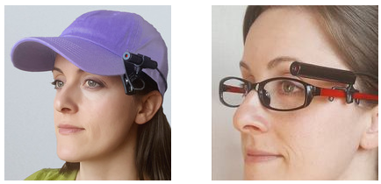
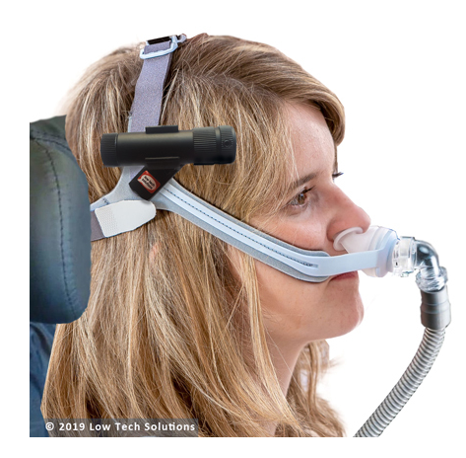
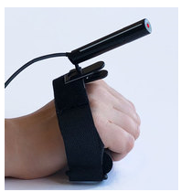
Laser Pointer

Slide 33
Higher Tech
Provided by patient/family
Phones
Tablets
Computers
We can provide text to speech app lists/suggestions
Scanning software is built in to some common devices; bluetooth devices can act as switches
Provided by us
AAC devices – mid and high tech
Usually not able to leave in the room
Eye gaze not often used but available
Electrolarynx – when is this feasible?
Amplification options

Slide 34
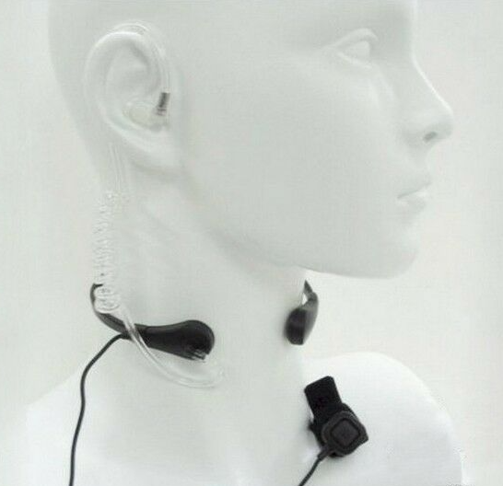
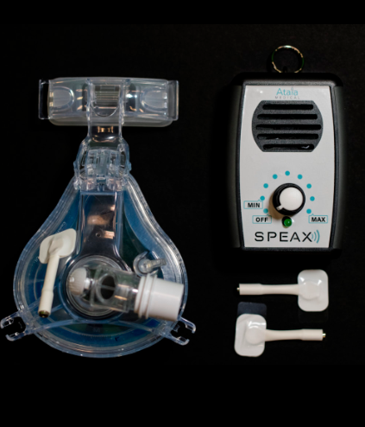
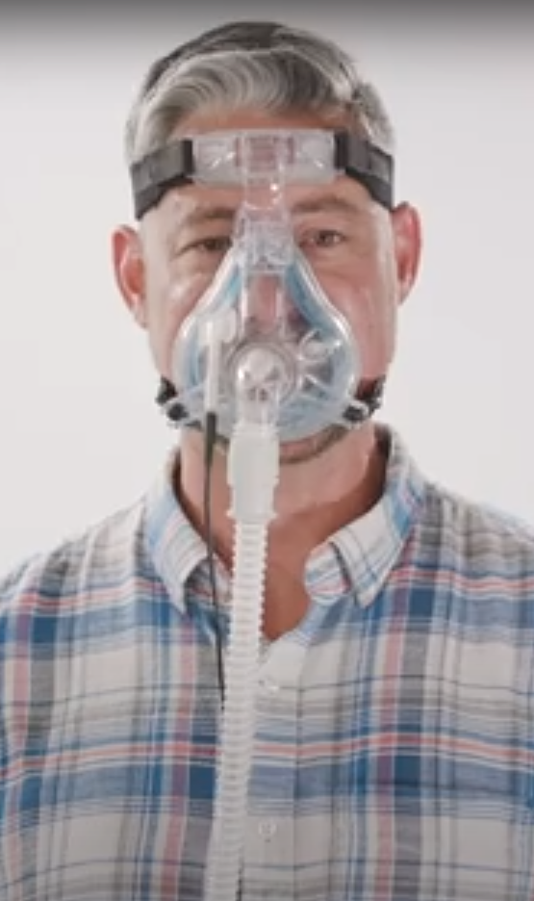
Options for Non-Invasive Ventilation

Slide 35
Selection Method Considerations
Physical limitations
Co-treat with PT/OT
Built up handle for stylus or other assistive tech for direct selection
Space limitations
mounting options
Enlist the family – they want to help!
Large communication boards
Laser pointer set ups
Partner-assisted scanning
Practice using the method established

Slide 36
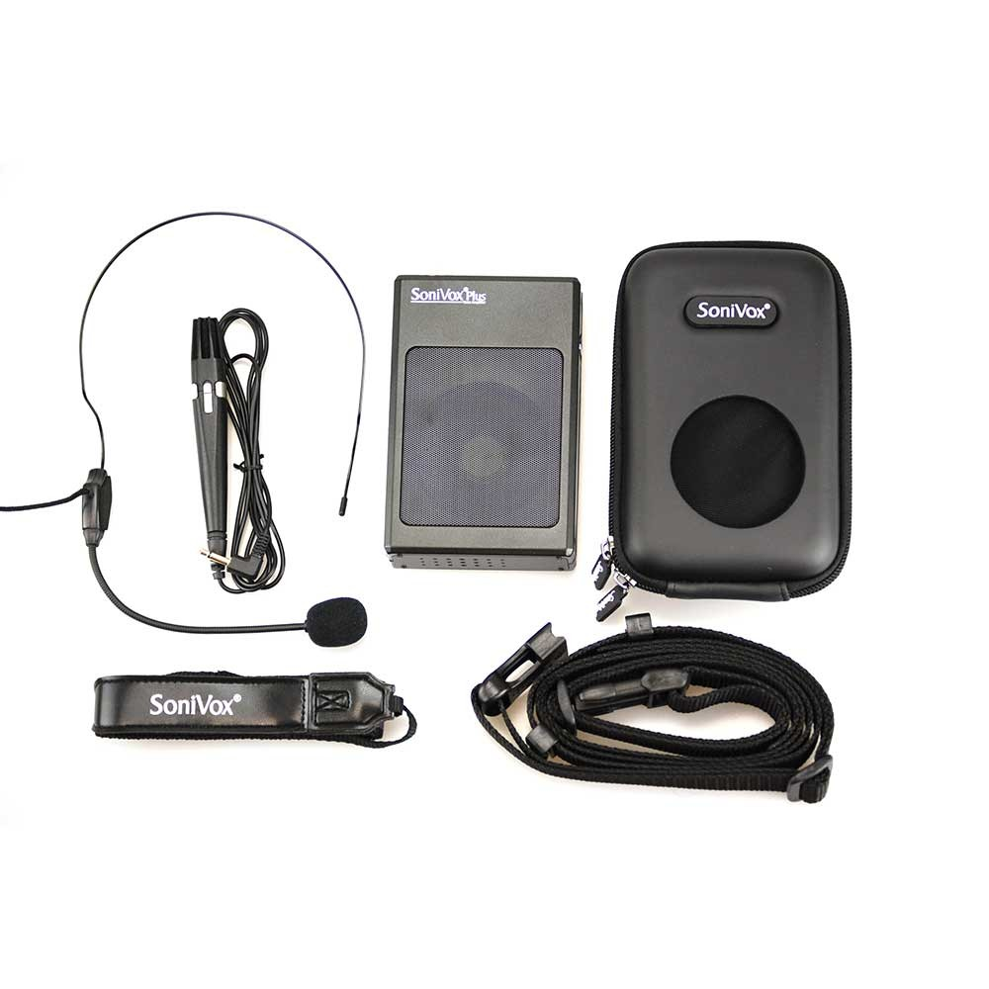
Amplifiers
Best for patients with poor breath support and intelligible speech
No or mild dysarthria
Benefits
Decreases effort needed to speak
Reduces vocal fatigue
Can be used in noisy situations or with hard of hearing communication partners
Microphone options
Directional mic worn as a headset
Transdermal mic (useful for patients on bipap)

Slide 37
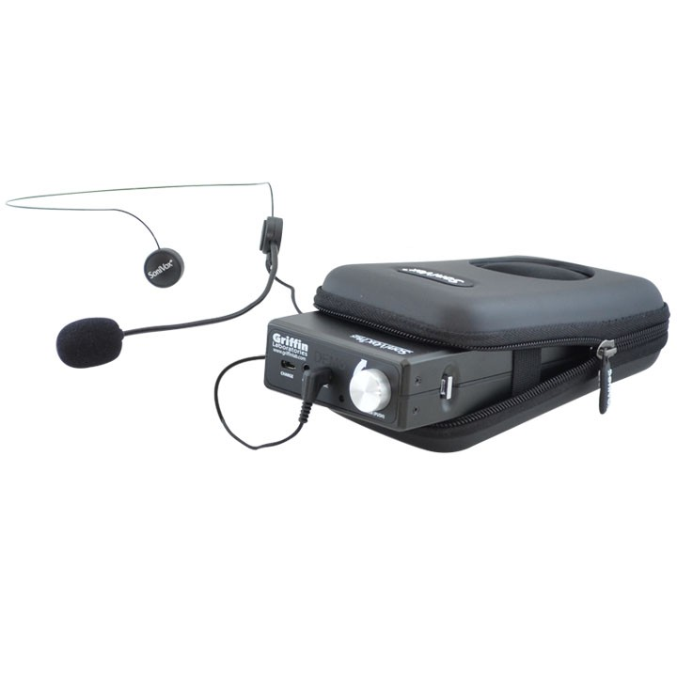
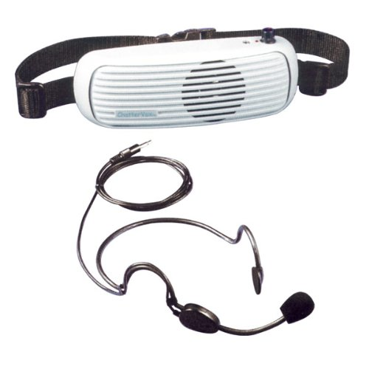
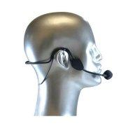
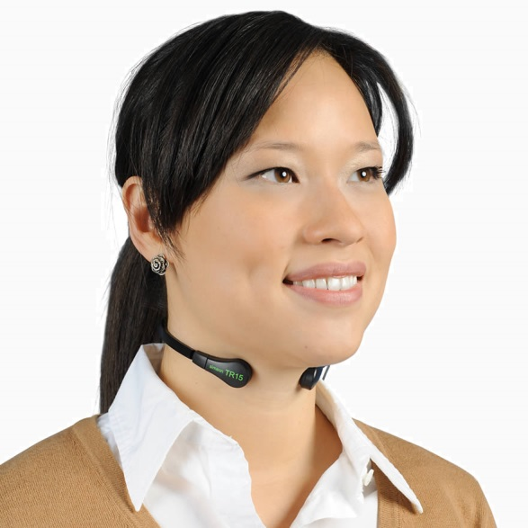
Amplifiers
Directional mic worn as a headset (video 1)
Transdermal mic (useful for patients on bipap) (video 4)
http://www.childrenshospital.org/centers-and-services/programs/a-_-e/als-augmentative-communication-program/protocol-of-assessment-considerations/voice-amplification

Slide 38
Voice Recognition Options
Communication comes in many forms
Speech may be normal but written communication can be affected
Possible solutions
Voice recognition software (Dragon Dictation)
Hands-free phones and tablets
Video chatting and voice messaging
Voice Activated Home Automation (e.g., Siri, Alexa, etc.)

Slide 39

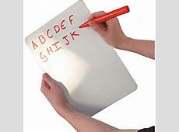
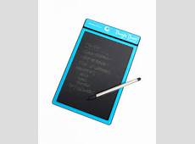
Writing as an Alternative or supplement to Speech
Best for patients with functional hand strength and legible hand writing

Slide 40
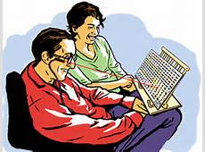
Communication Boards
Useful at any stage or level of impairment
Access/Selection Methods
Pointing with finger
Pointing with laser pointer affixed to glasses, cap, or wrist cuff
Eye gaze with partner
Partner assisted scanning

Slide 41
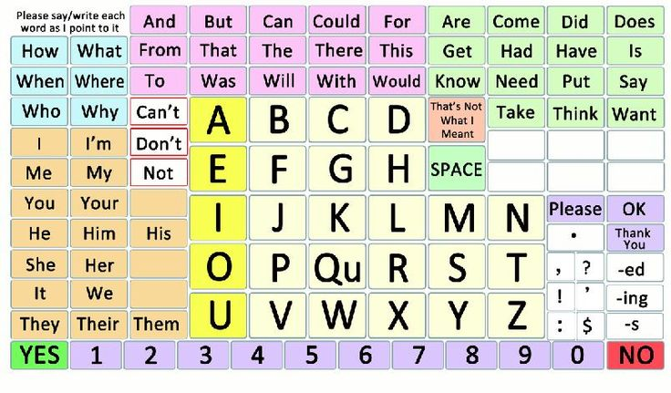
Communication Boards cont.
Alphabet/Letter boards
First letter cueing
Spelling out entire words
Word boards
Can be more restrictive than letter boards
May allow for quicker messages
Picture boards
Can be useful for frequent requests
Flip Books
(Boston Children’s Hospital)

Slide 42
iPads, tablets, computers, and mobile phones
Direct selection with finger, stylus, or keyboard
Head tracker apps (Sesame Enable)
iPad Loaner Program through the state
ALS Loan Closet
Relatively inexpensive
Many people have access to these already
Leaves insurance available for more complex devices

Slide 43
Text to speech Options
Computer settings (Excel)
Applications for mobile phones, iPads, and Tablets
Range from Free to expensive
iPad/Apple (there are many!)
Verbally – Lite (Free)
Clarocom (Free)
Speech Assistant AAC ($11.99)
Predictable ($159.99)
Speak4me (Free)
Proloquo4Text ($119.99)
Andriod
Talkadroid! – Lite (Free)
Type and Speak ($2.99)
Sonoflex ($99)

Slide 44
Phone communication
Patients will often stop making phone calls
Speech to Speech TTY
Text capabilities during Facetime calls
Apps:
Pedius (Free with option to purchase minutes-$30/year for unlimited communication)
Proloquo2Go v. 7 ($249.99)-phone and Facetime calls
Free text to speech applications can sometimes work well

Slide 45
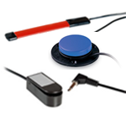
iPad and Switch Scanning
Switch Scanning
When to try a switch
Types of Switch Scanning on the iPad:
Item scanning
Point scanning
Step by Step Scanning
Communication will be significantly slower with switch scanning so many of our patients decide not to go this route

Slide 46
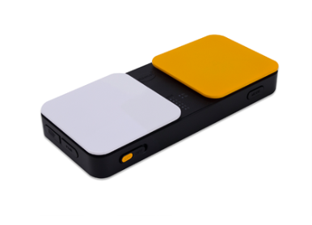
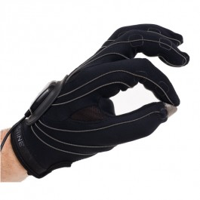
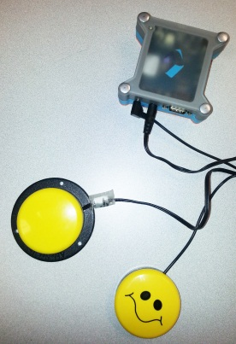
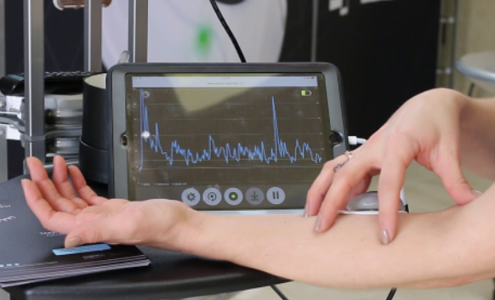
Types of Switches that Work with iPads/Tablets
External switches:
Blue 2
Tecla Dos
FreeHand Glove
The device screen
The device camera
NeuroNode

Slide 47
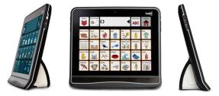
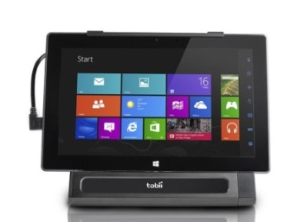
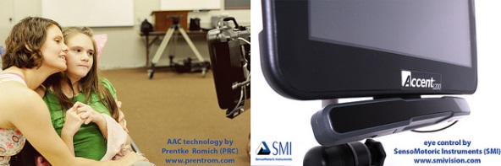
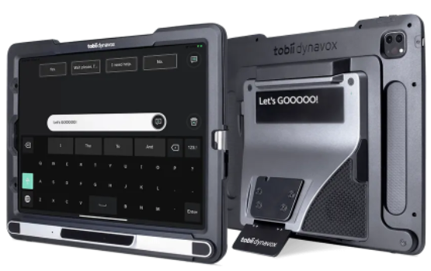
High Tech Devices
TobiiDynavox I-Series +
TobiiDynavox Pilot
Control Bionics Trilogy
PRC Accent series (2000 and 4000)
Other tablet based options – Apps vs SGD
Devices from the ALS NM Loan Closet

Slide 48
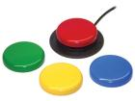
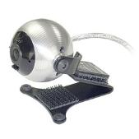
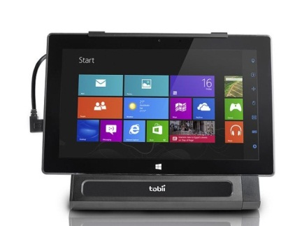
High Tech Device Access Options
Switch Scanning
Head Mouse
Eye Gaze
Dwell
Blink
Dwell-Less

Slide 49
Voice Banking
Voice Banking
Create a synthetic voice similar to natural voice
Intonation, prosody, and tone will not consistently match context
Can take 6 + hours to record all necessary messages (up to 1600)
Donor voices
Recording Options
Model Talker- Free (patient will need mostly intact speech and voice)
Acapela- $99/year to purchase voice (Can be used with a patient with mild dysarthria)
Vocal ID- $1499 plus monthly subscription fee (Can create a synthesized voice from 3 seconds of vocalization matched with crowd sourced voice banked voice)
Voices Work with:
Speech Generating Devices
Some iPad apps (e.g., Therapybox, Predictable, Chatable)
Some Android apps and as the system default voice

Slide 50
Message Banking
Generally speaking patient needs intelligible speech
Message Banking
Digitally record messages
Natural voice, inflection, and intonation
Legacy messages
Messages can later be uploaded to an SGD
Recording Options:
MyTobiiDynavox-Free Message Banking Website
Audacity
Windows Sound Recorder
Double Dipping option
http://www.childrenshospital.org/centers-and-services/programs/a-_-e/als-augmentative-communication-program/protocol-of-assessment-considerations/message-banking -ModelTalker
https://www.facebook.com/ACPCHBoston/videos/double-dipping-message-banking-to-create-a-custom-voice-bank/239956026695030/ --Acapela
https://www.youtube.com/watch?v=XqXYdnwD7Lo -Dysarthria

Slide 51
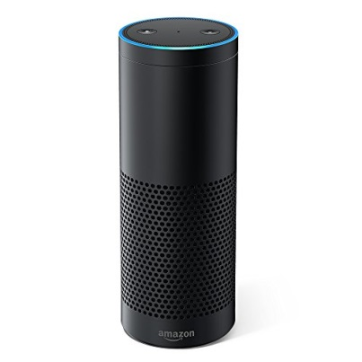

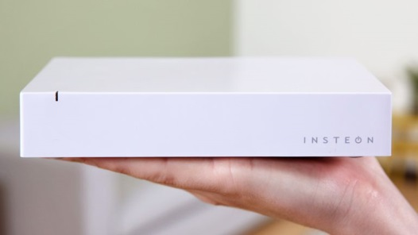
Home Automation/ Environmental Controls
Use natural speech, recorded speech from a communication device, and/or synthesized speech from a communication device to operate devices that control the environment
Option to control:
Lights
Television
Music player
Thermostat
Apps
And more…
Environmental control Options:
Amazon Echo (Alexa)
Apple HomeKit (Siri)
Insteon Hub
And more…
http://www.childrenshospital.org/centers-and-services/programs/a-_-e/als-augmentative-communication-program/protocol-of-assessment-considerations/speech-generating-devices/sgd-and-voice-control-of-environment

Slide 52
Important Information about AAC Funding
Insurance will only pay for a new AAC device every 5 years
Medicare allows the purchase of universal mounting systems
Medicare will pay for 80% of the device, leaving a 20% copay
A secondary insurance may help to cover at least a portion of the copay
Insurances vary in regard to device coverage
MDA, ALSA, and other organizations (e.g., HIS, Team Gleason) sometimes have grants/funds to support AAC device purchases

Slide 53
Steve Gleason Act
Allows access email, the internet and environmental controls on devices
SGDs can be used even if a person is admitted to a hospital, nursing facility, or hospice
This has now been made a permanent law

Slide 54
Occupational Therapy
for pALS

Slide 55
Our Role at ALS Clinic
Basic activities of daily living (BADLs) / Instrumental activities of daily living (IADLs)
Arm range of motion, strength, and coordination
Neck/arm/hand positioning needs/bracing
Driving screen
Home accessibility
Mobility/fall prevention
Leisure
Non-pharmacological pain management
Notes:
Assess B/IADL independence - BADLs = basic everyday tasks (e.g. bathing and dressing), IADLs = instrumental everyday tasks (e.g. transportation and meal prep), recommend equipment and/or pt./family/caregiver training
ROM/strength - focus on functional and recommend stretching
Positioning - GivMohr, wrist cock-up, resting hand, oxal 8, Eclipse collar, refer to outpatient hand clinic
Driving screen: refer to driving rehab specialist if needed
Home access: especially in the bedroom and bathroom as disease progresses, collaborate with SLPs
Functional mobility: collab with PT for MWC vs PWC vs transport chair, consider energy conservation

Slide 56

Let’s narrow it down…
Basic activities of daily living:
Feeding
Toileting
Bathing
Notes:
For the sake of our presentation today, we’ll focus on three self-care areas and move from low tech to high tech options

Slide 57
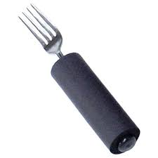
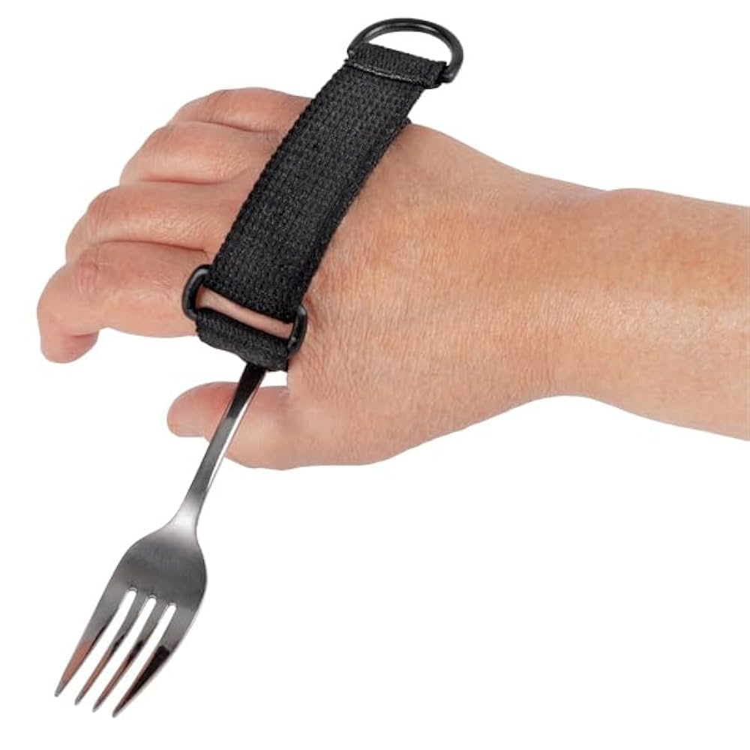
Feeding – Low Tech
Universal cuff
Built-up handles
Notes:
Built-up handles - help with energy conservation by using larger muscle groups, aim for foam/light-weight, low cost (Amazon)
Universal cuff - doesn’t require grip, opt for the one with velcro and a D-ring to help with getting on/off, low cost (Amazon)
Tools like these aren’t as aesthetic and may make some people feel self-conscious

Slide 58
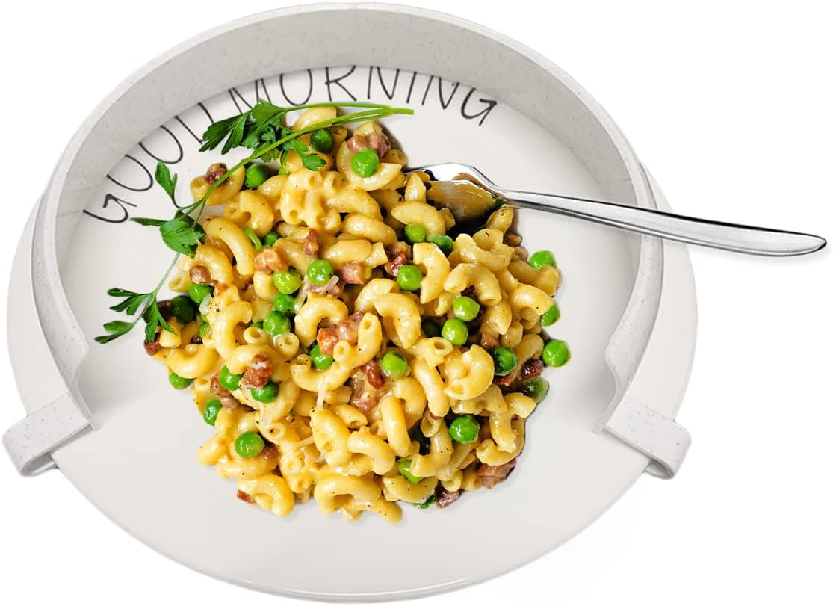

Feeding – Low Tech
Easy-scoop plate
Plate guard
Notes:
Amazon

Slide 59


Feeding – Low Tech
Built-up surface
Notes:
Built-up surface - minimize gravity by supporting arms closer to the mouth, more “aesthetic” options available, aim for NO LEDGE so pALS can prop forearms on it, this option has a place for a cup (we’ll show cup options shortly) and a tablet, $50+ (Amazon)

Slide 60



Feeding – Low Tech
Adaptive
handles
Notes:
Considerations: does pALS have some grip? no grip? aim for lightweight (Amazon & Wizard of Clay Pottery)

Slide 61


Feeding – Low Tech
Long straw
Water
bladder
Notes:
At a certain point, the only safe option for nutrition/medication is via feeding tube
(Walmart & Amazon)

Slide 62

Feeding – “Medium” Tech
Mobile Arm Support
Notes:
Counteracts gravity by unweighting the arm to allow for easier motion
While it’s an interesting device, it’s rarely used by our population since it can be bulky, cumbersome to set-up, and cumbersome to adjust with limited window of time to use it
$500
(Performance Health)

Slide 63

Feeding –High Tech
Stable Slide self-feeding support
Notes:
$450-590
Clamps to the table
Height/angle adjustable
Guides the arm and reduces the amount of muscle strength needed for self-feeding
We have not tried this option
(Performance Health)

Slide 64


Feeding –High Tech
Obi Robotic Dining Device
Notes:
With the momentary touch of a customizable switch, Obi allows users to select between four compartments of food and command when the food is captured and delivered to the mouth. It’s controlled by any part of the body that can activate a switch.
$9-10,000 new – insurance, VA, crowdfunding - our ALS loan closet purchased them with grant money to loan
YouTube: https://youtube.com/shorts/G9e6HO3QKXo?si=PDYvaaKs3AY94wpo

Slide 65



Bathing - Low Tech
Long handled
scrubber
Washcloth mitten
Automatic liquid soap/shampoo/conditioner dispenser
Notes:
Energy conservation is key
Dispenser ~$60
(Amazon)

Slide 66



Bathing - Low Tech
Non-slip
bath mats
Hand-held showerhead
Grab bars
Notes:
Grab bars: Multiple loops to reach different heights, rest arms on horizontal GBs inside shower for EC, we don’t recommend suction cup ones d/t the dry climate and tendency to lose suction - bolting them into the wall is ideal, Dept. of Sr. Affairs
Tub grab bar is removable
HHS - relatively easy to purchase/install w/out a professional, levers are easier to manage than knobs, HHS is helpful for cALS
(Amazon)

Slide 67




Bathing - Medium Tech
Tub
bench
Does insurance cover these?
Shower
stool
Notes:
Shower chair - with or without backrests, aesthetic ($50+)
Tub transfer bench - with or without sliding feature ($55-170+)
(Amazon)
Does insurance cover these (animation) - NO! - shower chairs aren’t considered medically necessary by most insurances (exception: VA)

Slide 68


Bathing - Medium Tech
Portable shower
Accessible bathtub
Notes:
Portable shower - Vitality Medical - $4000+
W/C tub - Royal Bath Place - $5900

Slide 69


Bathing - High Tech
Bath/shower transfer systems
Notes:
Options w/ portable commode, tilt, head rest, safety straps
~$1,000-3,200
(Med Mart and Your Medical Store

Slide 70


Bathing - High Tech
Bath lift
Hoyer lift
Notes:
Mechanical lifts
(Mediware) Bath lift - $230-1800
Hoyer - $1200+ (this one is ceiling mounted)
Toward the end of the disease progression, bed baths and dry shampoo or portable washing trays may be utilized

Slide 71






Toileting- Low Tech
Urinals, bed pans, external catheter, briefs
Notes:
“Bring Relief to you”
1) Shewee
2) Female urinal
3) Male urinal
4) Bed pan
5) Condom catheter
Benefits: Relatively low cost, easy to obtain, portable
Consider motor skills, ability to maintain skin integrity
Options for women & men ($ 7-20, ongoing costs for catheter + briefs)

Slide 72



Toileting- Medium Tech
Grab bars
Bedside Commode
Toilet safety frame
Notes:
Grab bars: install into the wall; avoid suction or temporary
Bedside Commode: Drop arm for lateral transfers
Bariatric commode options
3-in-1 commode for use bedside, over toilet, and in the shower
~$30-170

Slide 73


Toileting- Medium Tech
Raised Toilet Seat
Toilevator
Notes:
RTS: With or without grab bars, Various heights ,Portable, Not bidet compatible
~$30-100
Toilevator: Bidet compatible, Not compatible w/ 3-in-1 commode
~$85

Slide 74


Toileting- Hygiene Tech
Bidet systems
Notes:
Install on standard toilet
Variety of options/prices from handheld to luxary ($30-1300+)
Portable version for travel
Electric or manual operation
(Amazon)

Slide 75
Summary
ALS is a progressive disorder with significant variability in presentation
SLPs and OT have a unique role in assessing and supporting pALS ad cALS
pALS require customized solutions for their individual needs
This changes (sometimes rapidly) along their progression
Focus may shift to supporting the cALS
We need to consider physical and cognitive/behavioral changes when recommending assistive technology
Combinations of low/medium/high tech assistive technology may be beneficial along the progression
Funding sources must also be considered

Slide 76
References
OT:
ALSA Resource Guide : Functioning when mobility is affected by ALS (2017). http://alsa.org/assets/pdfs/living-with-als-manuals/1wals.07.2017.pdf
ALS Fact Sheet: https://www.ninds.nih.gov/Disorders/Patient-Caregiver-Education/Fact-Sheets/Amyotrophic-Lateral-Sclerosis-ALS-Fact-Sheet
ALS-FTD Article: http://alsn.mda.org/article/when-thinking-parts-brain-go-awry-als
Blog collections from people with ALS & support groups : http://lifey.org/amyotrophic-lateral-sclerosis/#difficulties
Caregiver tips for transfers: http://www.ideasforot.com/?page_id=184
Olney, A. (2005) Daily activities made easier for people with Amyotrophic Lateral Sclerosis. http://www.alsa.org/assets/pdfs/ot_manual_2006_1.pdf
(See speaker notes for photo references)

Slide 77
Questions?

Slide 78
Quiz Time!
Joe has bulbar onset ALS with severe dysarthria and dysphonia. He has been evaluated for a high tech speech generating device, and was able to obtain good calibration with is eyes but became fatigued. Which selection method(s) may be best for Joe?
Eye gaze
Eye gaze + EMG
Switch scanning
Touch access

Slide 79
Quiz Time!
2. Kate has bulbar onset ALS with mild dysarthria and intact fine motor control with her hands. She has completed voice and message banking. She is good with basic tech and still uses her computer and smartphone. What is her best option for supporting her communication?
Fully dedicated SGD
Text to speech app on her phone
Written communication
Voice amplification

Slide 80
Quiz Time!
3. Anthony was recently diagnosed with limb-onset (lower extremity) ALS and showering independently is very important to him. He has a tub-shower combo at home. He is able to transfer independently from his wheelchair using a slide board. What type of equipment would you currently recommend Anthony use at home for bathing?
A: Hoyer lift
B: Tub-transfer bench
C: Anthony should take sponge baths in his wheelchair
D: Home remodel to a wheelchair accessible tub
Notes:
Answer: B

